Slide 1
Space trip

Slide 2
We’ll visit five planets which help us to improve our grammar of the past simple tense and revise words and expressions on food and my working day. They are:
TONGUE TWISTER’S PLANET
GOOD EATER’S PLANET
TWO FRIEND’S PLANET
PLANET OF IRREGULAR VERBS
PLANET OF SWAMPS

Slide 3
TONGUE TWISTER’S PLANET
Here you should read a tongue-twister:
You’ve no need to light a night- light
On a light night like tonight,
For a night- light’s a slight light.

Slide 4
DON’T FORGET!
Правило чтения буквосочетания a light night
Если буквы I, G, H поставить в ряд, эти буквы громко [ ai] нам говорят.

Slide 5
This planet is also a planet of songs and poems
A song about food “He likes chicken”
Poems about meals and food

Slide 6
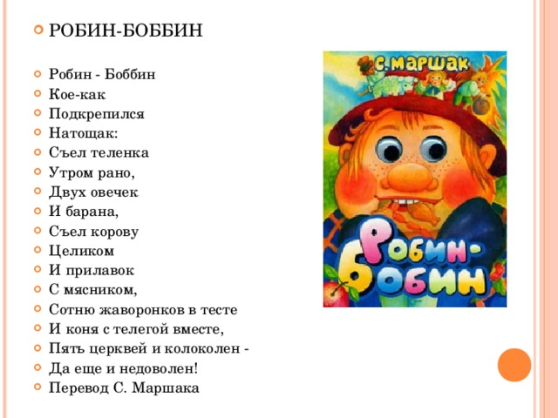
GOOD EATER’S PLANET
Now we are on a planet
where a good eater lives.
What is his name?
What food does he prefer? (Игра «Чемпион»)
What food would you like to eat and to drink? (Называние слов по цепочке с прибавлением слова: I’d like to eat…

Slide 7
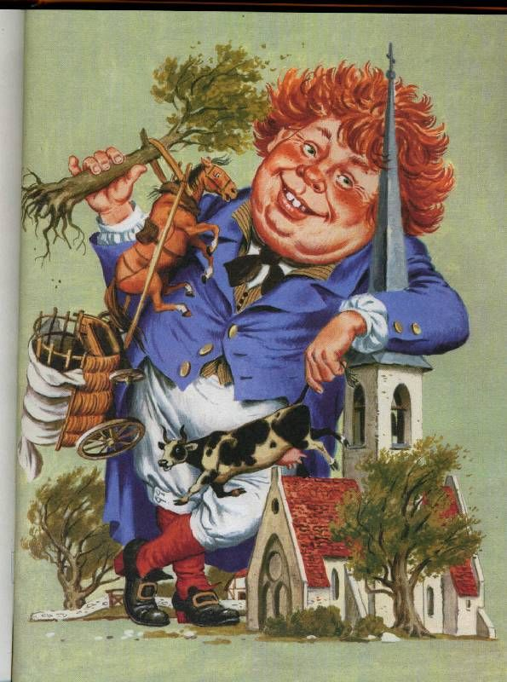
I see you are hungry and thirsty
Let’s ask some food. Who will be Robin-Bobin?
I’m hungry!
Would you like to eat…?
I’d love to!..

Slide 8
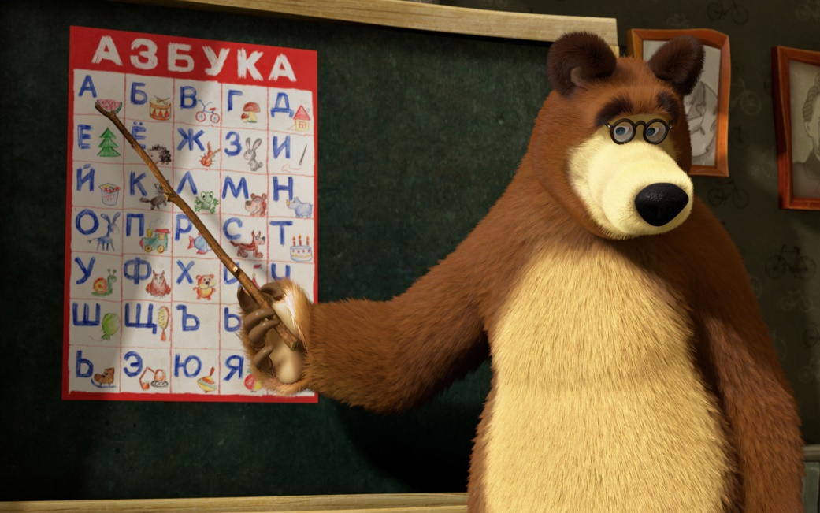
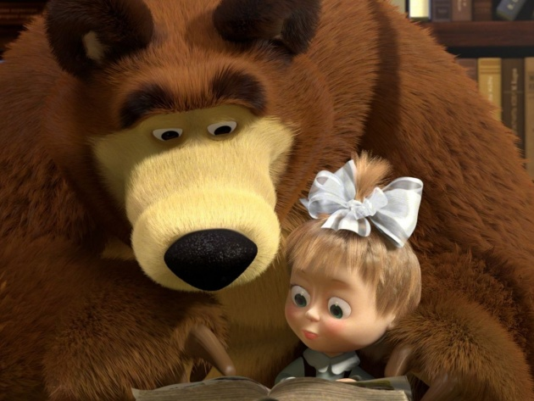
TWO FRIEND’S PLANET
Masha and the Bear live there.
They forget everything and always ask:
What did you do yesterday?
Look at the pictures and say what they did yesterday.

Slide 9
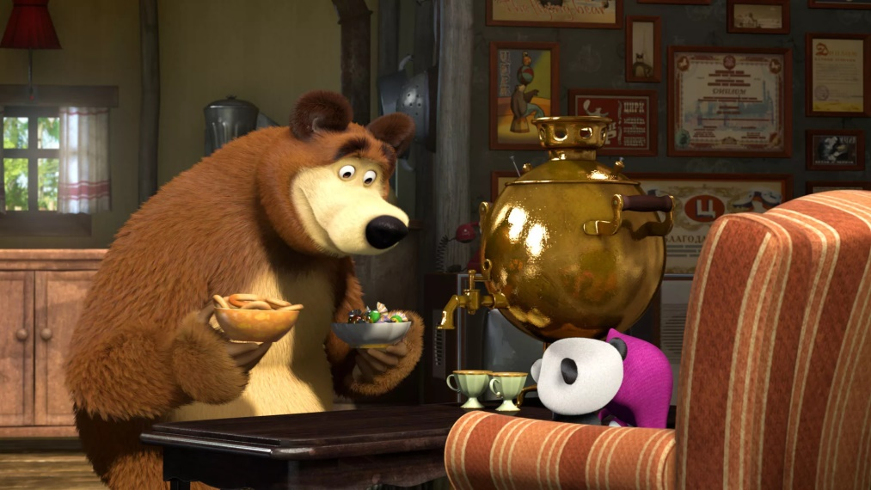
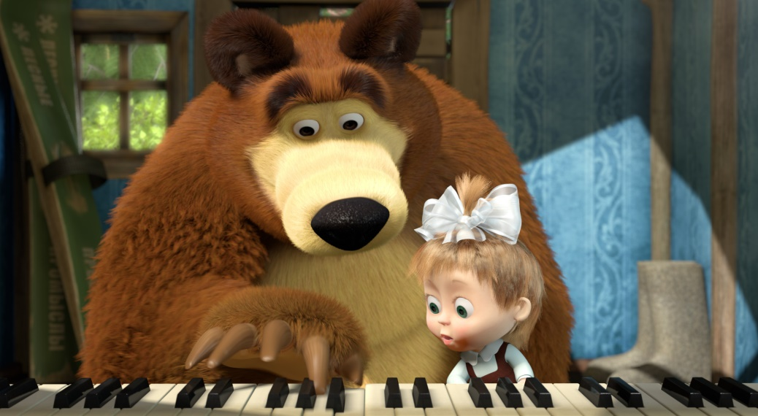
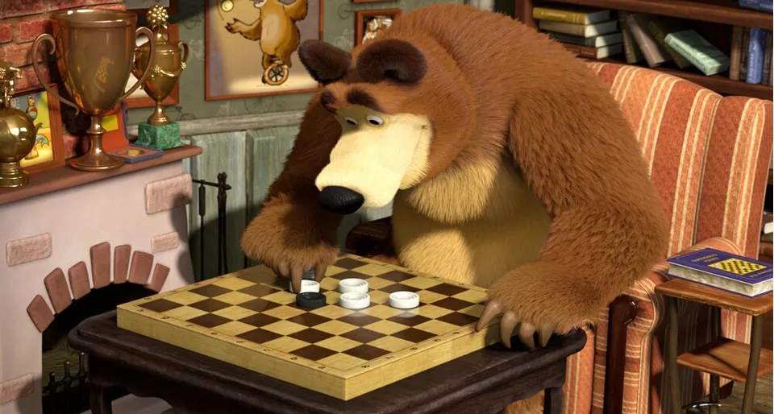
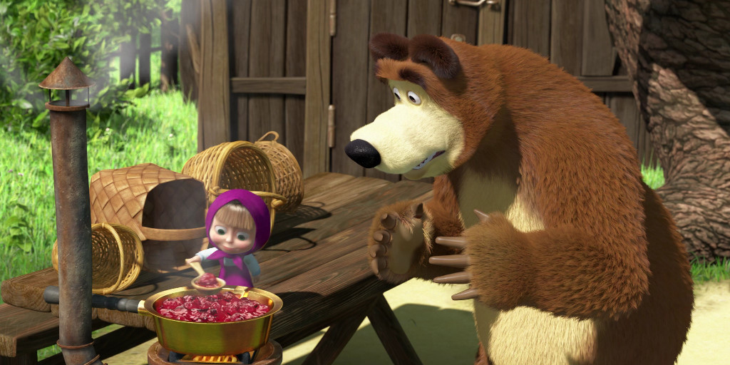

Slide 10
You have a good memory.
What did you do yesterday in the morning?.. (in the afternoon?.. in the evening?..)

Slide 11
PLANET OF IRREGULAR VERBS
Find the second form of the following verbs:
Meet
Read
Take
Give
Do
Be
Begin
…

Slide 12
PLANET OF SWAMPS
Use the words WAS and WERE to walk there.
1. Remember the song!
I was happy You were happy
He was happy We were happy
She was happy They were happy, too.
It was happy
2.
Yesterday I … in the forest.
The summer … hot.
There … three girls in the classroom.
We … happy yesterday.
Who … there?

Slide 13
We are back!
Remember our trip. Where were you? Open the brackets:
We (be) in space. We (visit) many planets. We (see) The Tongue Twister’s Planet. There we (read) a tongue twister and poems.
Then we (go) to The Good Eater Planet. There we (meet) Robin-Bobin, we (talk) and (play) games.
Next planet (be) The Two Friend’s Planet. We (visit) Masha and The Bear and (tell) about ourselves.
The fourth star (be) The Planet Of Irregular Verbs. We (remember) the forms of irregular verbs.
The Swam Planet (be) the last one. We (write) the test. Then we (come) home!

Slide 14
Now our trip is over.
Thank you for your work!

