Slide 1
I can I can’t Can you …?

Slide 2
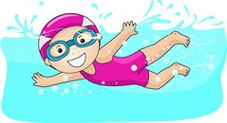
I can swim. I can’t swim. Can you
swim?

Slide 3
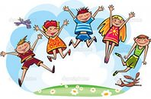
I can jump. I can’t jump. Can you jump?

Slide 4
I can hop. I can’t hop. Can you hop?

Slide 5
I can fly. I can’t fly. Can you fly?

Slide 6
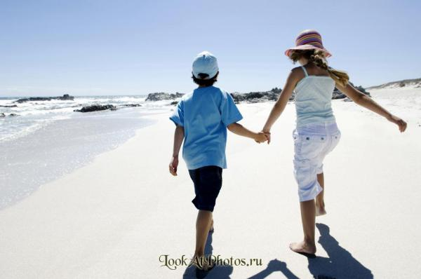
I can walk. I can’t walk. Can you walk?

Slide 7
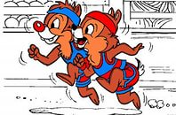
I can run. I can’t run. Can you run?

Slide 8
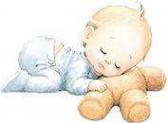
I can sleep. I can’t sleep. Can you sleep?

Slide 9
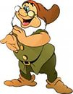
I can clap. I can’t clap. Can you clap?

Slide 10
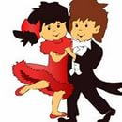
I can dance. I can’t dance. Can you dance?

Slide 11
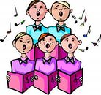
I can sing. I can’t sing. Can you sing?

Slide 12
Well done!!!

