Slide 1
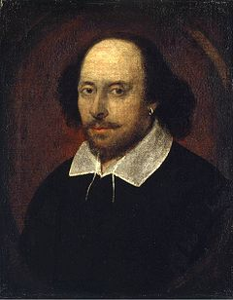
William Shakespeare
1564-1616
The greatest of all playwrights and poets of all times.

Slide 2
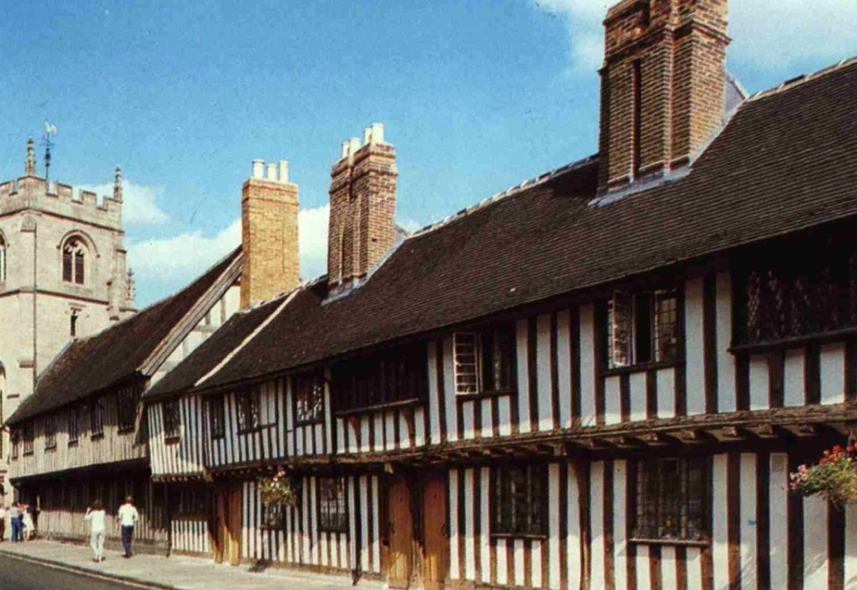
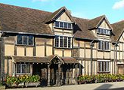
His early years
William was born on April 23, 1564 in Stratford-upon- Avon. His mother was the daughter of a farmer. His father was a glove-maker. William attended the local grammar school and got a classical education. In 1582 he married Anne Hathaway. During some years his three children were born: Susannah and then twins - a son, Hamnet and a girl, Judith.
Shakespeare’s school
Shakespeare’s home

Slide 3
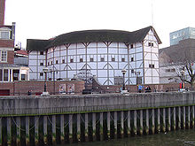
His activity
In 1587 Shakespeare went to work in London, leaving his family at home. Soon he became an actor playing supporting roles. In 1599 William became a part owner of the Globe Theatre in London. Most of his plays were performed in the new Globe Theatre built on the bank of the River Thames.

Slide 4
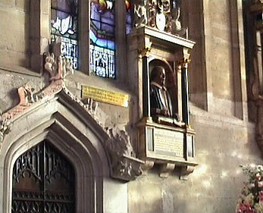
His death
In 1613 he stopped writing and came back to Stratford where he died in 1616.
This is the place where the house on which Shakespeare died used to be. It was a big house bought by William Shakespeare for his family when he was still in London. Here he spent the last years of his life. Unfortunately, the house was destroyed.
It’s interesting that William died on his birthday, 23 April.

Slide 5
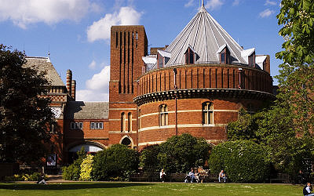
MEMORIALS
Another memorial to William Shakespeare is the Royal Shakespeare Theatre. The present building was constructed in 1932. The first building was opened on Shakespeare’s birthday in 1987 and destroyed by fire in 1926.

Slide 6
Memorials
The bronze statue of Shakespeare, presented to Stratford by Lord Ronald Sutterland Gower in 1988. Shakespeare’s figure is high above the ground and on the ground there are small figures of Shakespeare’s famous characters.

Slide 7
The works of Shakespeare
William Shakespeare wrote a lot of masterpieces among them historical plays, comedies and tragedies.
1593 - The Comedy of Errors
1595 - Romeo and Juliet
1596 - A Midsummer Night’s Dream
1597 - The Merchant of Venice
1599 - Julius Caesar
1600 - As You Like It; Twelfth Night
1601 - Hamlet
1603 - All’s Well That Ends Well
1604 - Othello
1606 - King Lear; Macbeth.

Slide 8
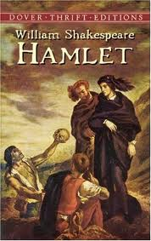
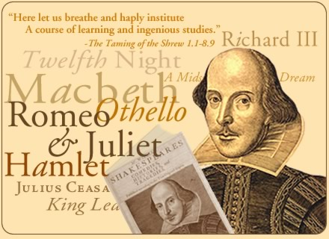
END
Many centuries have passed since his death, but Shakespeare is still considered to be the greatest of all playwrights and poets. His plays are still acted in the whole world.

