Slide 1
What do you like to do in your free time?

Slide 2
Station № 1 « The world of hobbies»
( Мир моих увлечений)
I like
I think it’s interesting
I don’t like

Slide 3
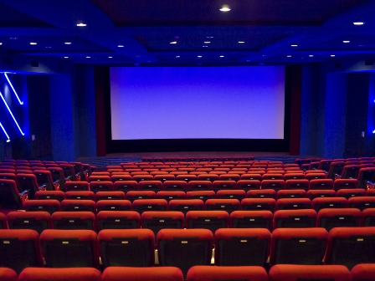
Station №2 «At the cinema»
( Кинотеатр)
There are a lot of wonderful comedies, detective films, love stories, historical films, fantasy films,horror and adventure films. People say that watching a good film is the best relaxation.
Do you like to watch TV or prefer to go to the cinema?
How often do you go to the cinema?
What kind of films do you like most of all?
What’s your favourite film?

Slide 4
Do you really like films?
Do you like cartoons?
Read the questionnaire and answer the questions making the right choice.
QUESTIONNAIRE
1. Alex, Marty, Gloria are the main characters of the famous cartoon…
a) Ice Period b) Madagascar c) Tom and Jerry
2. Who played “ Terminator”?
a) Schwarzenegger b) Van Dam c) Stallone
3. Who created Mickey Mouse and Donald Duck?
a) Madonna b) Julia Roberts c) Walt Disney
4. Titanic is a love story about…
a) Jack and Rose b) Tom and Kate c) Nick and Jane
5. “ Star Wars” is …
a) a comedy b) a horror film c) an action film

Slide 5
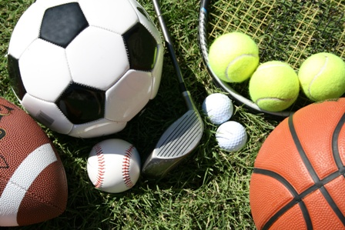
Station №3 «Sports and Games»
( Спортивная)
Complete the sentences with necessary information
1). D. Beckham is a world-known football-player
2). Y.Plushchenko is the star of figure-skating
3). Marat Saffin is a famous tennis- player
4). M. Jordan is an American basketball-player
5). Winter sports are skiing, biathlon, hockey.

Slide 6
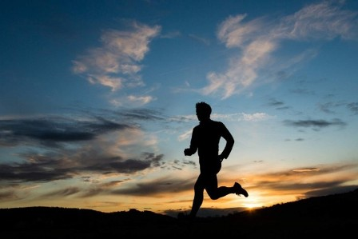
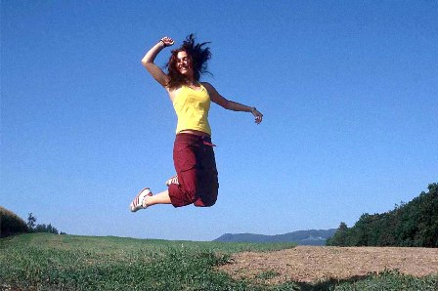
Let’s do some exercises to be healthy.

Slide 7
Station №4 « The world of books»
( Книжная)
«Literary quiz show»
Match the names of famous poets and writers with the characters from their books.
. Соотнести имена авторов с именами героев их произведений.
N Nosov a) Romeo and Juliet
M.Twain b) Tsar Gvidon
W.Shakespeare c) Tom Sawyer
A.Pushkin d) Mowgli
R.Kipling e)Neznaika

Slide 8
Station №5
«The world of projects»
Мир проектов
Project
Daily routines
In the morning…
After school…
Free time…
In the evening…
Good night!

Slide 9
Reflection.
1) Which station did you like most of all?
2)What was the most difficult?
3) How do you feel? Choose the drawing that reflects your spirits. Happy Sad
Fifty-fifty

Slide 10
Your homework
SB, p 38, ex 1.2 Culture… Ireland’s Young Musicians

Slide 11
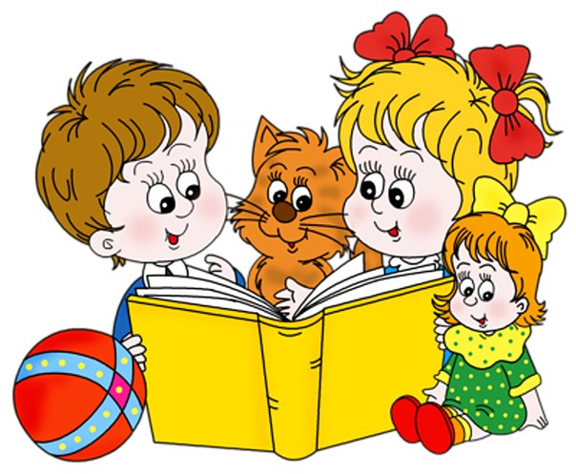
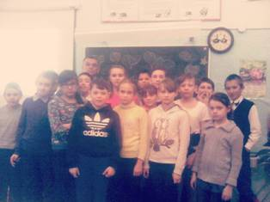
Well done! Thank you!

