Slide 1
Страны и национальности

Slide 2
Flags of English –speaking countries

Slide 3
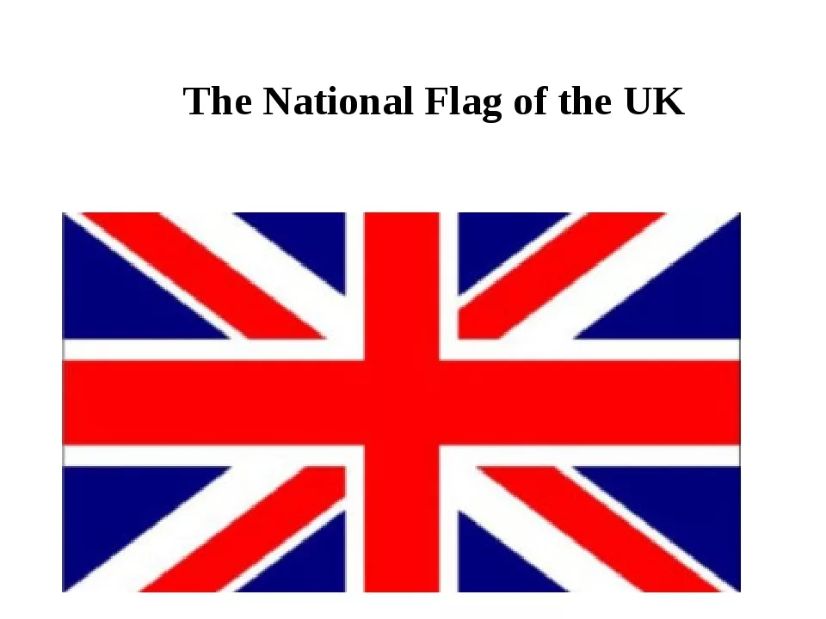

Slide 4
Australia

Slide 6
New Zealand

Slide 7
The USA

Slide 8
France

Slide 9
Japan

Slide 10
Countries | Nationalities
The UK | British
The USA | American
Canada | Canadian
Australia | Australian
New Zealand | New Zealander
France | French
Japan | Japanese

