Slide 1
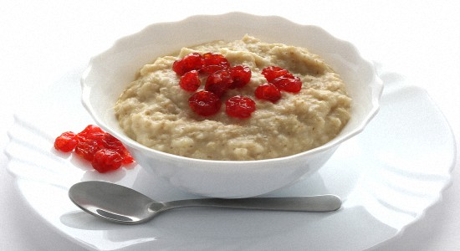

Slide 2
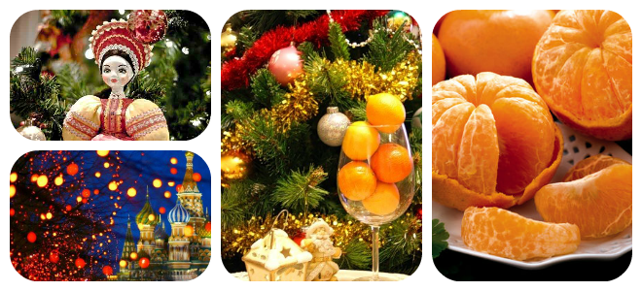
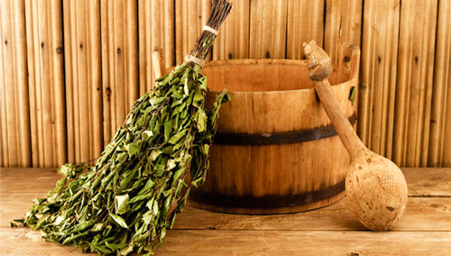

Slide 3
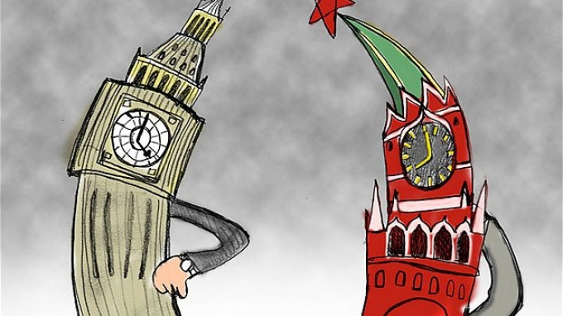
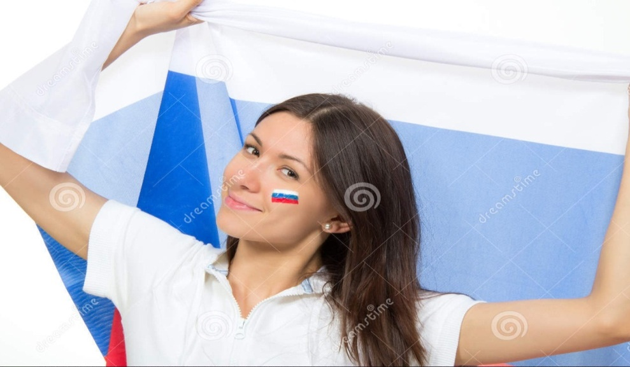
The habits of the English and Russian

Slide 4
Go to hot places for their holidays

Slide 5
Often have cornflakes for breakfast

Slide 6
Don’t like living in flats

Slide 7
Love gardens and flowers

Slide 8
Often eat porridge for breakfast

Slide 9
Love playing and watching football

Slide 10
Usually have two or three children in a family

Slide 11
Like having pets at home

Slide 12
Work on computers a lot

Slide 13
Travel by car a lot

Slide 14
Have school holidays in winter, spring and summer

Slide 15
don’t often speak Russian

Slide 16
8-9

