Slide 1
Word Formation
in Modern English
Павленко Валентина Александровна
МАОУ «СОШ № 4»,
г. Ялуторовск

Slide 2
The aim of my work is
to analyze word formation in Modern English

Slide 3
Word formation is the process of creating new words

Slide 4
Main Ways of Word Formation in Modern English
Affixation.
Conversion.
Compounding

Slide 5
Negative Prefixes
Prefixes don’t change
the word class!
un-
il-
unfair;
uncommon;
untrue...
illegal;
illegitimate;
illogical...
im-
impossible;
immature;
imperfect...
dis-
disadvantage;
dislike;
dishonest...
in-
incorrect;
informal;
inconvenient...
Mis-
ir-
misunderstanding;
mistrust;
misbehave...
Non-
irrational;
irrelevant;
irresponsible...
non-smoker;
non-violent;
non-profit...

Slide 6
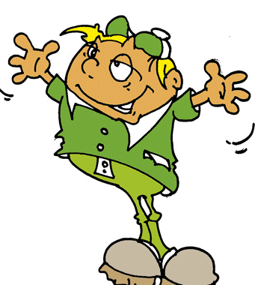
Word Formation Processes
1. Derivation
2. Back-formation
3. Conversion
4. Compounding
5. Clipping
6. Blending
7. Abbreviations
8. Acronyms
9. Eponyms
10. Coinages
11. Nonce words
12. Borrowing
13. Calquing

Slide 7
“Language is the dress of thought”
Francis Bacon

