Slide 1
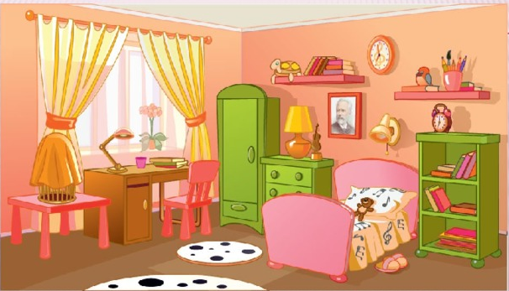
In my room!
Разработала учитель английского языка Сватиньш Ольга Имантовна

Slide 2
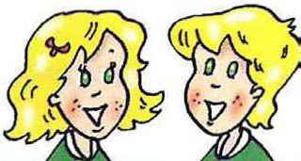
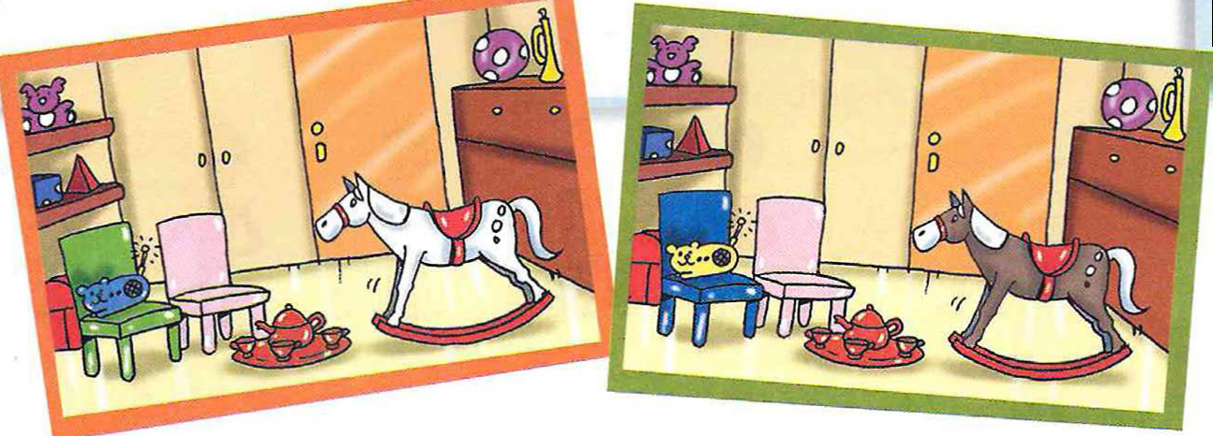
What is their room?
This is Donna and Danny. This is their playroom! These are their toys. That's Danny's rocking horse. lt's brown and white. This is Donna's tea set. lt's red! Donna's chair is pink and Danny's chair is bluе. And look at the funny radio! lt looks like а yellow mouse.
2
1

Slide 3
Yes or No?
Donna and Danny has got many toys.
2. This is their bedroom.
3. The rocking horse is brown and white.
4. Donna’s chair is blue.
5.The radio looks like a mouse.

Slide 4
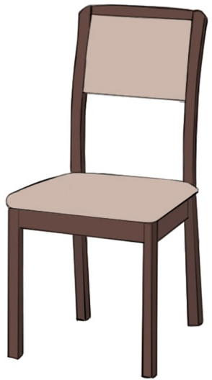
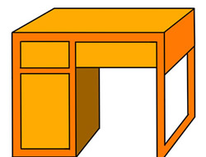
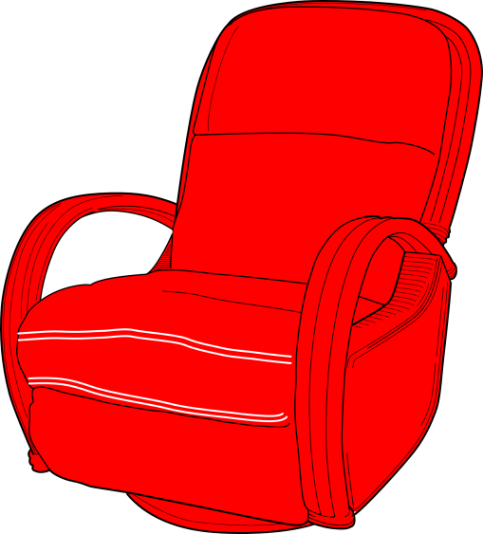
What can we see in a room?
2
4
1
3
7
6
5
8

Slide 5
Whose is this … ?
Mary
Anton
Vika
Platon

Slide 6
Whose is this … ?
Damian
Yegor
Elina
Vadim

Slide 7
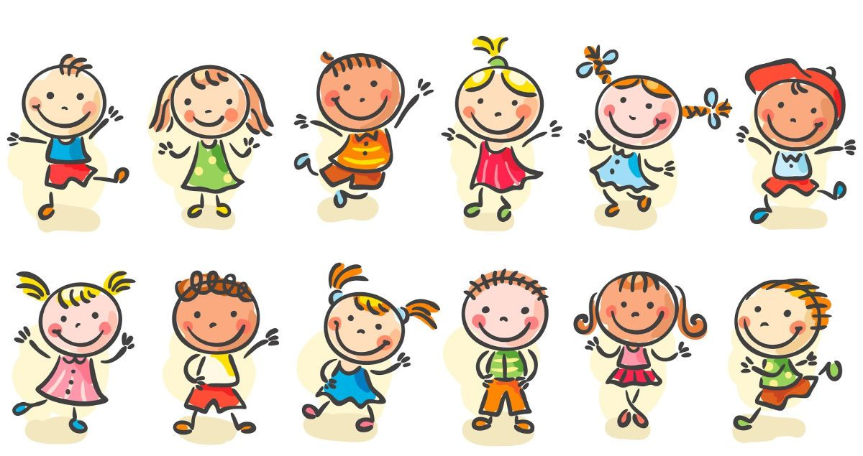
Let’s move

Slide 8
Указательные местоимения
 | единственное число | множественное число
близко | this | these
далеко | that | those

Slide 9
This/ That/ These/ Those
1……is a desk.
2…….are
chairs.
3…….is a bed.
4…….are
armchairs.
5…..is a computer.
6……are radios.
7……are lamps.
8…….is a TV.

Slide 10
Make the sentences plural
1. This is a doll.
2. That is a ball.
3. That is my desk.
4. This is my book.
5. This is a tea set
6. That is a train.

Slide 11
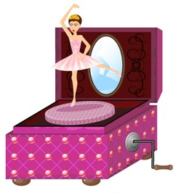
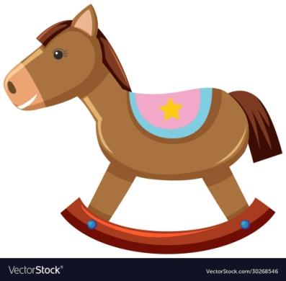
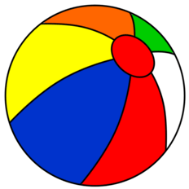
Today we are going to learn how to ask questions
What is this?
What is that?
What are these?
What are those?

Slide 12
Ask questions Example: a musical box (близко) What is this? – It’s a musical box.
aeroplanes (далеко)
What are those? – They are aeroplanes.
a doll (близко)
a train (далеко)
bags (далеко)
pens (близко)
lunch boxes (близко)
a tea set (далеко)
rocking horses (далеко)

Slide 13
Homework
Сб. р.56 ех.6 - 10

Slide 14
Рефлексия
1. Я знаю названия предметов в комнате.
2. Я умею говорить, кому принадлежат
предметы.
3. Я умею использовать местоимения
this/ that/ these/ those.
4. Я умею задавать вопросы:What is this?/
What is that?/What are these?/What are those?

