Slide 1
Welcome
to our lesson!

Slide 2
3 | 21 | 19 | 20 | 15 | 13 | 19
1 | 14 | 4
20 | 18 | 1 | 4 | 9 | 20 | 9 | 15 | 14 | 19

Slide 3
A 1 | B 2 | C 3 | D 4 | E 5 | F 6 | G 7 | H 8 | I 9
J 10 | K 11 | L 12 | M 13 | N 14 | O 15 | P 16 | Q 17 | R 18
S 19 | T 20 | U 21 | V 22 | W 23 | X 24 | Y 25 | Z 26

Slide 4
“Customs and Traditions
in Great Britain”

Slide 5
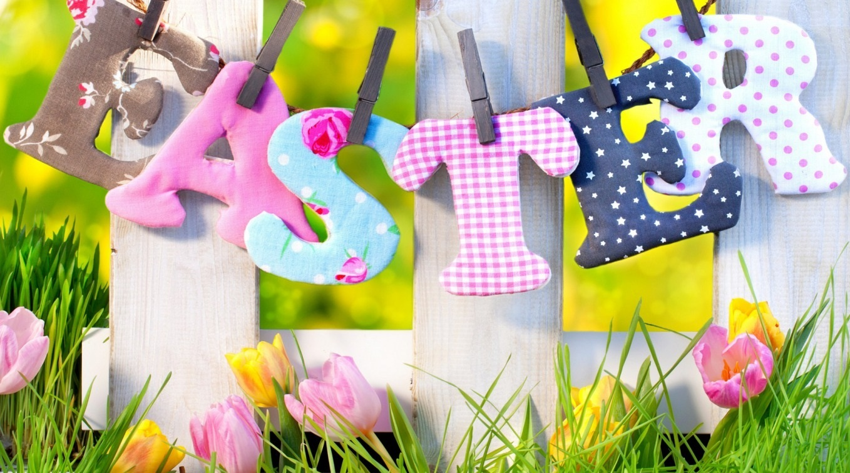

Slide 6
Easter
Many English traditions are usually connected with Holidays. One of them is Easter.
Easter is a Christian spring festival. It is usually celebrated in March or April. Children decorate eggs. People hold Easter egg hunts. The day preceding Lent is known as Pancake Day. It is famous for pancake celebration. This tradition dates from 1445. When the bell is sounded the contestants have to run holding a frying pan with a pancake in it.

Slide 7
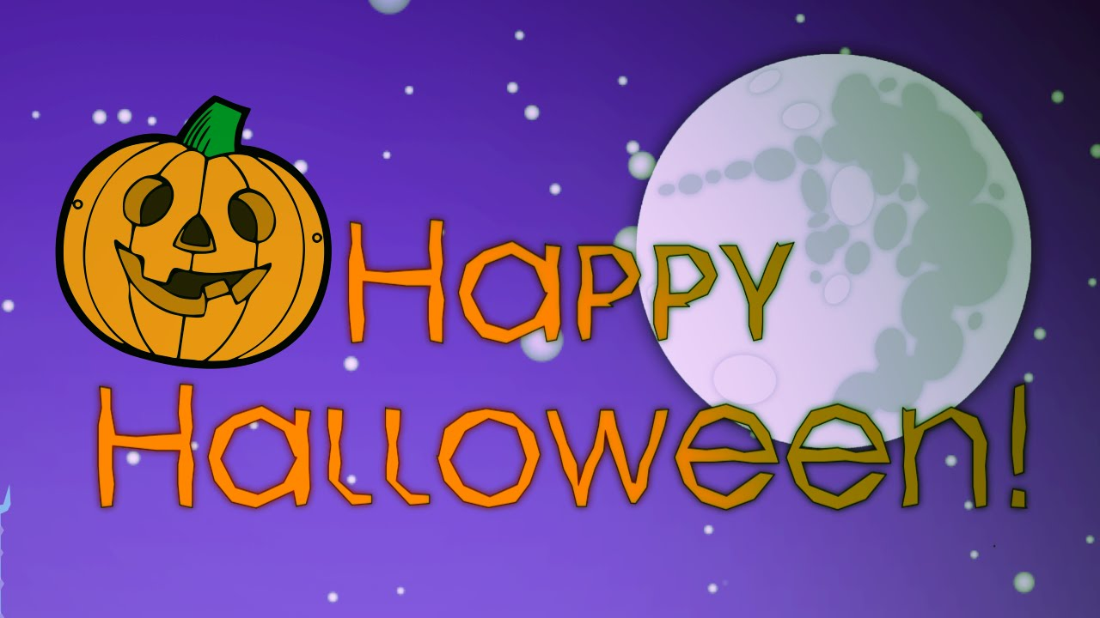

Slide 8
Halloween
Traditionally on Halloween Night people wear scary or funny costumes of witches, vampires, pirates and ghosts. The most popular children's amusement on Halloween is "trick-or-treating".
Usually people give them sweets, fruit and candies, but if they don't, the children can play a trick on them.
Another famous tradition is making Jack O'Lantern: people carve a smiling face on a pumpkin and put a candle inside.

Slide 9
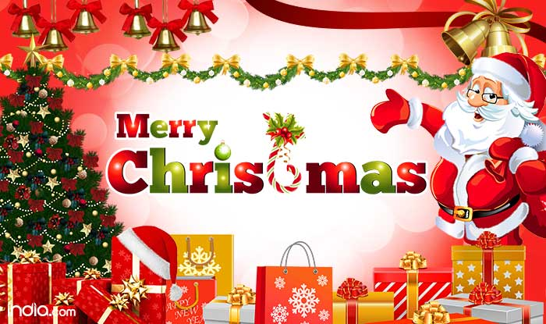

Slide 10
Christmas
Christmas is Christian holiday that celebrates the birth of Jesus Christ. People of different countries celebrate Christmas in various ways. People decorate their homes with Christmas trees, streets are filled with coloured lights; the sound of bells.
Many children believe that Santa Claus arrives on Christmas Eve and brings presents. Some children hang up stockings, so Santa Claus can fill them with candy, fruit and other small gifts.
People walk from house to house and sing Christmas carols.
A traditional Christmas dinner consists of stuffed turkey, mashed potatoes, and a variety and fruitcake are favourite desserts of other dishes.

Slide 11
custom – әдет-ғұрып
tradition – дәстүр
Easter – Пасха (христиандар мейрамы)
celebrate – тойлау
belief – наным, сенім
believe – сену
hold – алып жүру,өткізу
egg hunts – жұмыртқа іздеу жорығы
pancake – құймақ
decorate – безендіру
gift, present – сыйлық
candy, sweet – тәтті, кәмпит
stuffed turkey – фаршталған күркетауық
mashed potatoes – картоп пюресі

Slide 12
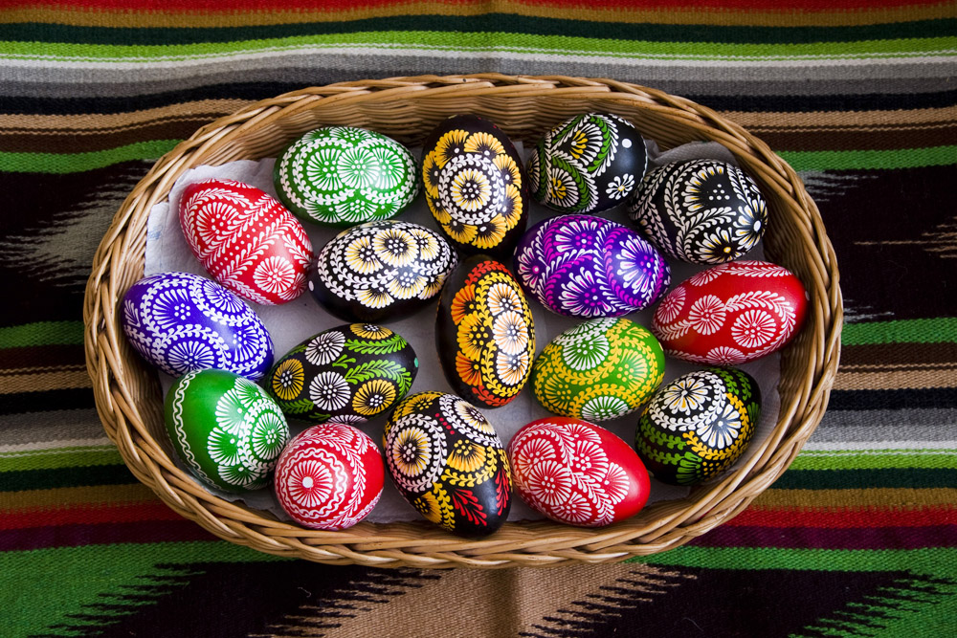
customs

Slide 13
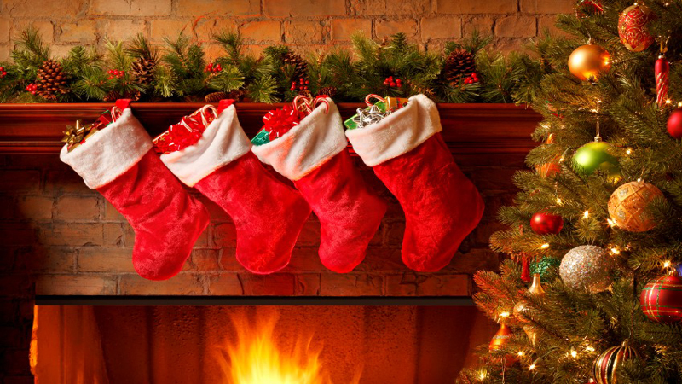
traditions

Slide 14
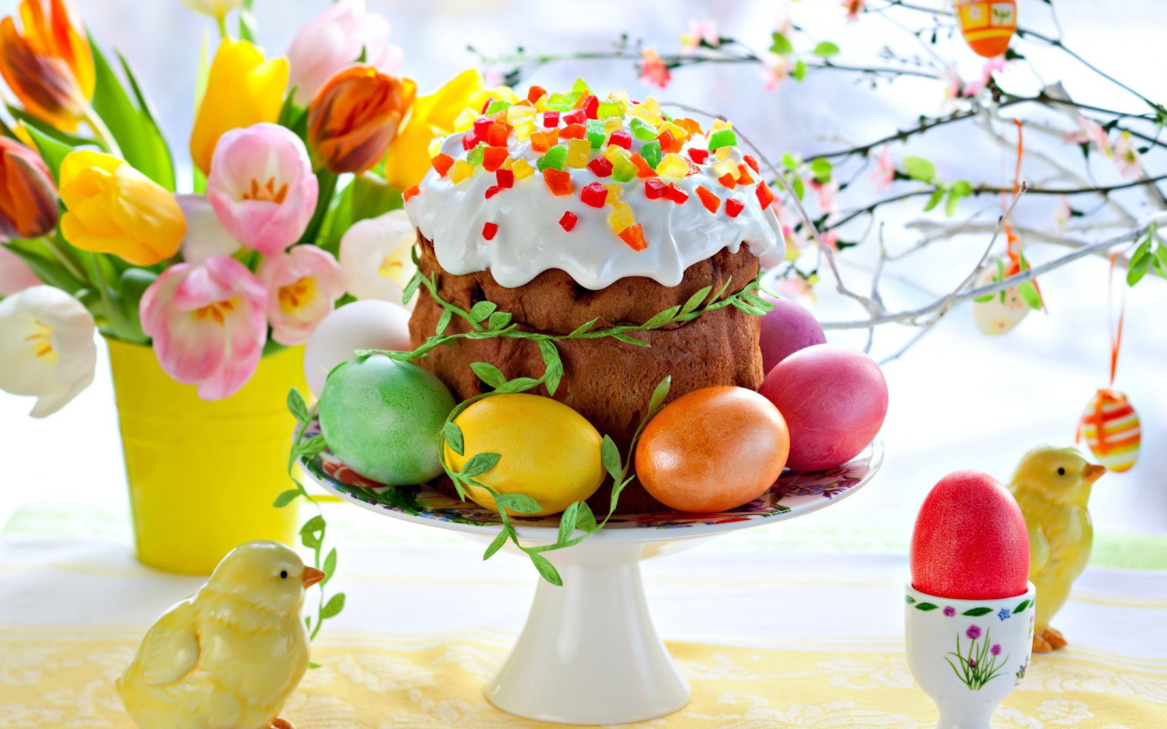
Easter

Slide 15
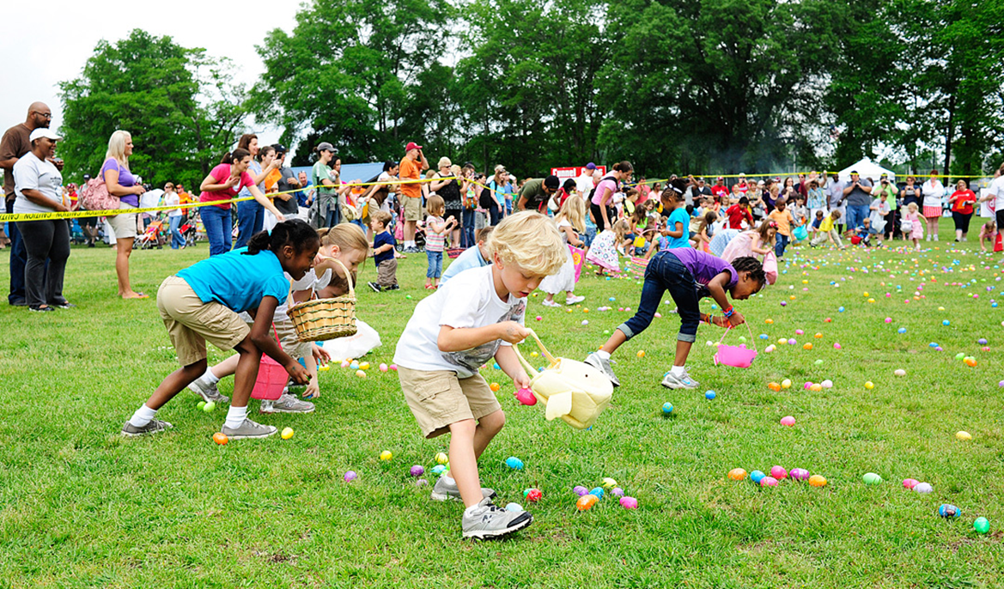
celebrate

Slide 16
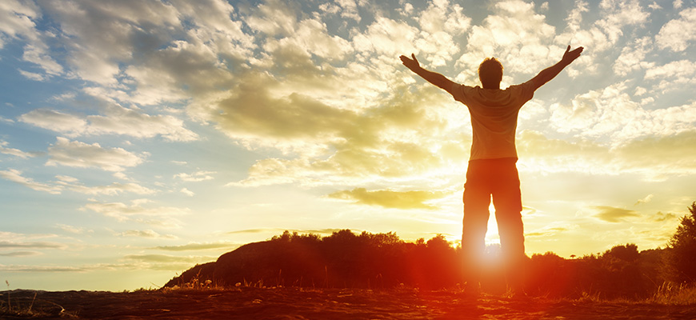
belief

Slide 17
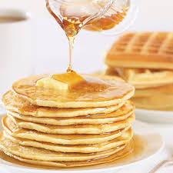
pancake

Slide 18
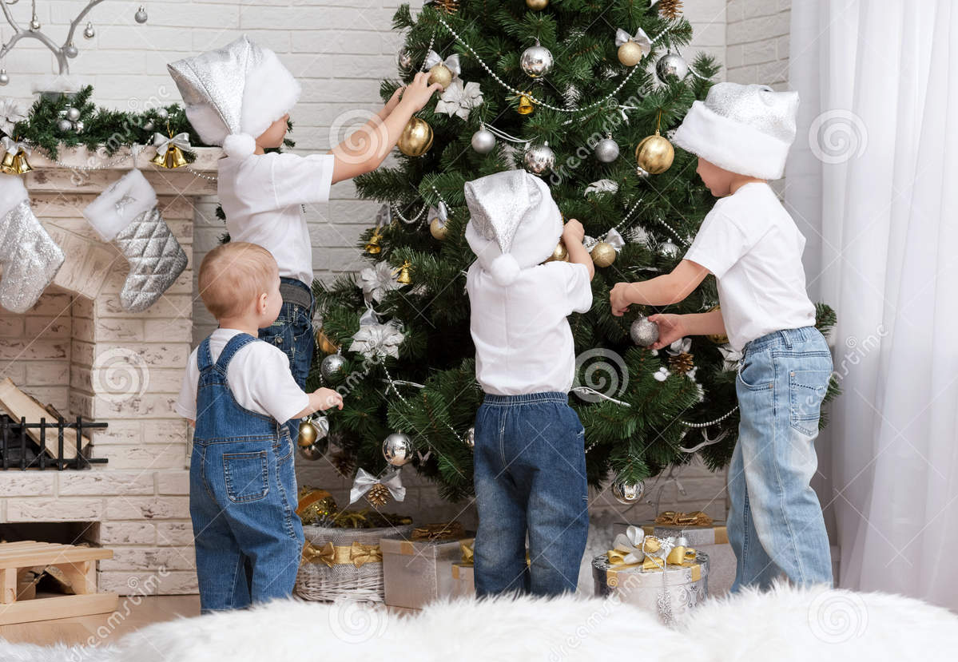
decorate

Slide 19
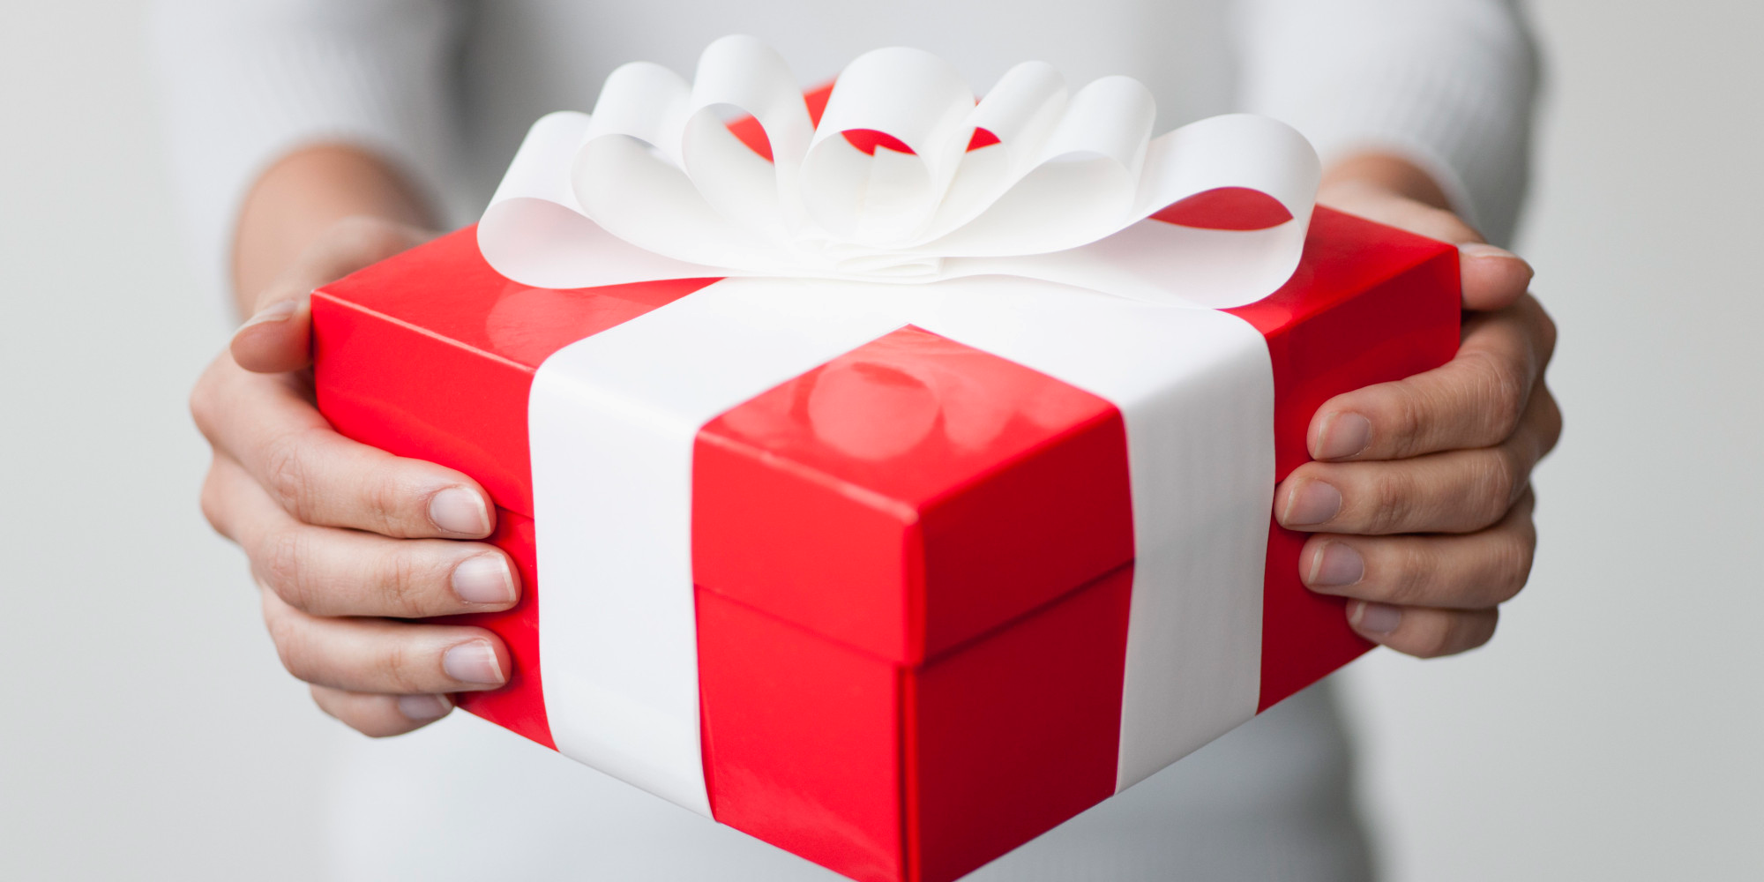
gift, present

Slide 20
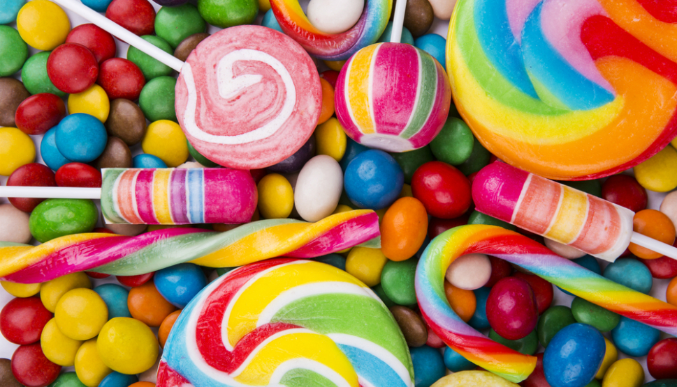
candy, sweet

Slide 21
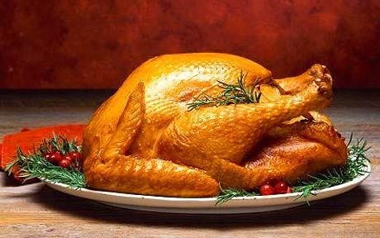
stuffed turkey

Slide 22
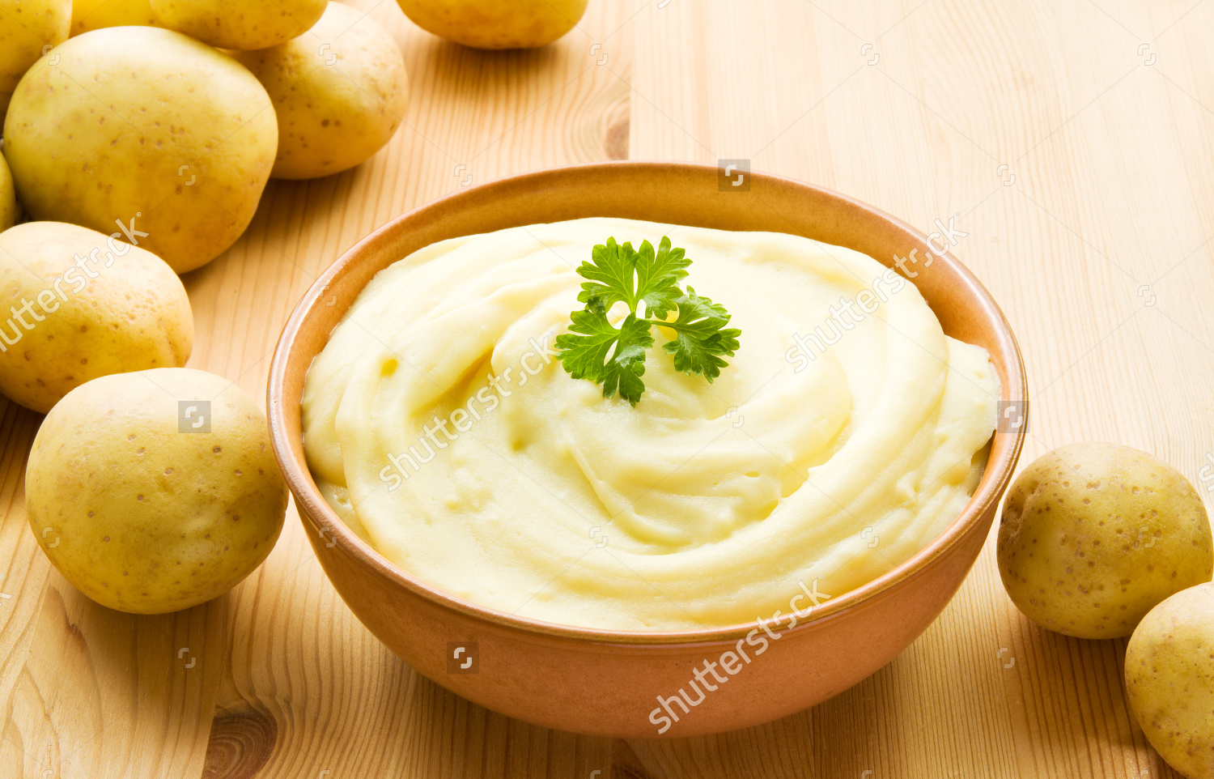
mashed potatoes

Slide 34
Divide the words into groups of nouns and verbs. Complete the table:
Nouns (Зат есім) | Verbs (Етістік)

Slide 35
Make up the sentences using the
words:
traditions are and in Great There Britain customs many.
2. celebrate Britain Halloween on 31st
People of October in.
3. is or April celebrated in March Easter.
cook people usually Christmas Stuffed On turkey and potatoes mashed.
5. like a to Christmas decorateTree Children.

Slide 36
1. There are many customs and traditions in Great Britain.
2. People in Britain celebrate Halloween on 31st of October.
3. Easter is celebrated in March or
April.
4. On Christmas people usually cook Stuffed turkey and mashed potatoes.
5. Children like to decorate a Christmas Tree.

Slide 37
Listen to the audio and fill the gaps with the words below:

Slide 38
Christmas

Slide 39
Easter

Slide 40
Halloween

Slide 41
Good Bye!

