Slide 1
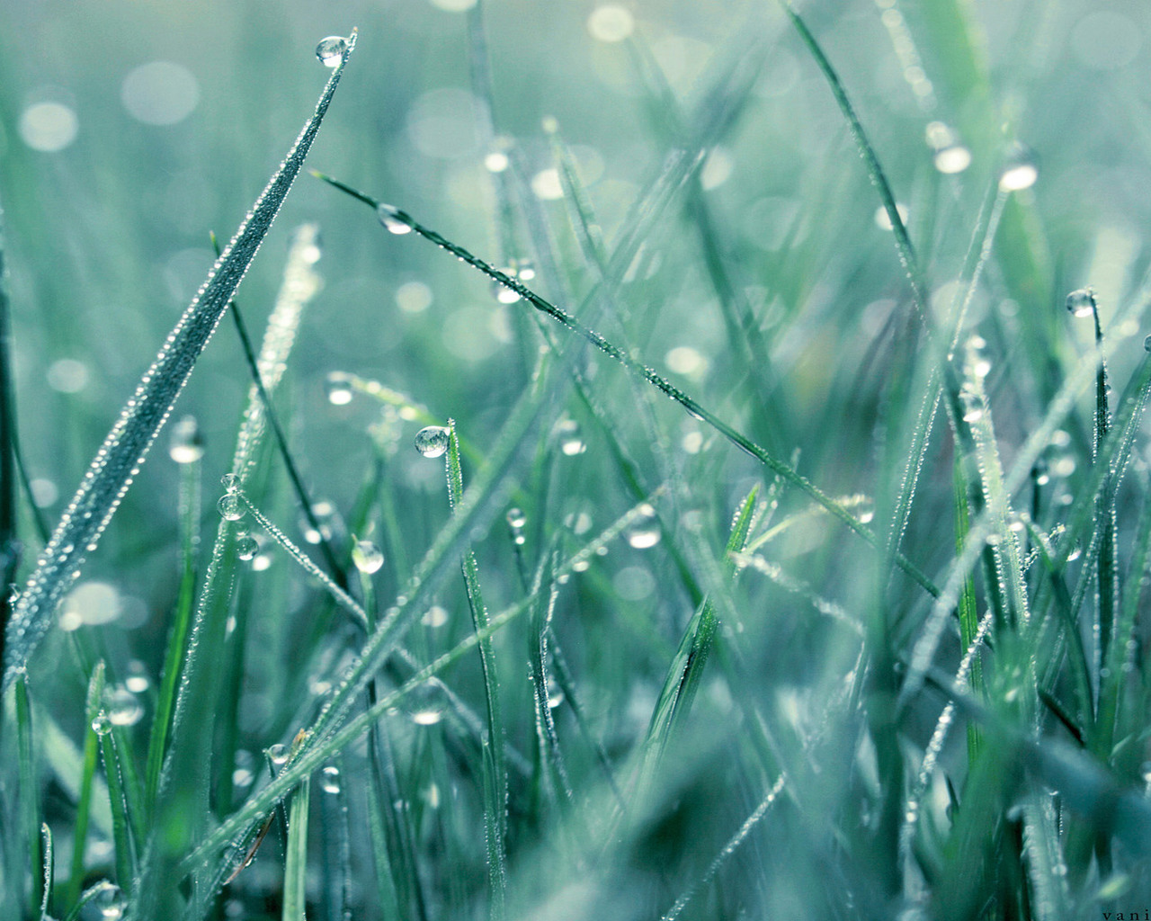
Present Perfect Tense (настоящее совершённое время)

Slide 2
Употребляется, когда :
Мы говорим о действии, которое завершилось, и нам важно действие и его результат в настоящем, а не время, когда оно произошло:
We have raked the leaves in the park.
Мы говорим о действии, которое завершилось, но период времени, когда оно произошло, ещё не истёк (today, this morning/week, so far и т.д.)
She has helped her granny this week.
Образуется:
have
has
+ V₃

Slide 3
Past Participle (V3)
правильных глаголов - ed
explain –
clean –
taste –
work –
want –
receive –
prepare –
move –
неправильных глаголов – 3 форма в таблице
be -
become -
buy -
do -
give -
ride -
sew -
sing -
sweep -
take -
explained
been
cleaned
become
tasted
bought
worked
done
wanted
given
received
ridden
prepared
sewn
moved
sung
swept
taken

Slide 4
Ex. 2. 2)
Alex has helped Mrs Welsh. Alex has raked the leaves and has swept the paths.
Ann hasn’t cleaned up the house. She hasn’t bought food for Mr Elson. But she has sewn a toy.
Jay and Jane have cleaned up the house. But they haven’t swept the path and haven’t sewn two toys.
Helen has watered the flowers and has sewn a toy. But she hasn’t cleaned up the house.
Ron has done the shopping for Mr Elson. But he hasn’t watered the flowers for Mrs Welsh.

Slide 5
Home task:
SB ex. 4 p. 43
Grammar p. 40

Slide 6
Good luck, children !

