Slide 1
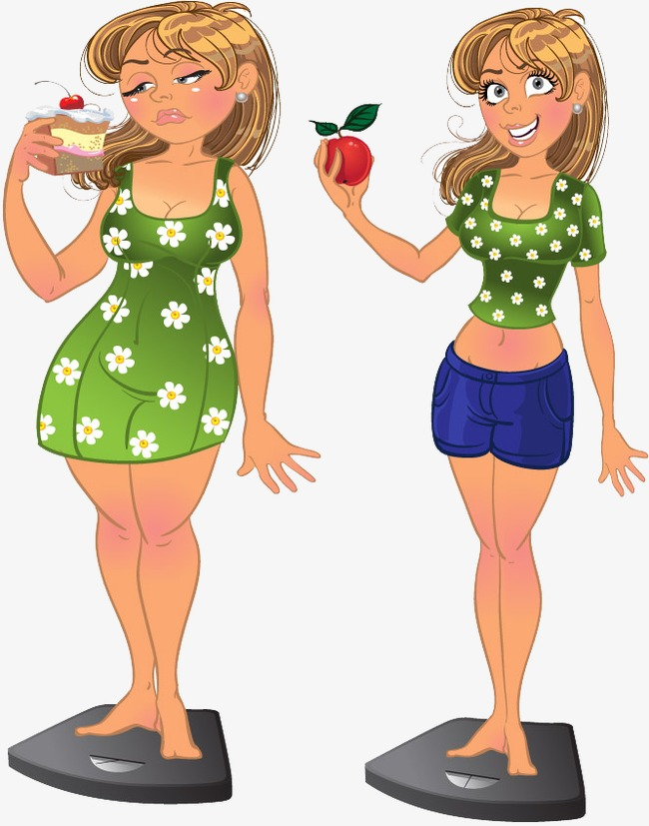
am I tall?
big
slim

Slide 2
переведите предложения
I am tall.
I am not slim.
He is big.
She is short.
I-я
he-он
she-она
we-мы
you-ты, вы
they-они
am
is
are

