Slide 1
English

Slide 2
Maths

Slide 3
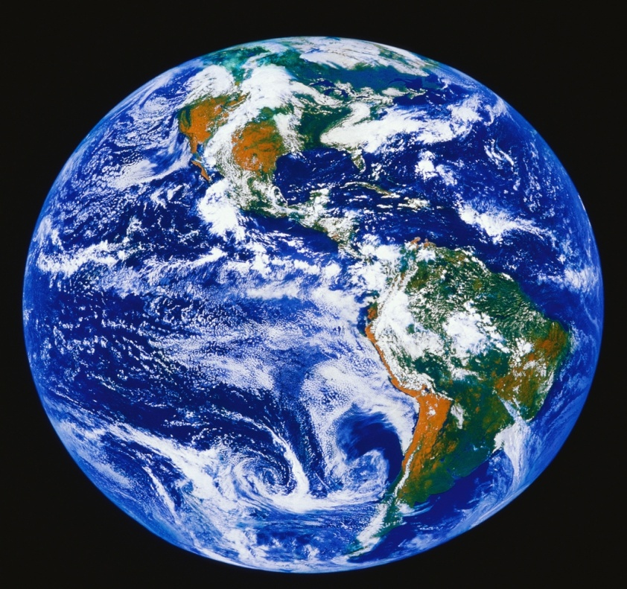
Geography

Slide 4
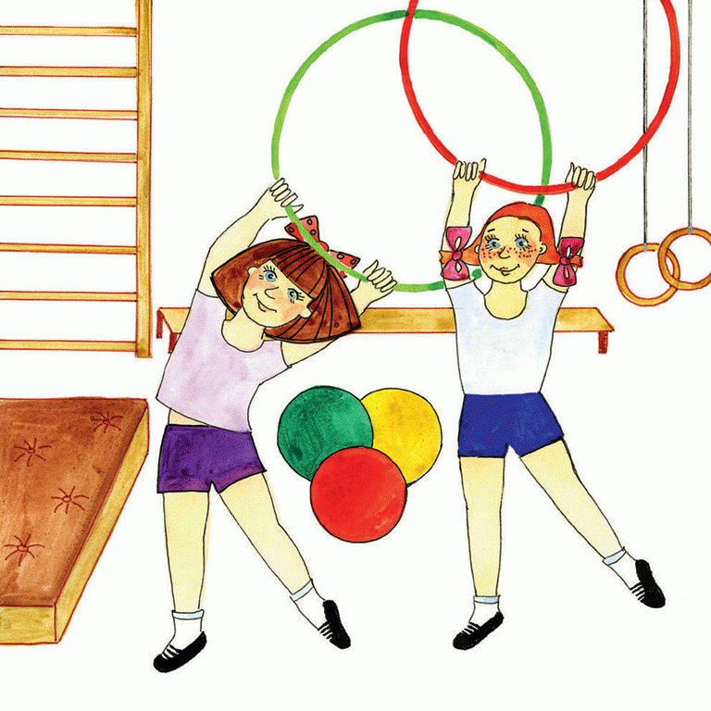
PE

Slide 5
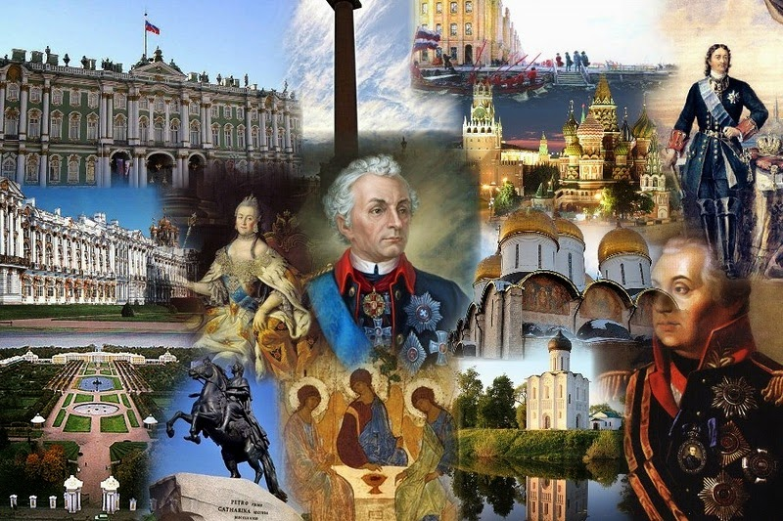
History

Slide 6
Science

Slide 7
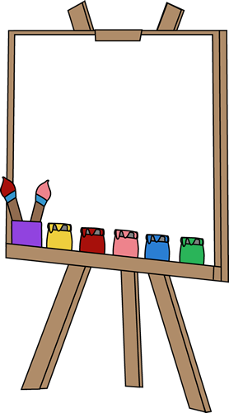
Art

Slide 8
Music

