Slide 1
Birthday party
Выполнила:
Учитель английского языка
Макарова М.В.
МАОУ СОШ №30
город Тамбов

Slide 2
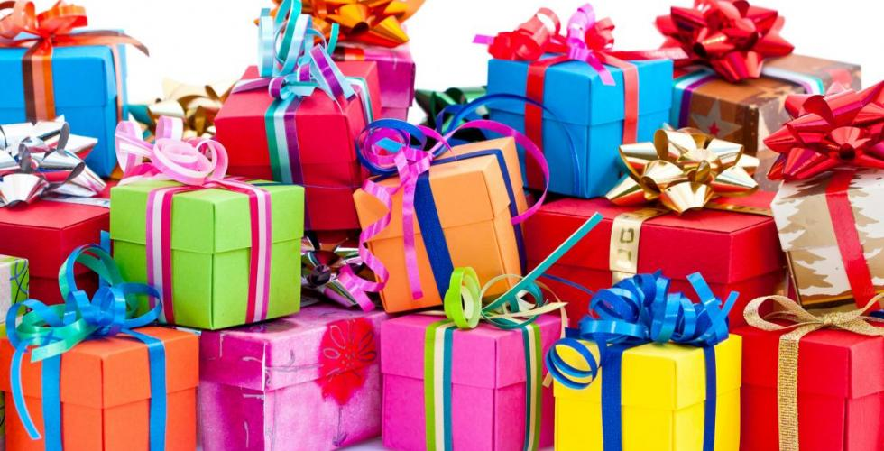
Presents

Slide 3


Slide 4


Slide 5
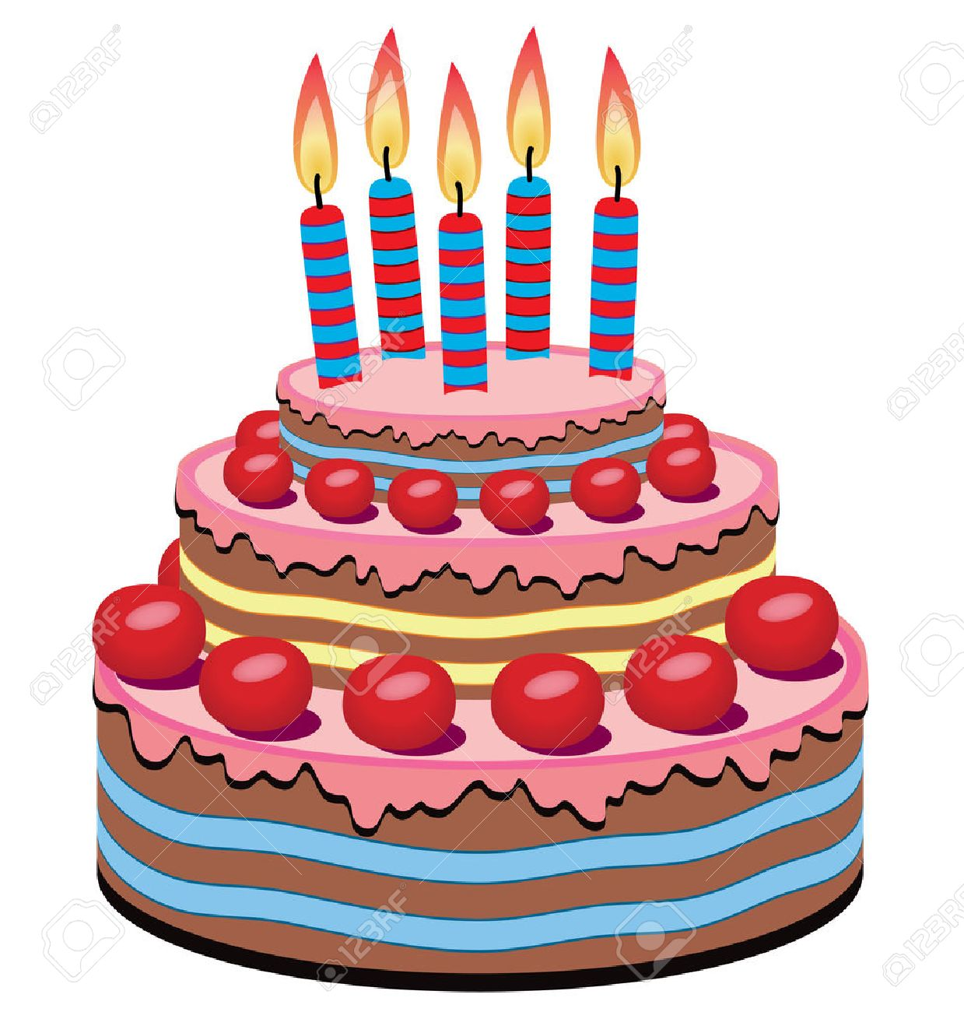

Slide 6
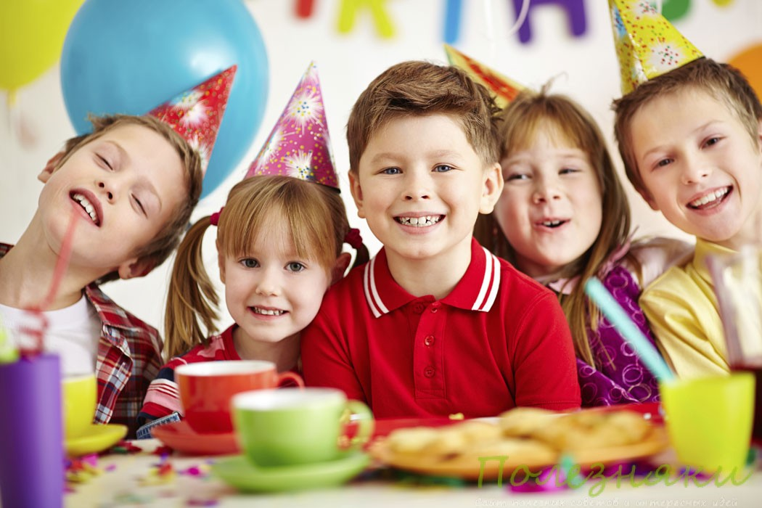

Slide 7
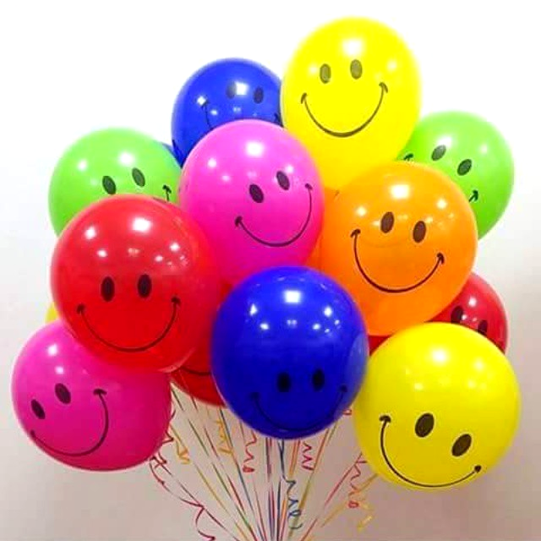

Slide 8
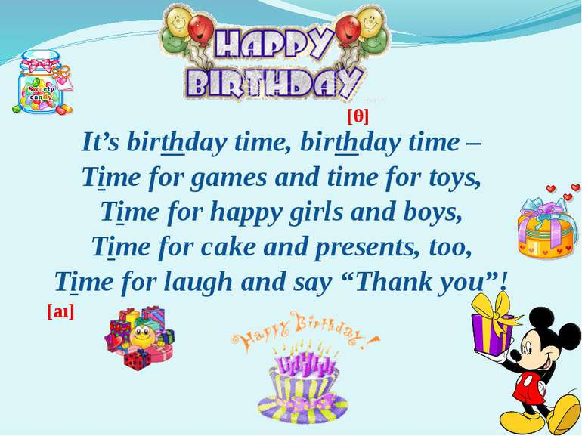

Slide 9
Plan
Invite guests (write an invitation card / phone)
Decorate your house
Buy tasty things
Think about presents
Have fun (competitions, games, songs)

Slide 10
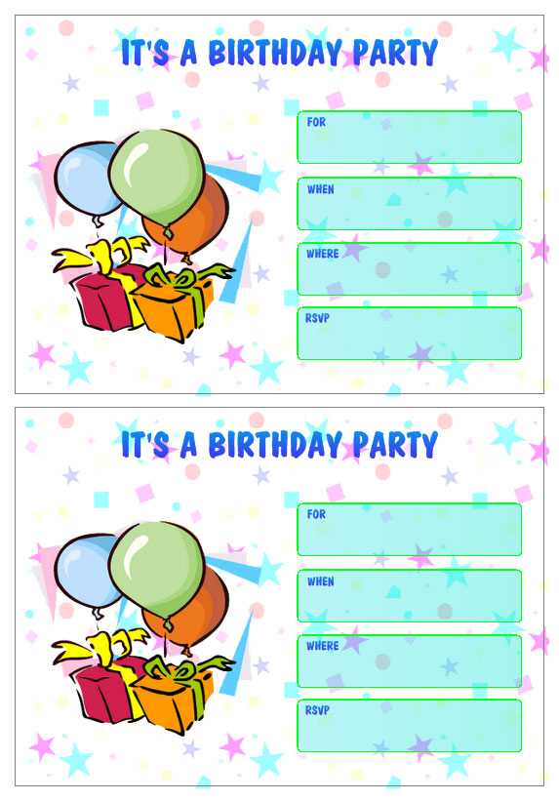

Slide 11


Slide 12
Shopping list
Вставьте в пропуски is или are :
There ….. a cake in the trolley.
There ….. a lot of apples in the trolley.
There ….. two pizzas in the trolley.
There ….. a bottle of Coke in the trolley.
There ….. a lot of sweets in the trolley.

Slide 13
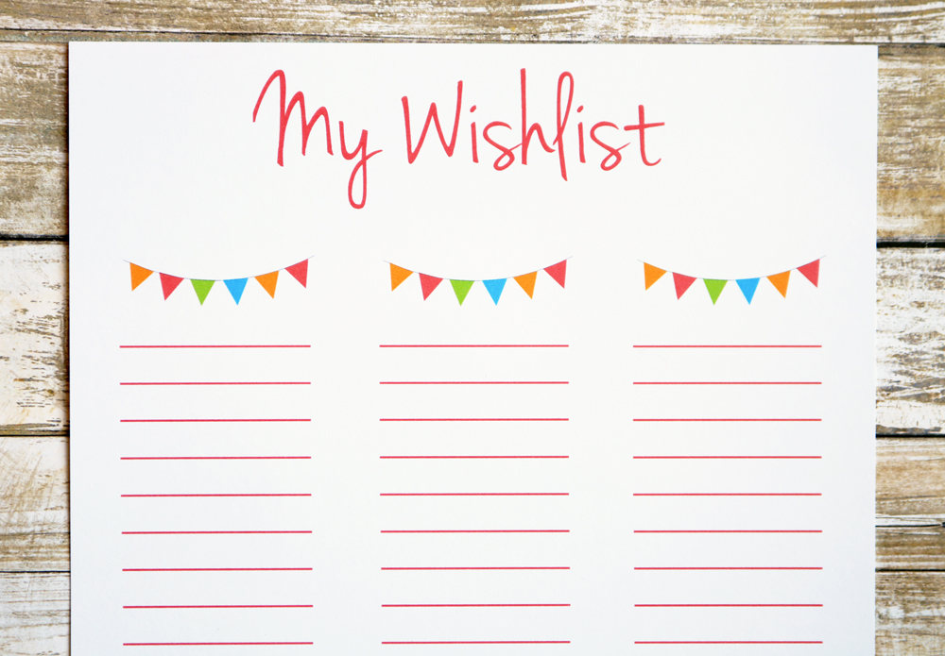

Slide 14

Have fun

Slide 15


