Slide 1
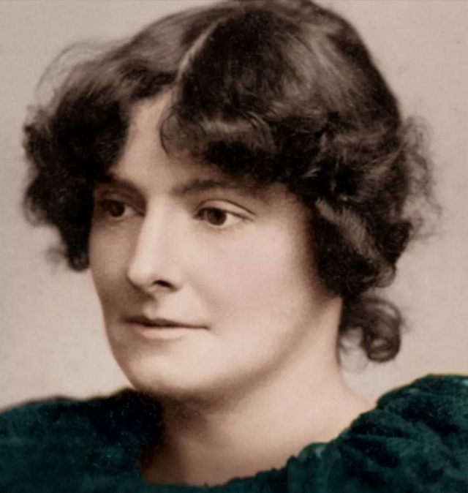
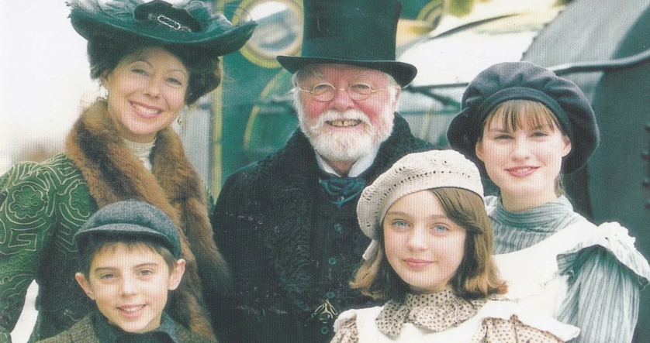
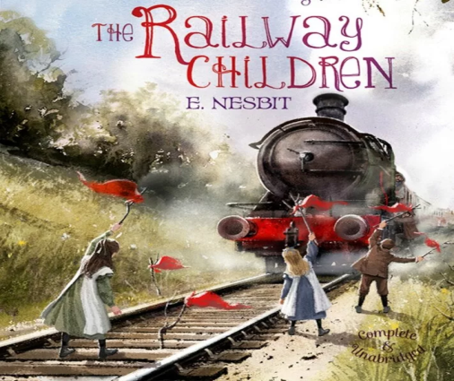
Edith Nesbit and the Railway Children.

Slide 2
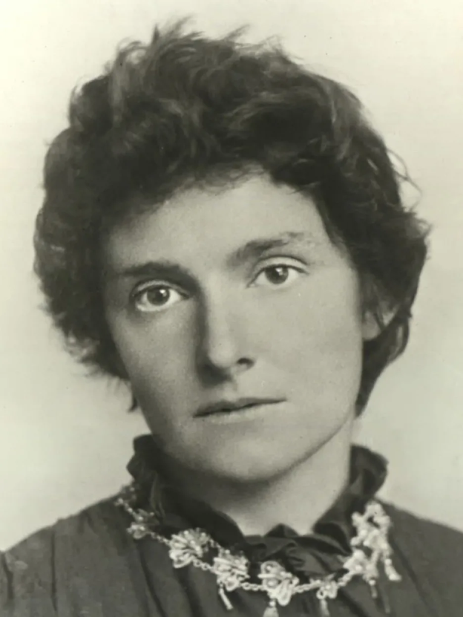
Biography.
Edith Nesbit was born in Surrey. After she got married in 1880, she started writing children's poems and stories ю help support her large family.

Slide 3
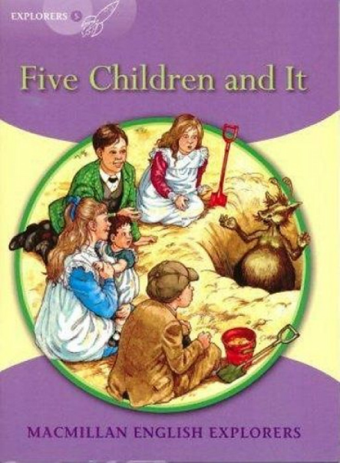
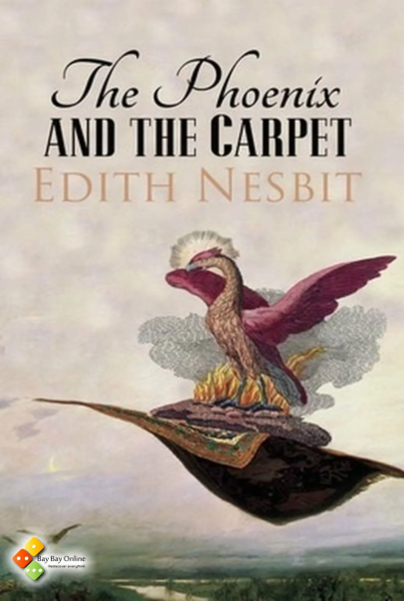
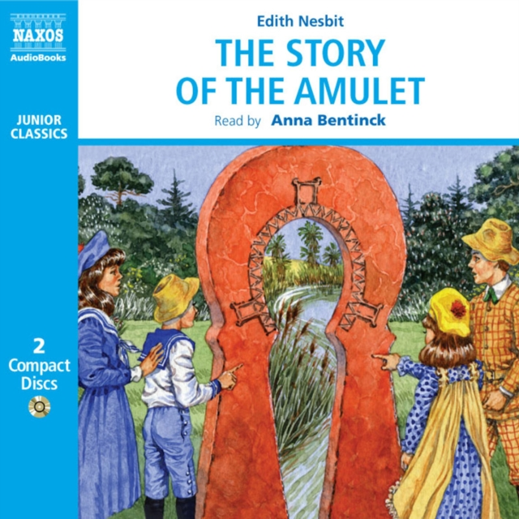
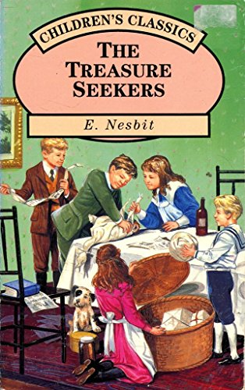
Biography.
Her writing was very popular. Her well-known stories include «Five Children and It»(1902) and «The Phoenix and the Carpet» (1904). Altogether, she published more than 40 novels before her death in 1924.

Slide 4
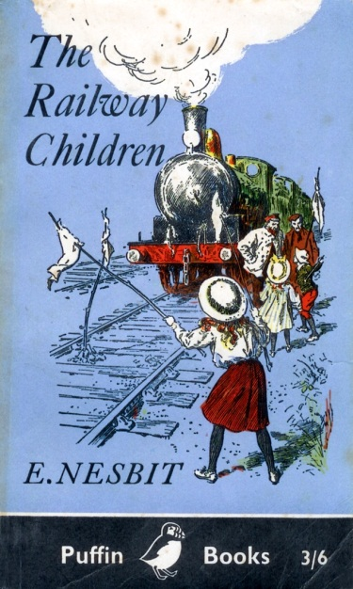
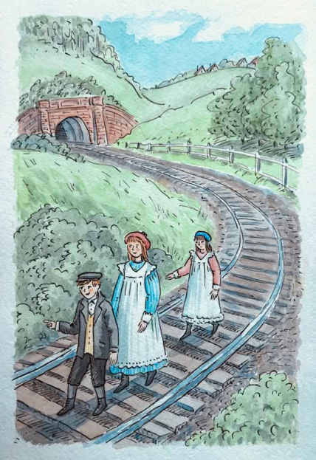
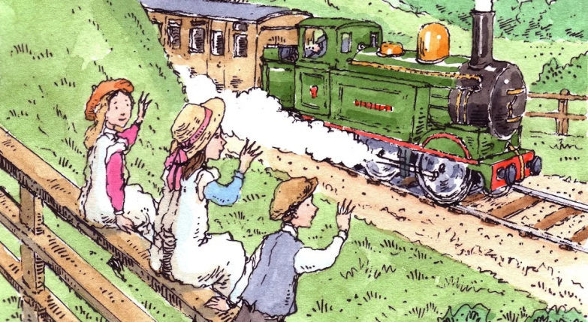
Biography.
Nesbit's most famous and well-loved story is «The Railway Children» (1906).The novel is about the adventures of a middle class Edwardian family living near a railway station in the suburbs of London at the turn of the 19th century. In 1970, the book was made into an extremely successful film.

Slide 5
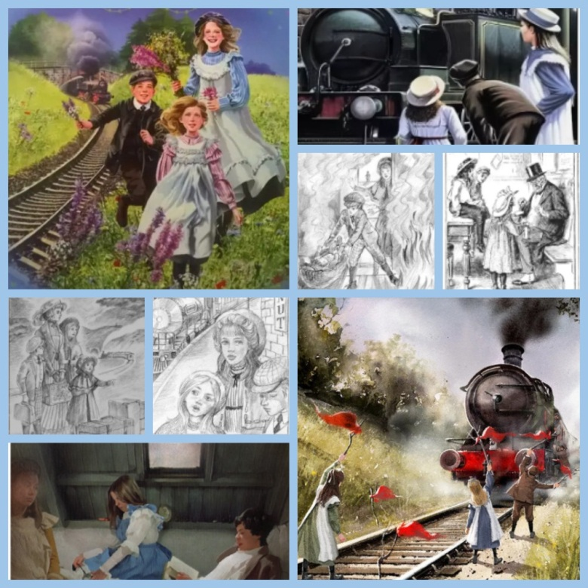
The Railway Children.
The story is about a family who move from London to "The Three Chimneys", a house near the railway in Yorkshire, after their father’s mysterious disappearing.

Slide 6
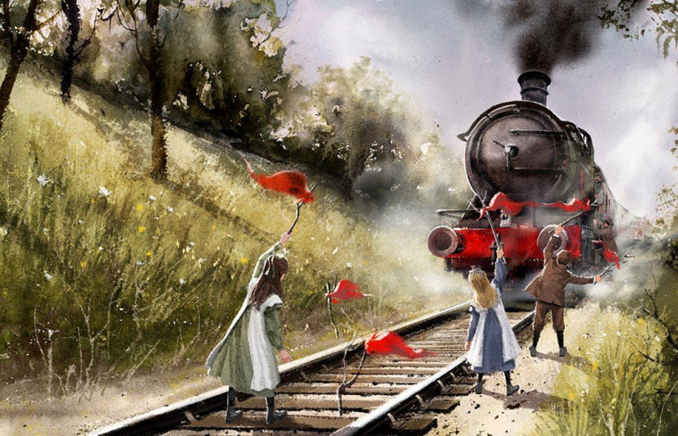
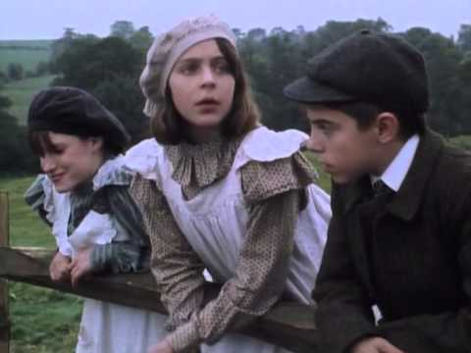
The Railway Children.
Their new life is full of adventures and events. So, the children meet an Old Gentleman who regularly takes the 9:15 train near their home. The family takes care of a Russian exile, Mr. Szczepansky, who came to England looking for his family (later located) and Jim, the grandson of the Old Gentleman, who suffers a broken leg in a tunnel.

Slide 7
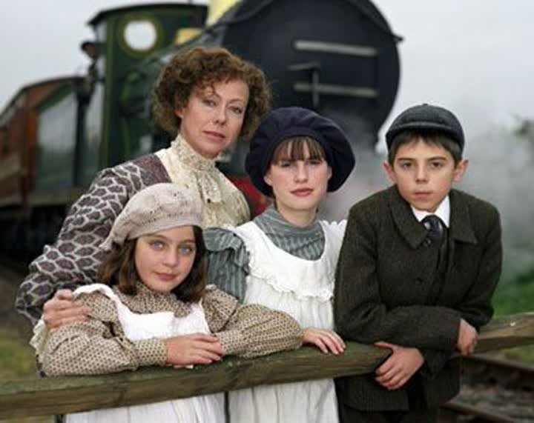
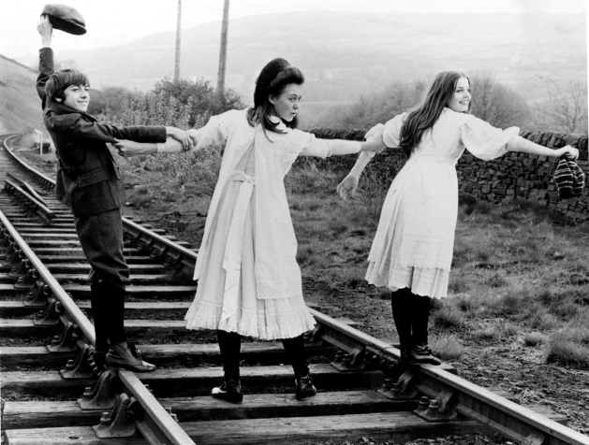
The Railway Children.
Later we know that their father, who works at the Foreign Office, is imprisoned after being falsely accused of spying. But an Old Gentleman eventually able to help prove their father's innocence, and the family is reunited.

Slide 8
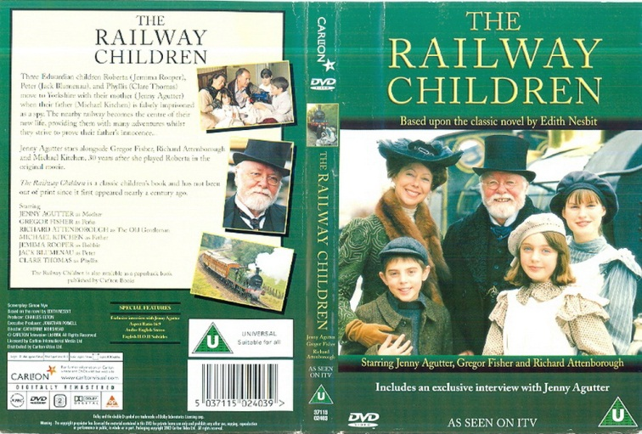
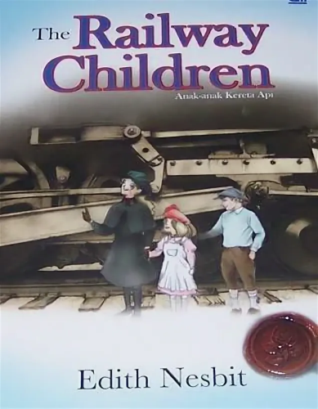
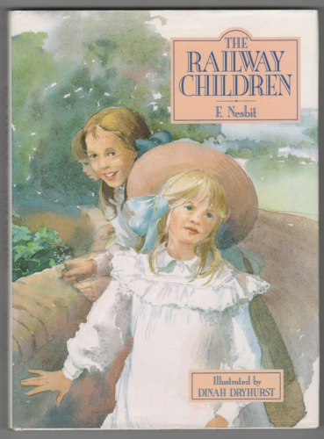
The Railway Children.
The book by Edith Nesbit, originally serialised in The London Magazine during 1905 and first published in book form in 1906. It has been adapted for the screen several times, of which the 1970 film version is the best known.

