Slide 1
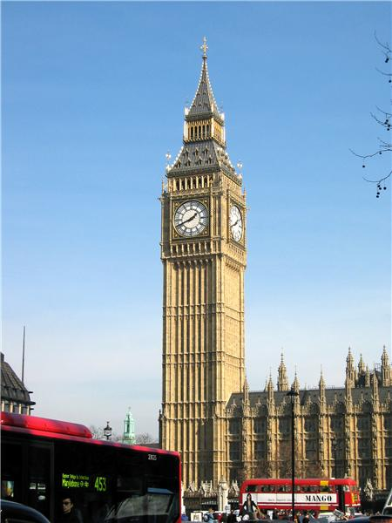
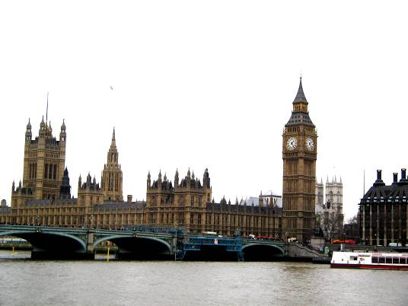
London sights

Slide 2
Big Ben
It’s a clock in the tower and it is a big bell.
You can hear it every hour.
It weighs 13.5 tons.

Slide 3
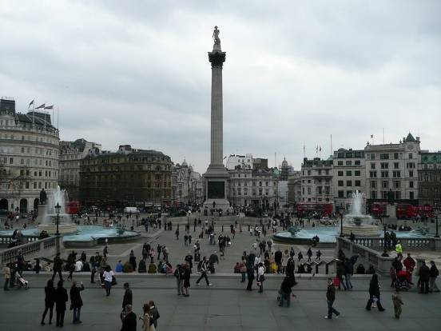
Trafalgar Square
It is the central square of London and traditional place for people to meet.

Slide 4
The Houses of Parliament
It is a place where the British Government sits.
It consists of three parts: the Royal Apartments, the House of Lords and the House of Commons.

Slide 5
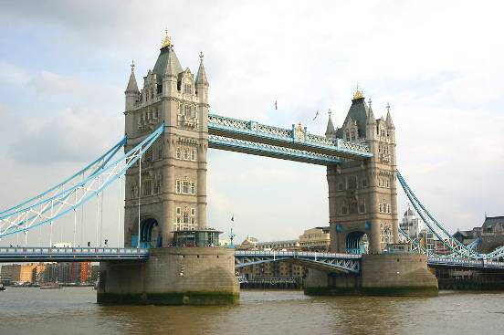
Tower Bridge
It is the oldest and famous bridge across the Thames.
It was made of wood by the Romans, but it was often burnt down.
Later it was made of stone.

Slide 6
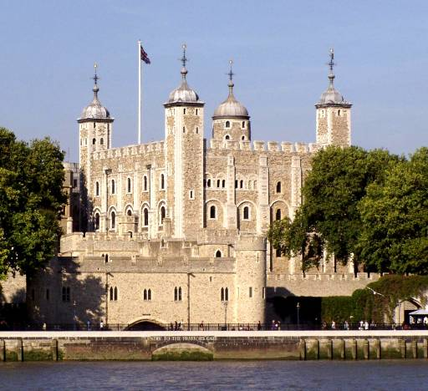
The Tower of London
It has a long history. In the past it was a fortress, a prison, a castle and a zoo.
It was built to protect the city from the enemies. There are a lot of ravens at this place.
Nowadays this building is a very popular museum.

Slide 7
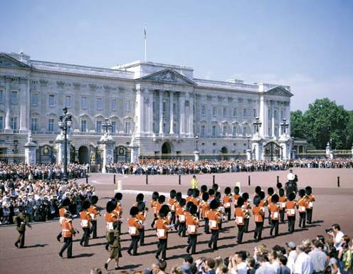
Buckingham Palace
It’s the London home of the Queen.
Buckingham Palace was built between 1702 and 1705.
The palace is open to public.

Slide 8
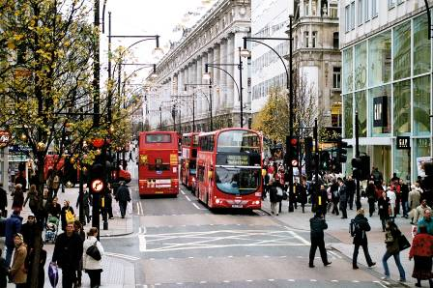
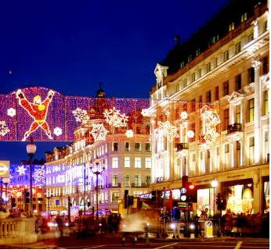
Oxford Street
It is the biggest shopping street in London.
There are 548 shops in Oxford Street.

Slide 9
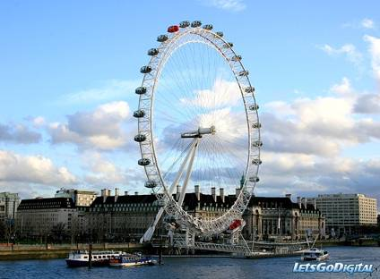
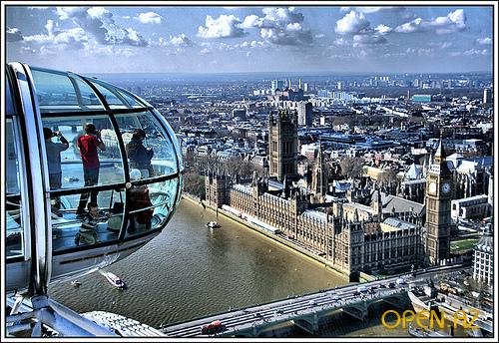
The London Eye
It’s the biggest observation wheel in the world.
It is situated on the banks of the River Thames in Central London
It’s height is 135 meters.

Slide 10
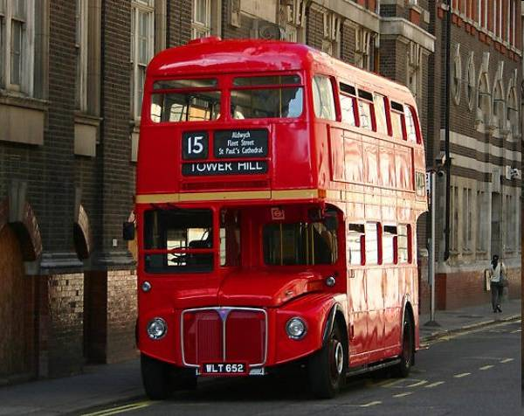
London bus.
And the last symbol in our list is the London bus which is known all over the world.

Slide 11
Thank for your attention!

