Slide 1
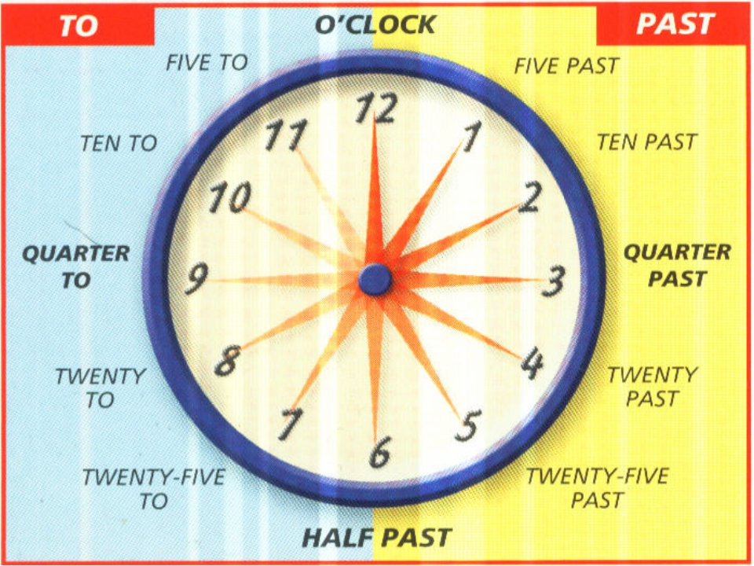

Slide 2
Good manners
Write the time
8.30
7.45
6.15
10.20
5.25
2.35
1.10
9.55

Slide 3
Write and read
to call up before
to be late
to come on time
to talk with full mouth
to wash hands
to say “thank you”
to say “good buy”
Usually I come on time.

Slide 4
Местоимения
личные
притяжательные
I
he
she
it
we
you
they
my
his
her
its
our
your
their

