Slide 1
Animals are our friends

Slide 2
Animals
I see a monkey
I see a dog
I see a rabbit
I see a frog.
I like this monkey
I like this dog
I like this rabbit
I like this frog.

Slide 3
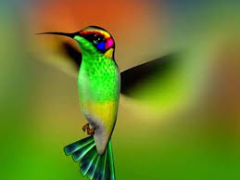
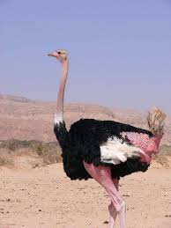
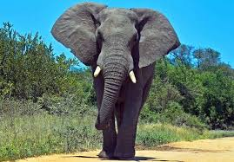
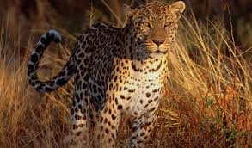
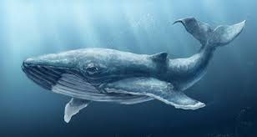
Who is the biggest animal on the land? (an alehenpt)
Who is the fastest animal on the land? (a earlodp)
Who is the smallest bird? (a hmungim ibrd)
Who is the biggest animal in the sea? (a hlwae)
Who is the heaviest bird? (an orticsh)

Slide 4
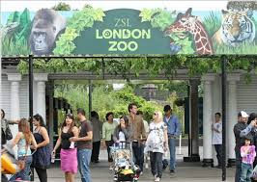
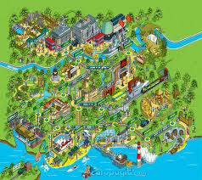
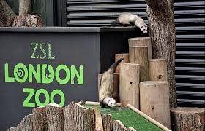
Welcome to London Zoo. It is the oldest zoo in the world.

Slide 5
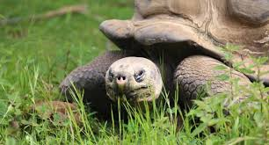
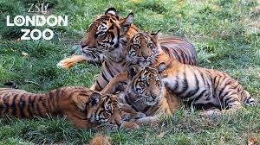
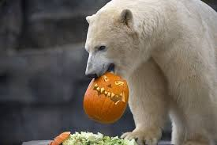
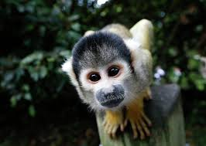
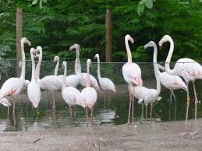
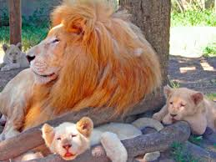
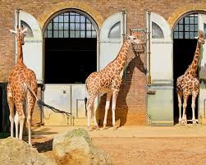
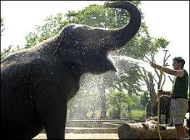
long, fast, heavy, fluffy, dangerous, cheerful, smart, tall, fat, silly, beautiful, brave, big Bears are bigger than lions.

Slide 6
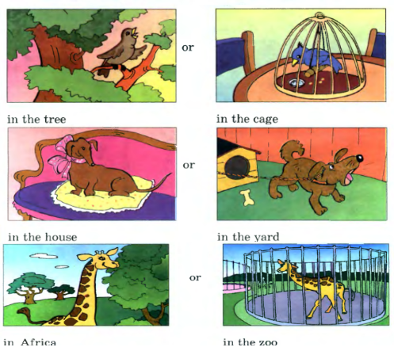

Slide 7
All animals are our friends. We should not help animals. All animals should live in zoos.

Slide 8
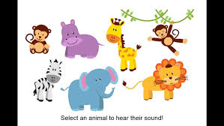
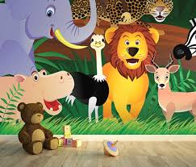
Thank you! Good bye!

