Slide 1
«Healthy food»
Презентация к уроку учителя английского языка Абдулгамидова З.Г.

Slide 2
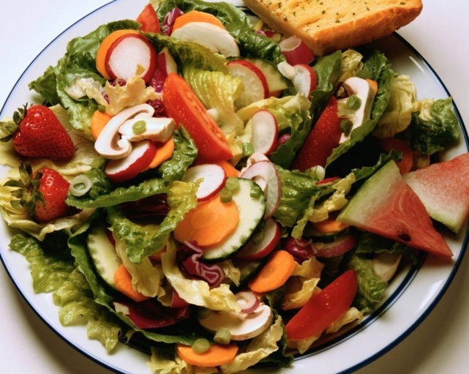
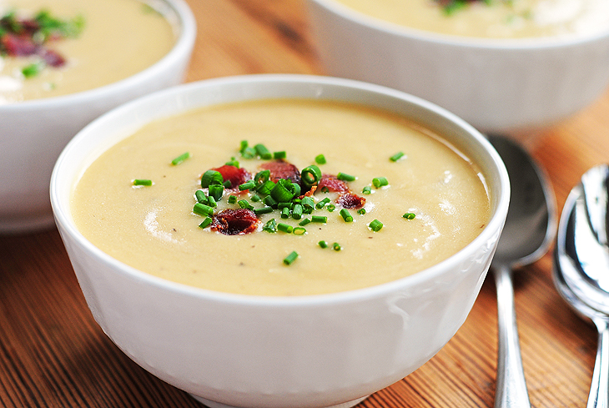
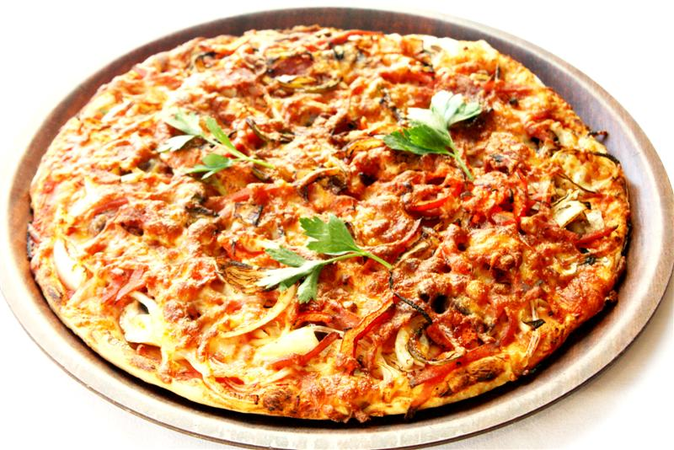
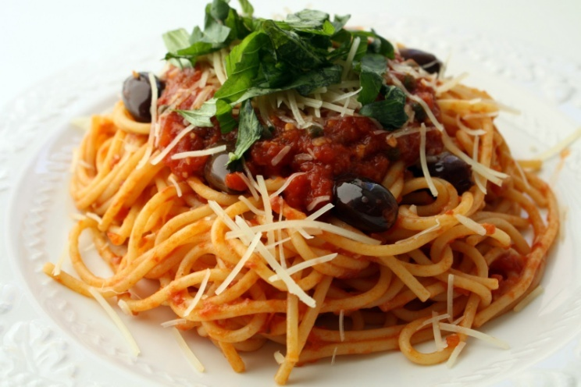
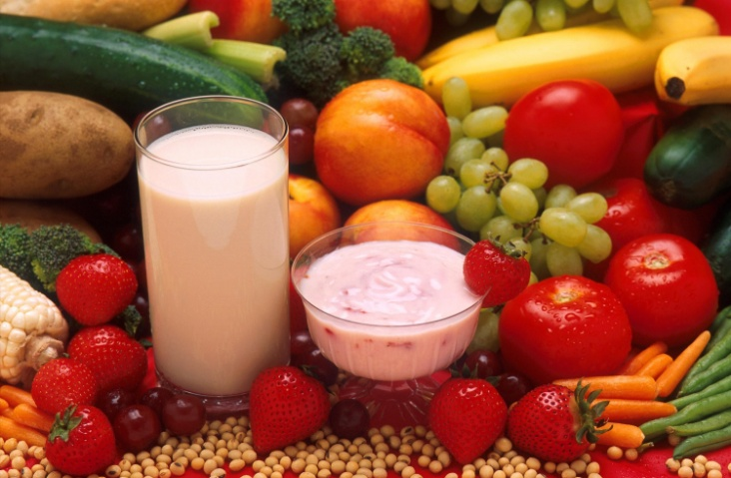
Answer the questions.
What’s your favourite food?

Slide 3
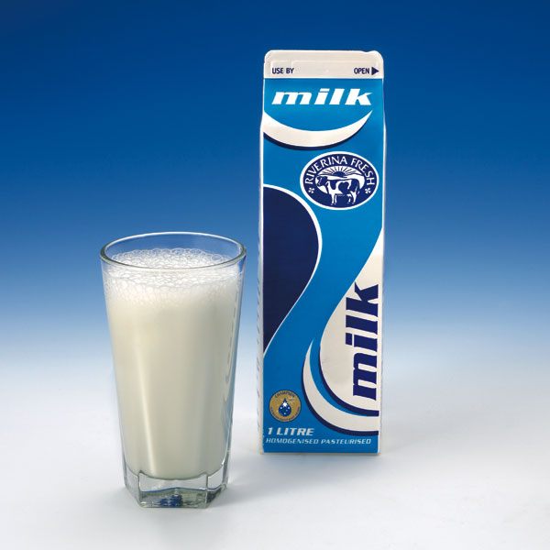
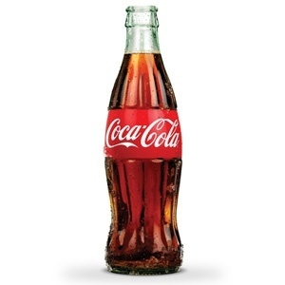
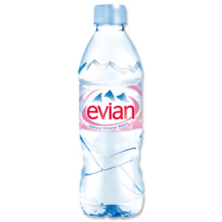
What do you usually drink?

Slide 4
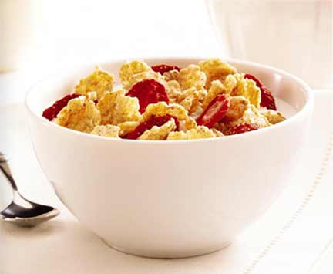
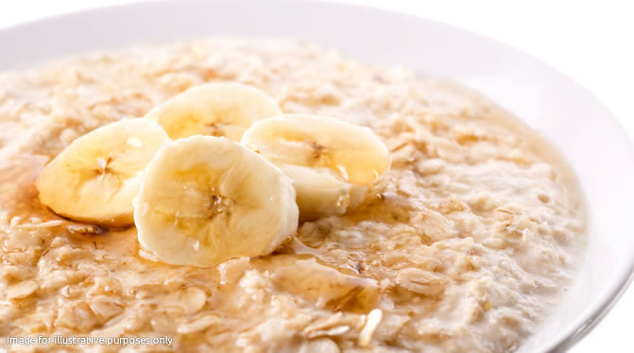
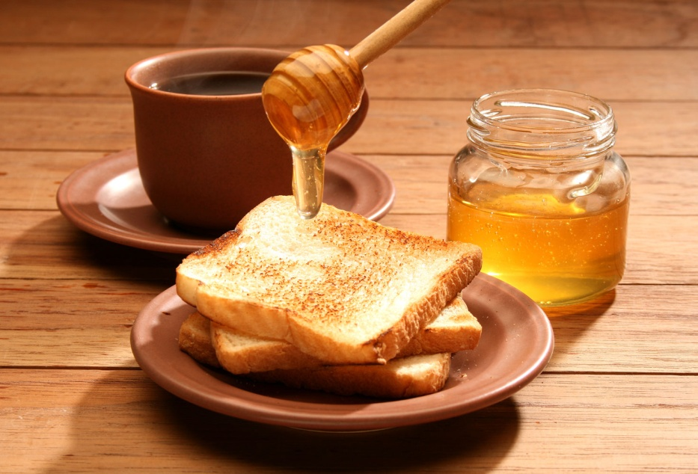
What do you have for breakfast?

Slide 5
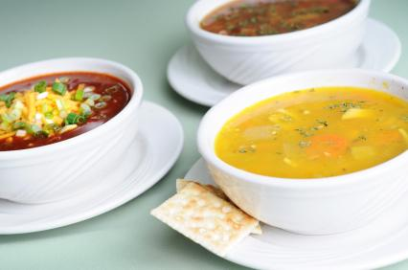
Do you have soup for lunch?

Slide 6
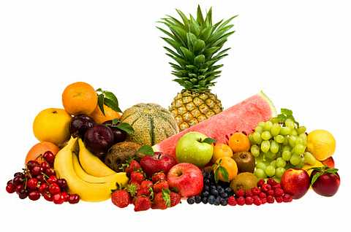
Do you like fruit?

Slide 7
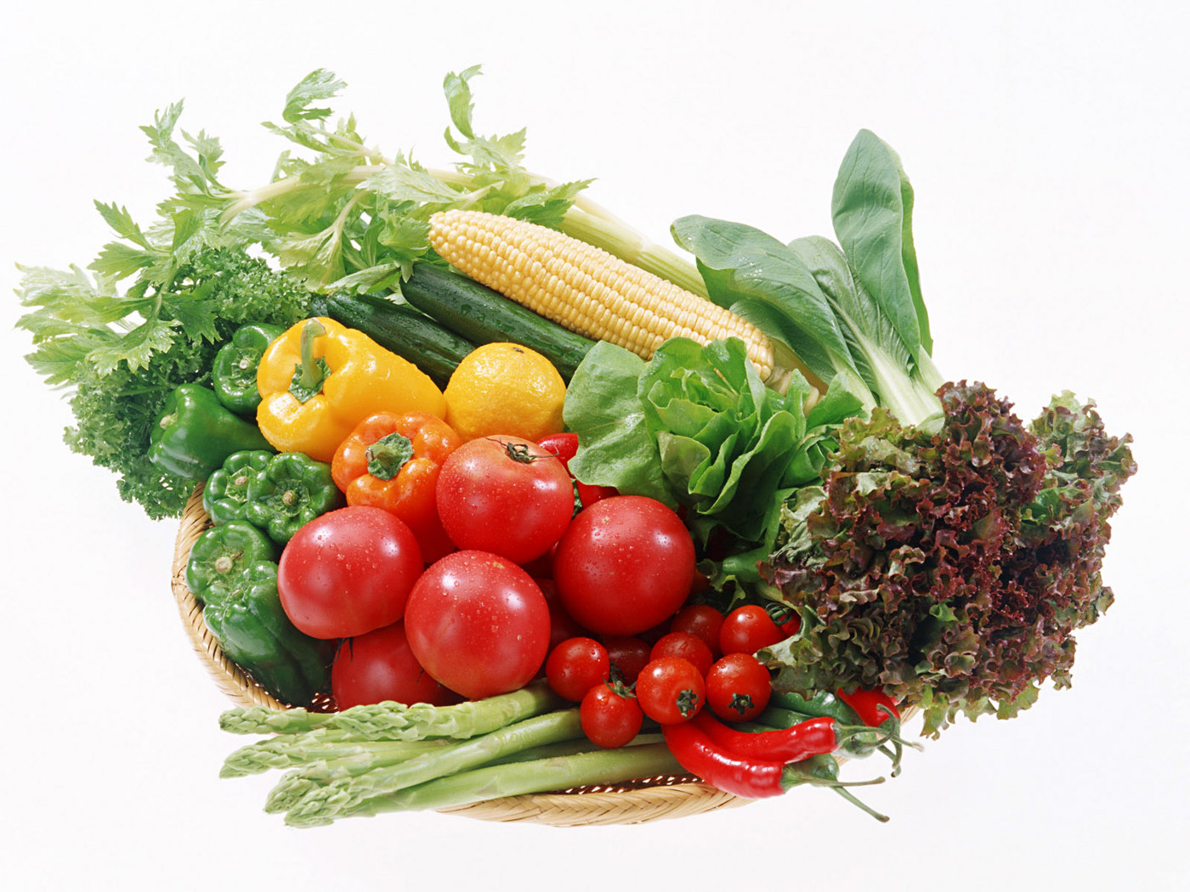
Do you eat vegetables every day?

Slide 8
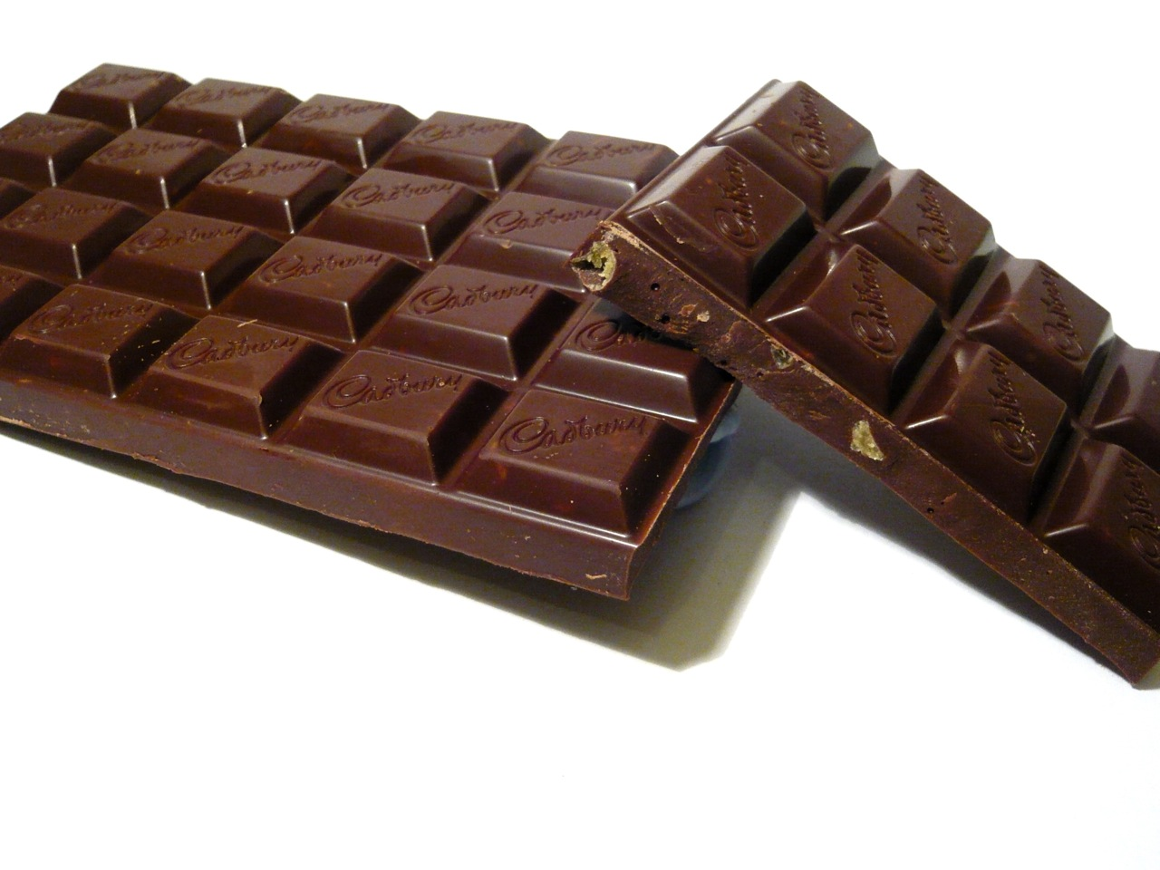
Do you like chocolate?

Slide 9
Get up, little Freddy,
Breakfast is ready:
Butter and cheese
All that you please
Milk and bread for little Fred.
Tea and jam for brother Sam.

Slide 10
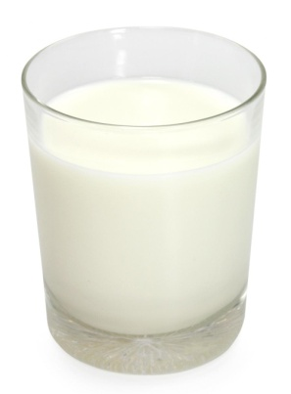
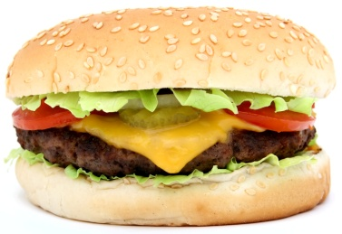
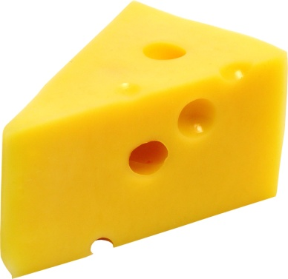
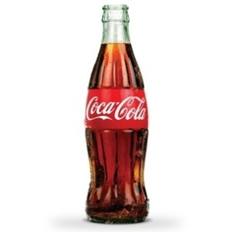
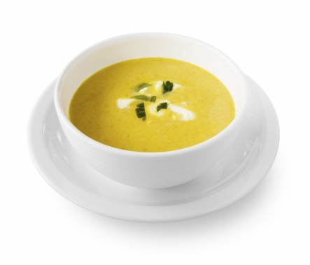
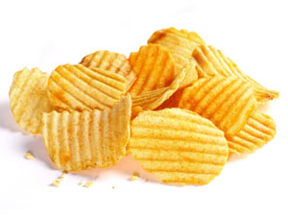
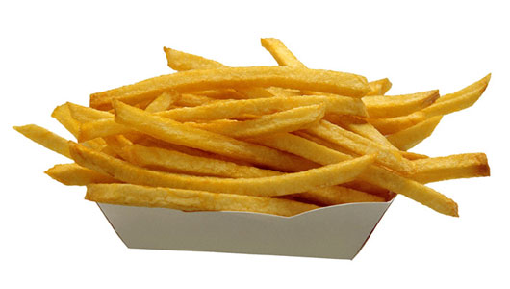
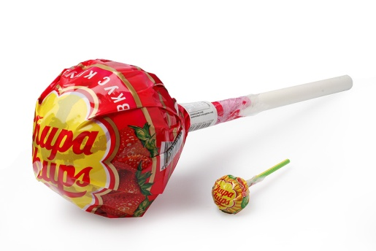
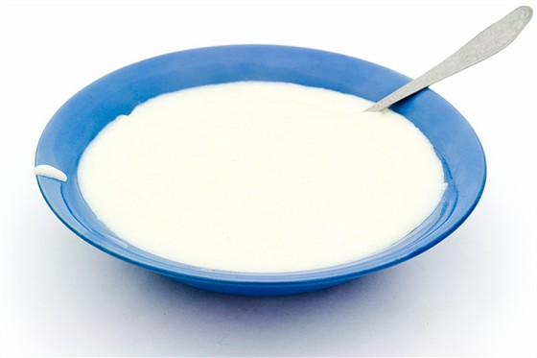
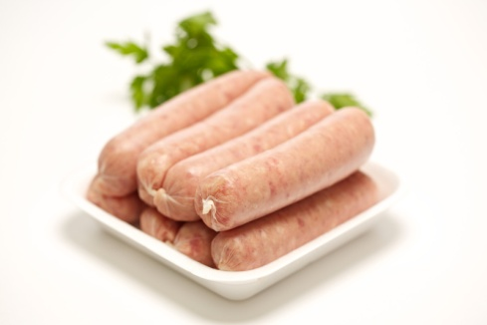
Which foods do you think are good for you?

Slide 11
HEALTHY FOOD | NOT VERY HEALTHY FOOD
Milk Cheese Soup Porridge Vegetables Fruit Juice | Sausages Hamburger Fry potatoes Chips Sweets Cola Cake

Slide 12
We need healthy food to stay healthy. Good food has a lot of vitamins, protein and minerals.

Slide 13
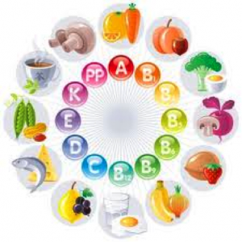
Vitamins
are important for
your body.

Slide 14
Protein helps you to grow and give you energy.

Slide 15
Minerals make your bones and teeth strong.

Slide 16
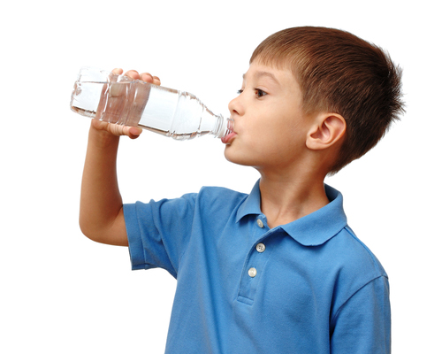
Water is important for your blood.
Drink lots of water every day!

Slide 17
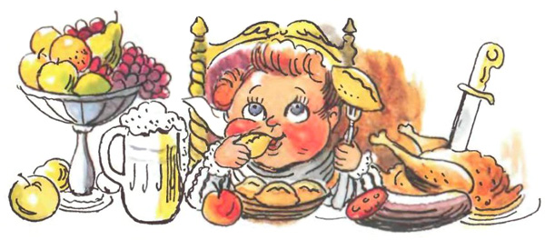

Slide 18
Listen and complete the text. Use these words.
sugar, diet, vitamins, protein, fat, vegetables, minerals
I eat healthy food. I drink milk for ___.
I don’t eat lots of cake. Cakes have lots of ___. Sometimes I eat sausages. They have lots of good ___, but they’ve got ___. I eat lots of fruit and ___. There are different types of ___ in milk, vegetables, eggs, meat, cereals and many other foods. I eat soup every day. It’s very good for you. I drink lots of water every day. I have a healthy ___.

Slide 19
What is your favourite food?
How many meals you eat every day?
How often do you eat vegetables and salad?
How often do you eat fruit?
How often do you drink cola or other ‘fizzy’ drinks?
How often do you eat sweets?
Is your friend’s diet healthy?

Slide 20
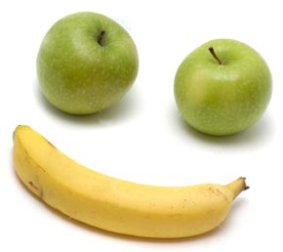
EAT WELL,
STAY HEALTHY!

