Slide 1
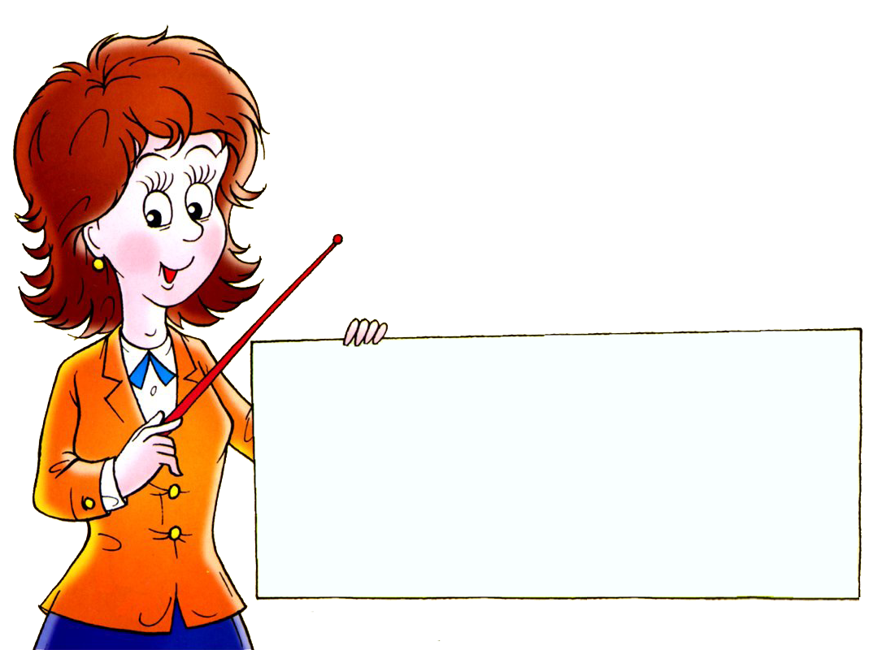
Множественное число существительных
(исключения)

Slide 3
Learn and Don’t Forget!
a man
men

Slide 4
Learn and Don’t Forget!
a woman
women

Slide 5
Learn and Don’t Forget!
a child
children

Slide 6
Learn and Don’t Forget!
a mouse
mice

Slide 7
Learn and Don’t Forget!
a foot
feet

Slide 8
Learn and Don’t Forget!
a tooth
teeth

Slide 9
Learn and Don’t Forget!
a fish
fish

Slide 10
Learn and Don’t Forget!
a sheep
sheep

Slide 11
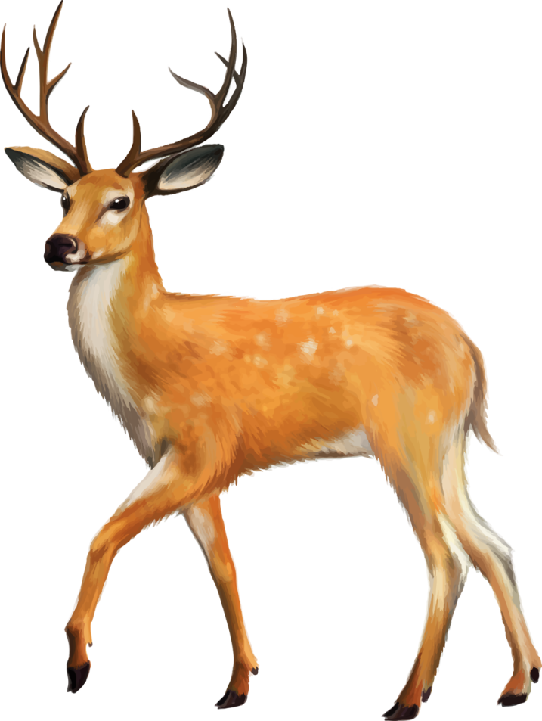
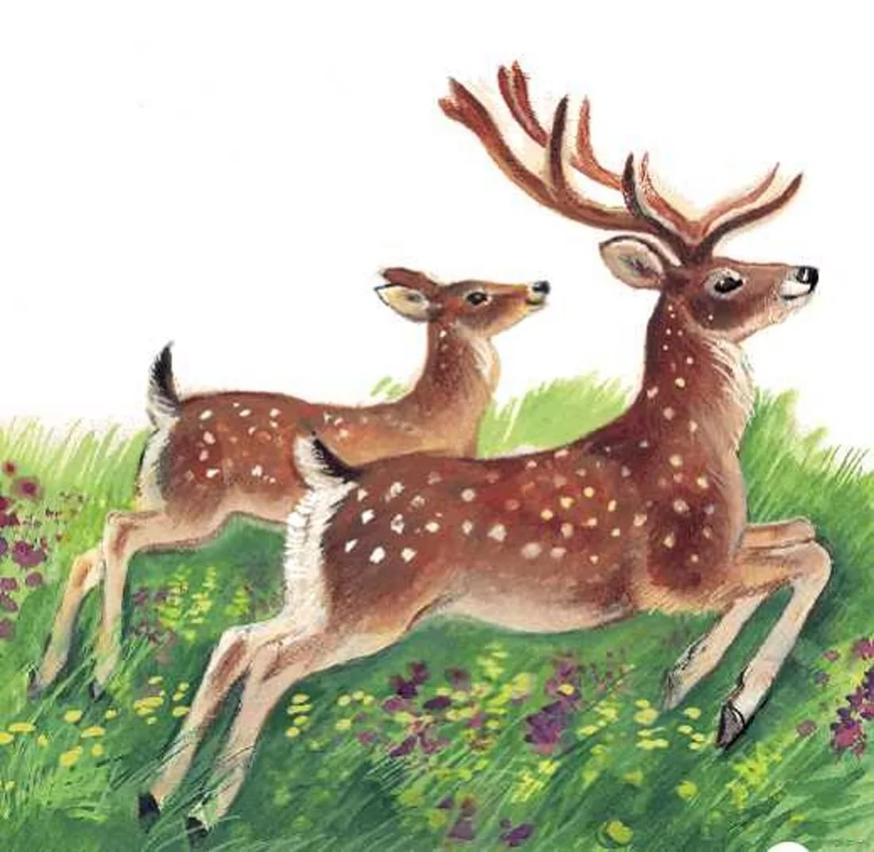
Learn and Don’t Forget!
a deer
deer

Slide 12
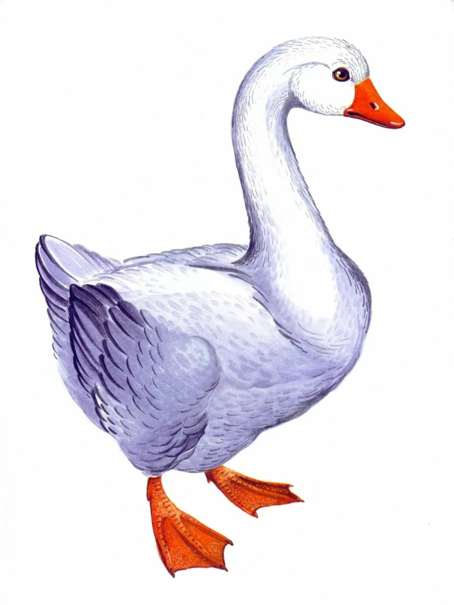
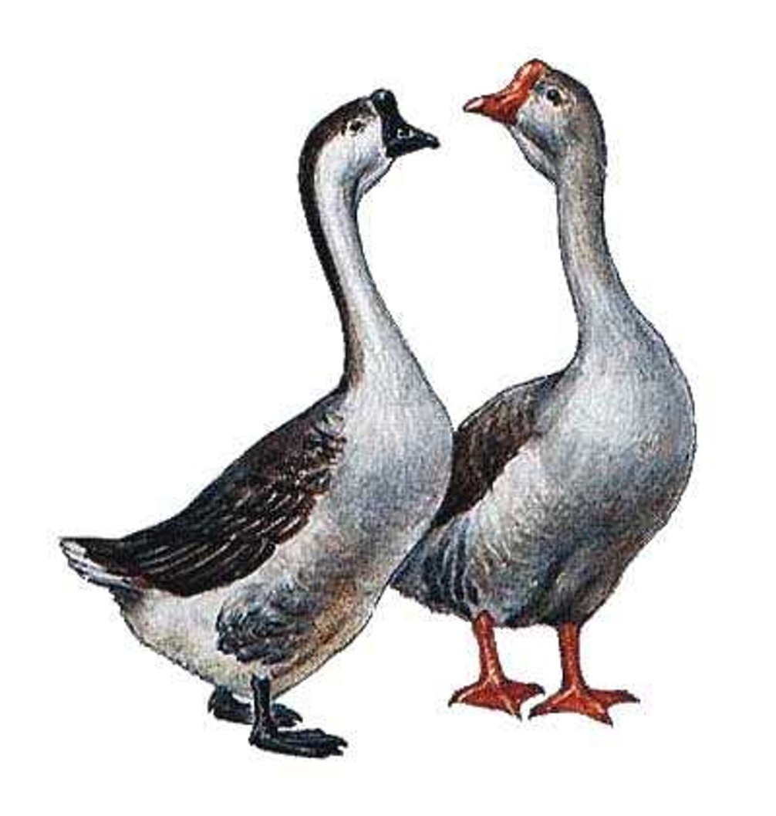
Learn and Don’t Forget!
a goose
geese

Slide 13
Read and Remember
a man – men
a woman – women
a child – children
a mouse – mice
a foot – feet
a tooth – teeth
a fish – fish
a sheep - sheep

Slide 14
Make up the words
man
a, m, n –
h, c, l, i, d –
w, m, n, o, a –
o, m, u, e, s –
i, s, f, h –
t, t, o, h, o –
s, e, h, p, e –
e, f, e, t
child
woman
mouse
fish
tooth
sheep
feet

Slide 15
Fill in the table
one | many | one | many
man |  |  | fish
 | women | cat
child |  |  | teeth
dog |  | foot
 | mice | sheep
men
fish
woman
cats
children
tooth
dogs
feet
mouse
sheep

Slide 16
Translate into English
2 -
7 -
5 -
10 -
3 -
6 -

Slide 17
Your homework
Book – page 50 ex.5 (читать, переводить, отвечать на вопросы).

