Slide 1
Student’s Book p. 118

Slide 4
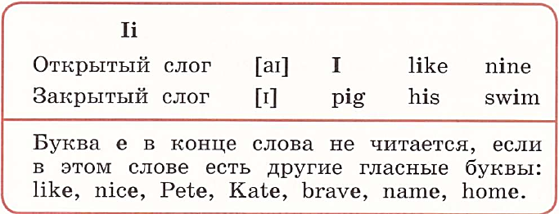

Slide 10
