Slide 1
Student’s Book p. 112

Slide 6
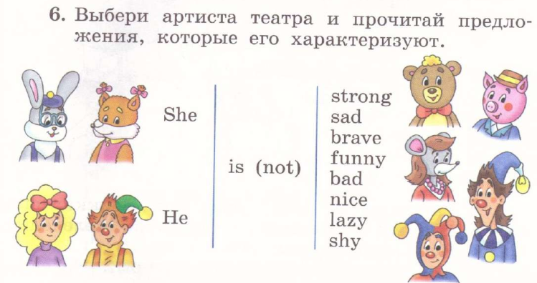

Slide 7
