Slide 1
Student’s Book p. 105

Slide 2
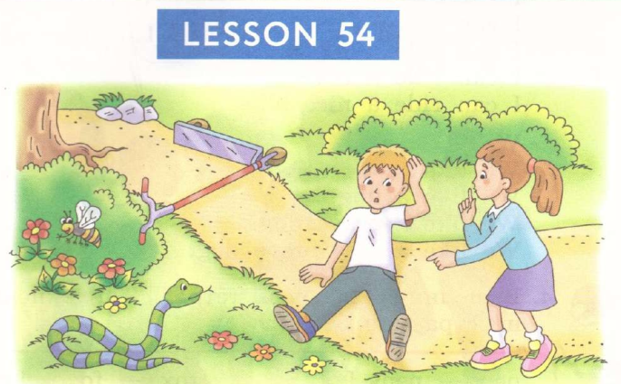

Slide 3
