Slide 1
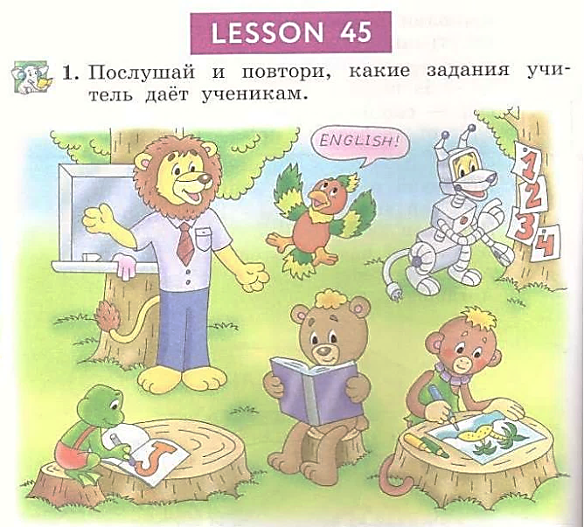
Student’s Book
p. 88

Slide 7
