Slide 1
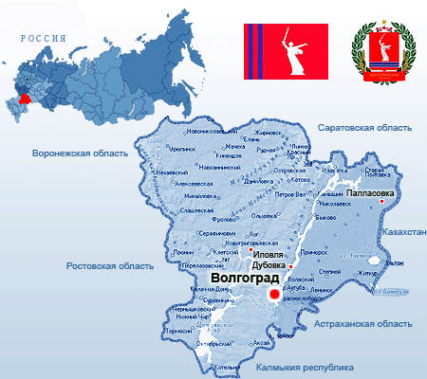
My Region. Project.

Slide 2
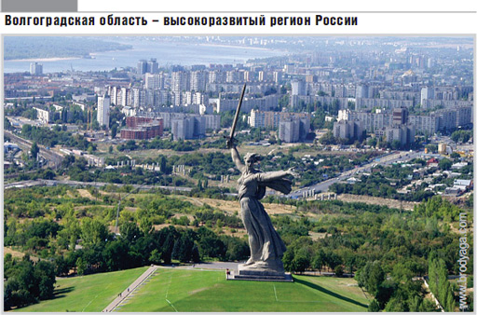
The project was done by
Xeniya Makarenko
Teacher E. Yu. Makarenko

Slide 3
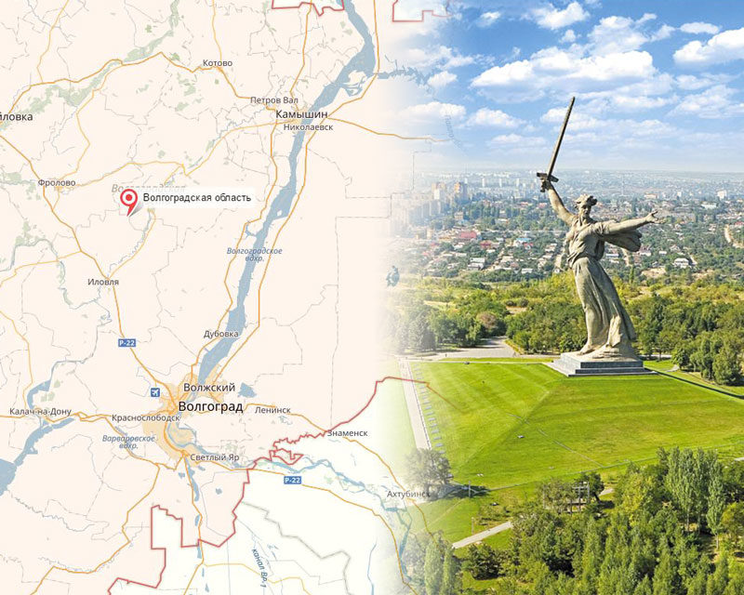
Aim
To tell about our region

Slide 4
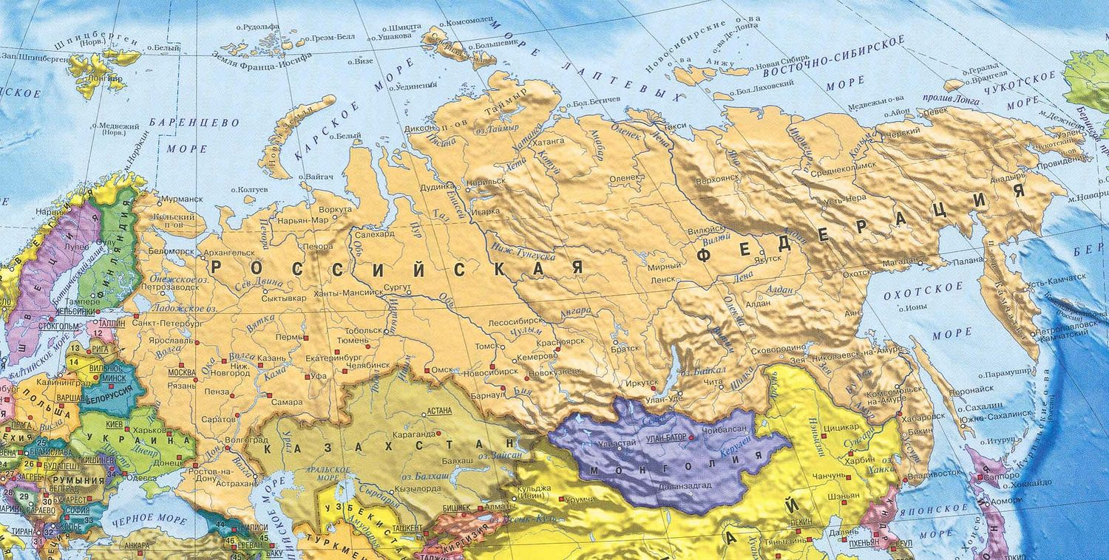
Tasks
To find information about our region
To present information

Slide 5
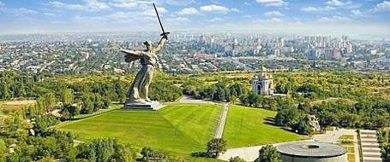
Hypothesis
Our region is the best.

Slide 6
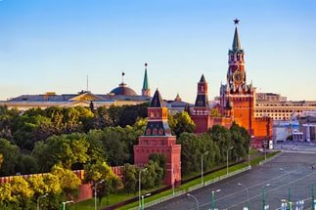
I live in Russia.
Russia is a big and beautiful country.

Slide 7
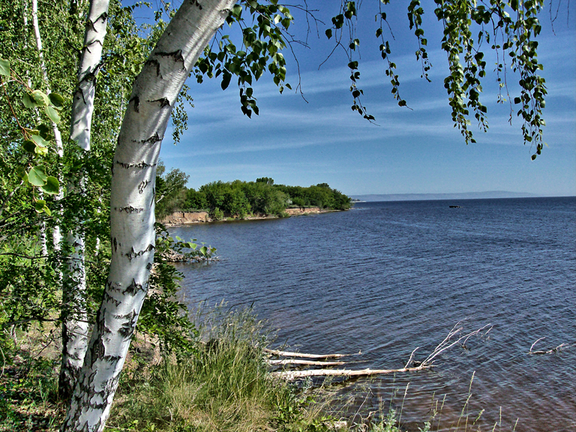
There are many beautiful forests, lakes, rivers in Russia .

Slide 8
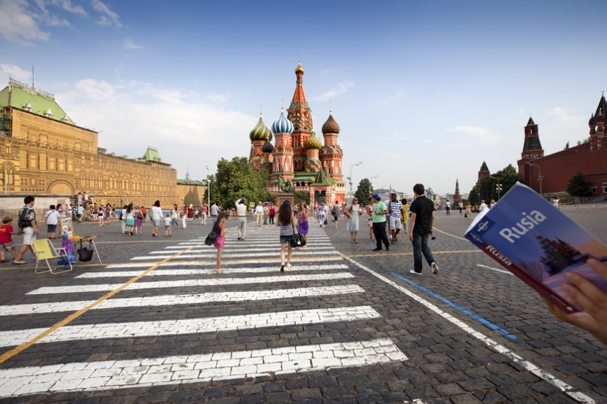
A lot of tourists visit our country every year.

Slide 9
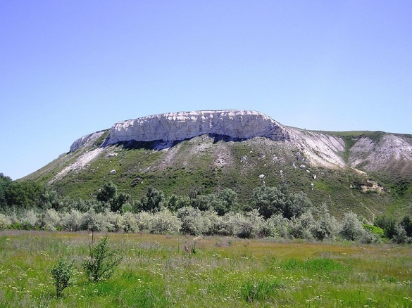
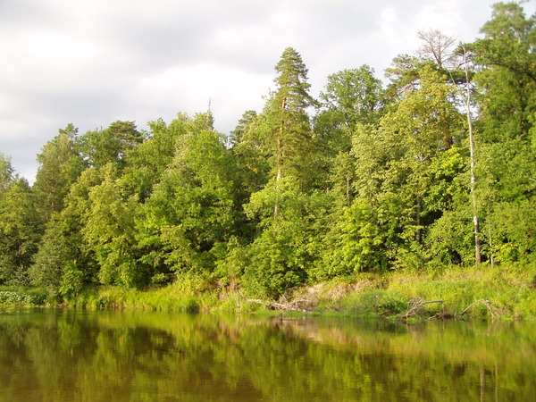
Volgograd Region
green and unique

Slide 10
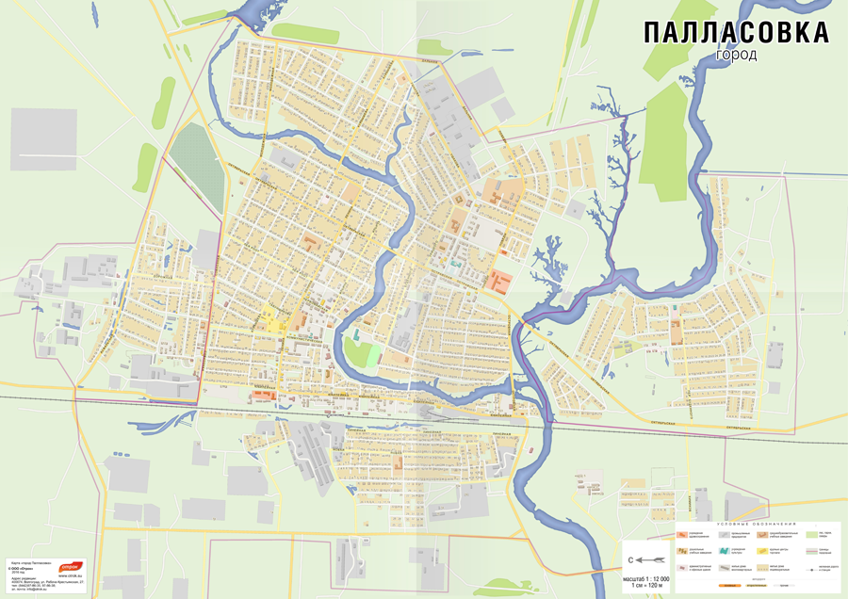
My hometown

Slide 11
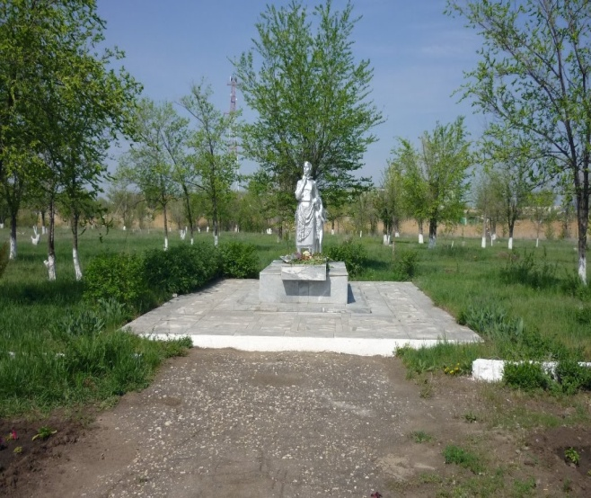
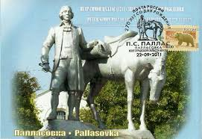
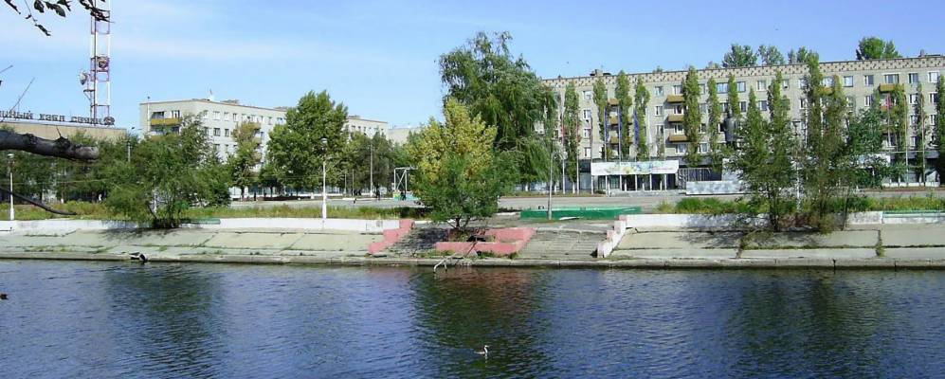
NICE PLACES IN PALLASOVKA

Slide 12
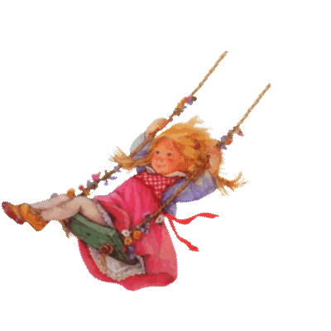
My favorite place is a park.

Slide 13
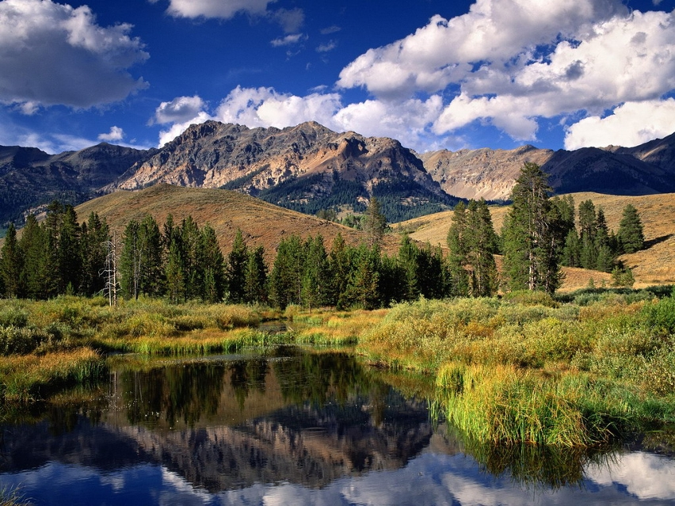
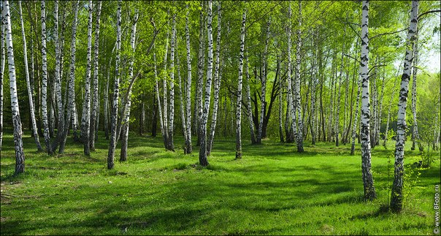
Conclusion
Our region is the best.

Slide 14
I love my country, my city very much.

Slide 15
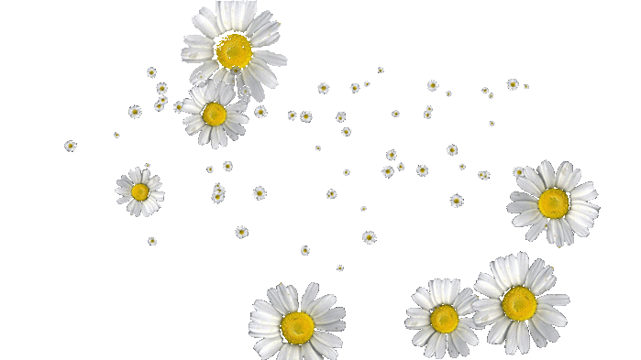
Thanks for attention!

