Slide 2
Self- assessment sheet
№ | Names of tasks | Your mark
1 | Scheme “Jobs” (work in group)
2 | Board game “What do these people do at their jobs?” (work in pairs)
3 | Listening “What are they going to be?” (individual work)
4 | Mini- project “Formal & Informal letter”
5 | Total mark
Rating scale
0-1 mistakes | 2-3 mistakes | More than 3 mistakes
“5” | “4” | “3”

Slide 3
What are we going to talk about?
We are going to talk
about
_____________________.

Slide 4
The aim of our lesson is to practise the topic “Jobs” (“Professions”)

Slide 5
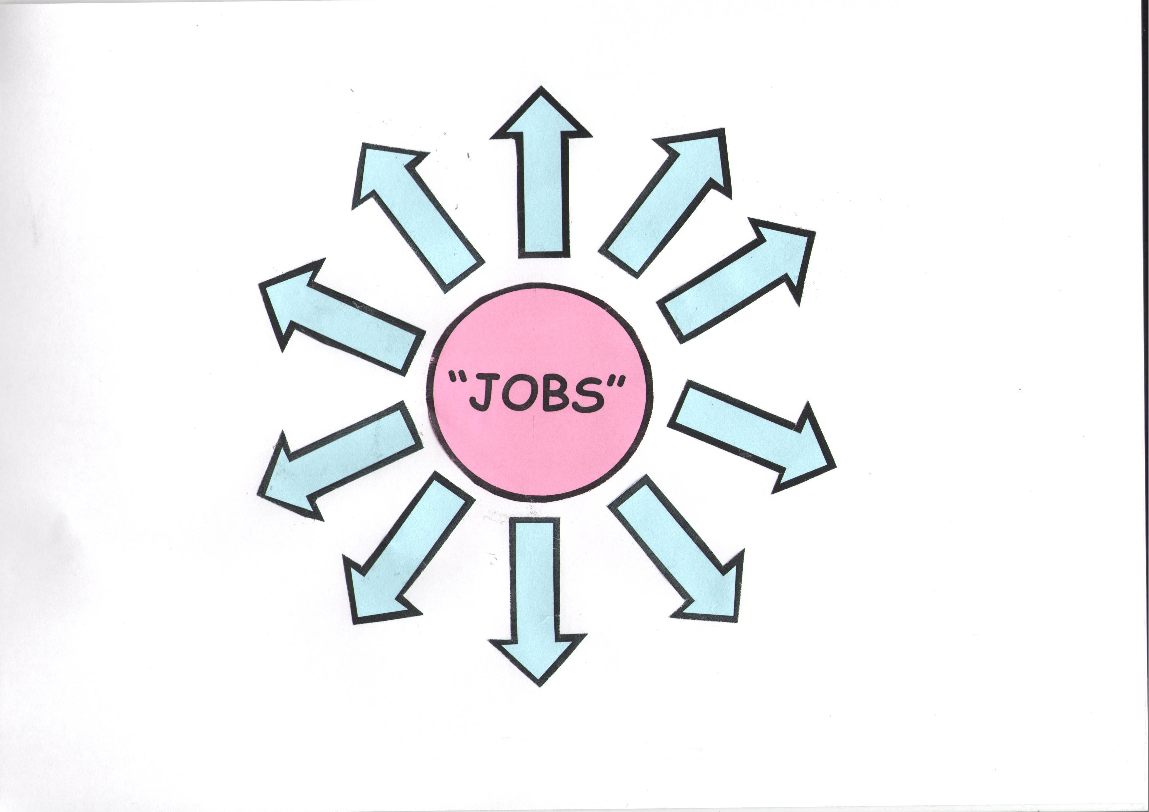
SCHEME “jOBS”

Slide 6
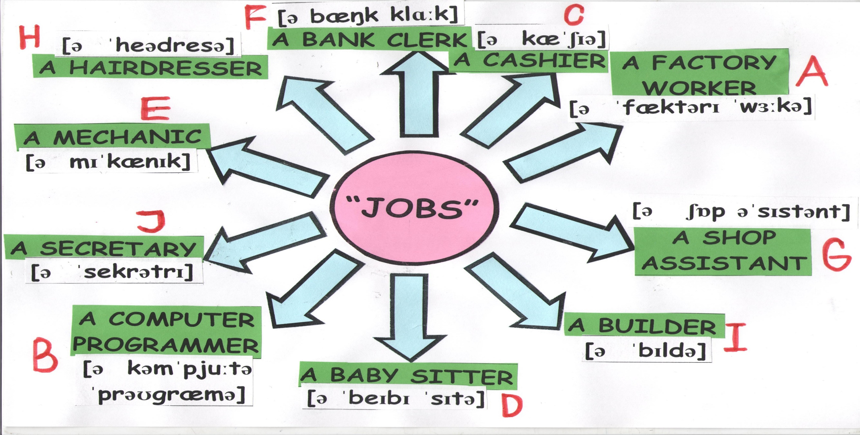
SCHEME “JOBS”

Slide 7
BOARD GAME
“Who does it?”

Slide 8
_________
is good
for me
because
I like to
__________.
Which job is good for you?
Why?

Slide 9
Let’s have a rest

Slide 10
Listening “what are they going to be?”

Slide 11
Listening “what are they going to be?
POLICE OFFICER | COMPUTER PROGRAMMER | LIBRARIAN | DOCTOR

Slide 12
Listening “what are they going to be?
POLICE OFFICER | COMPUTER PROGRAMMER | LIBRARIAN | DOCTOR
3 | 4 | 1 | 2

Slide 13
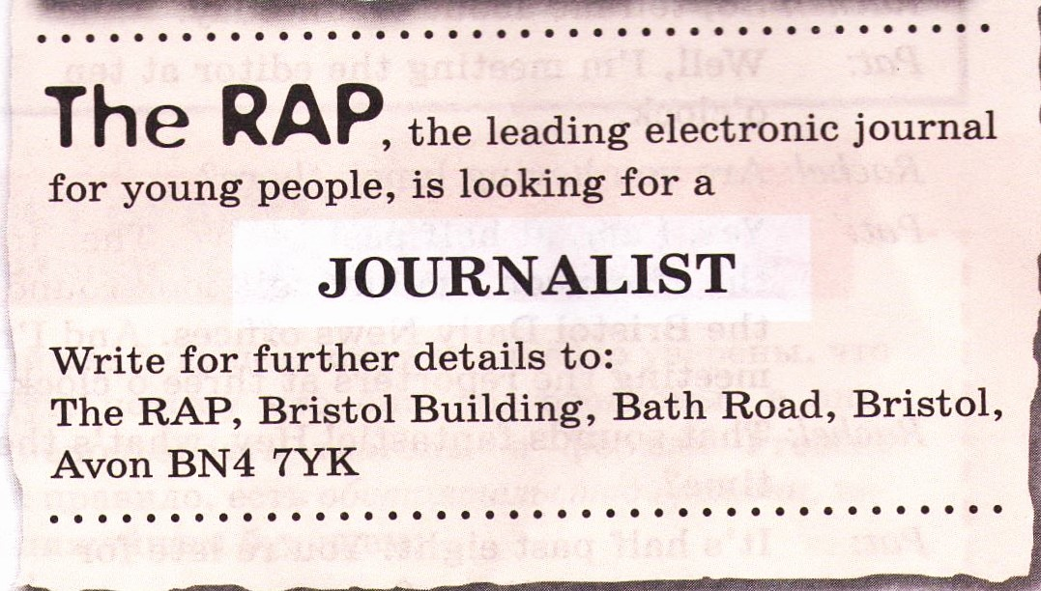

Slide 14
FORMAL LETTER | INFORMAL LETTER
This letter is written to a business, a collage, newspaper’s or journal’s agents. | This letter is a letter we would write to a friend or a family.
We must write our address and address of the newspaper’s or journal’s agencies, offices or colleges. | We should write our full or short address in the top right corner.
We use for greeting the words: Dear Sir\ Madam + (surname, family name), | We use for greeting the words: Dear +name,
In the main paragraph, we should write what we want. | In the main paragraph, we should answer our friend’s questions.
This letter we finish with sign off: Yours,\Your faithfully, and write your first name and family name under the sign off. | This letter we finish with sign off: Bye,\ Best wishes,\ Yours, and write only our first name under the sign off.

Slide 15
The aim of our lesson is to practise the topic “Jobs” (“Professions”)

Slide 16
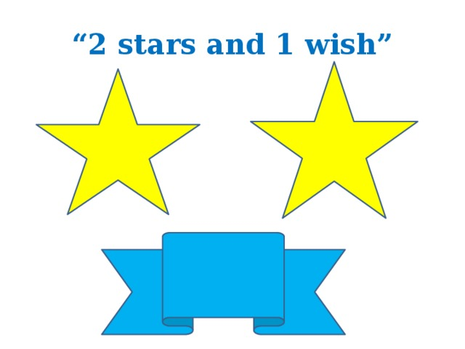

Slide 17
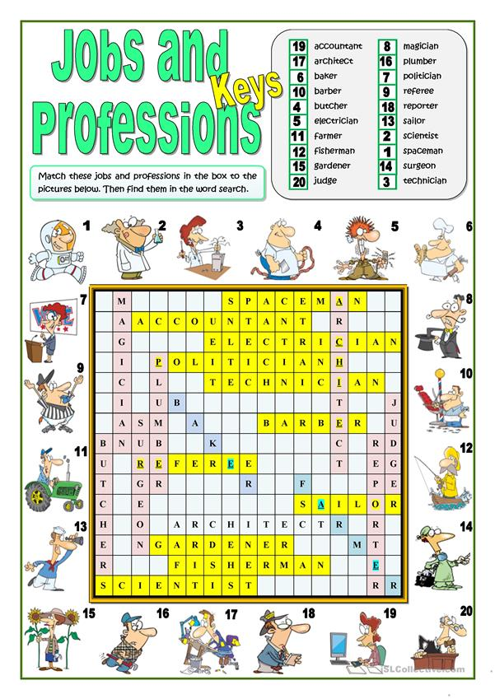
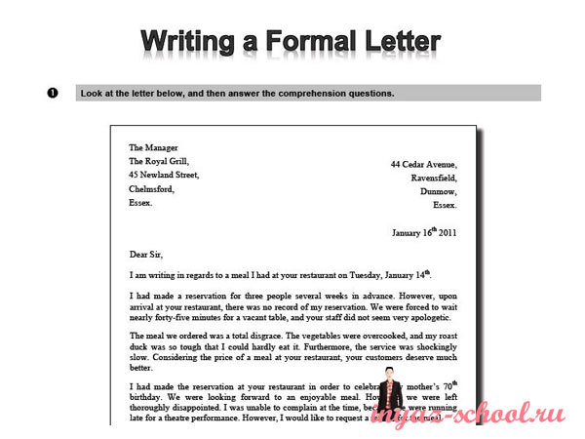
homework
make a crossword on the topic “Professions” (“Jobs”) using exercises 1 and 2 on page 24;
write a formal letter using Pat’s letter on page 25.

