Slide 1
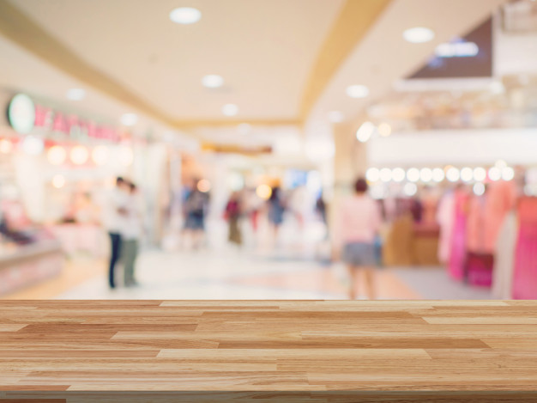
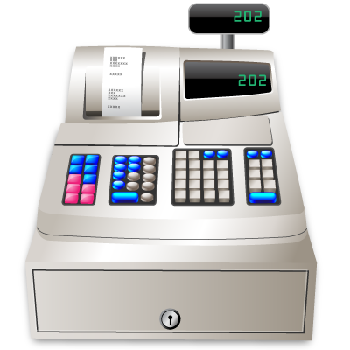
Hi! I would like a cup of tea and a piece of cake, please!
Good morning! How can I help you?
Just a second!

Slide 2
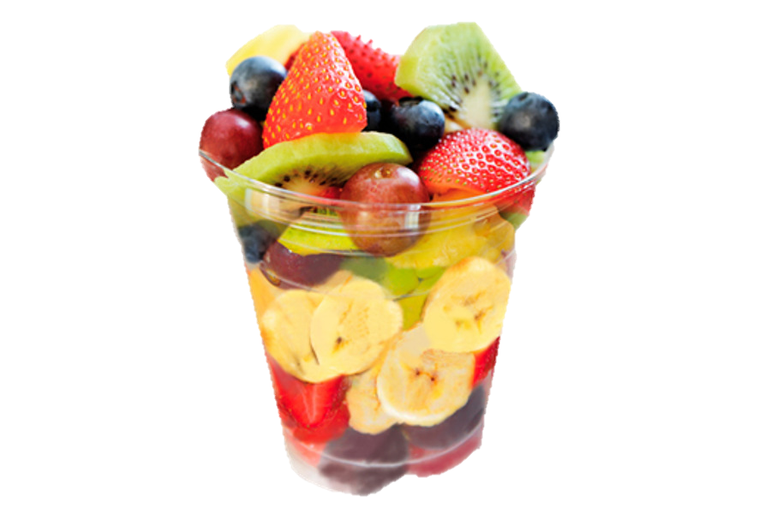
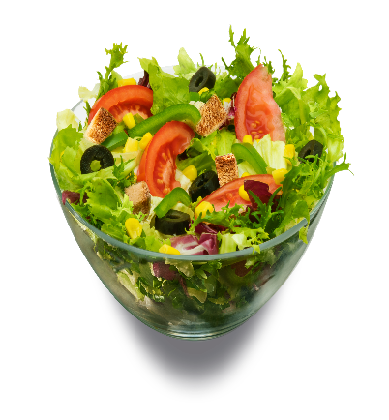
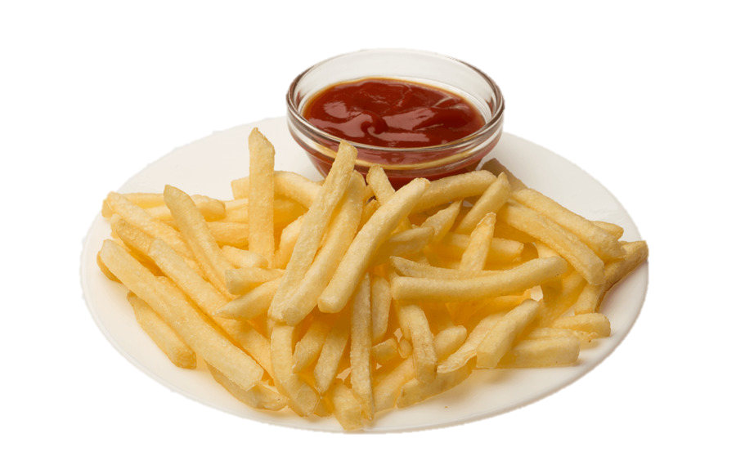
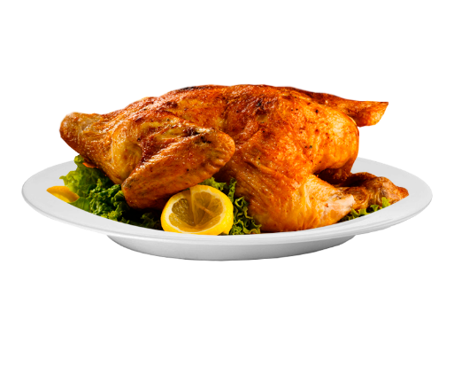
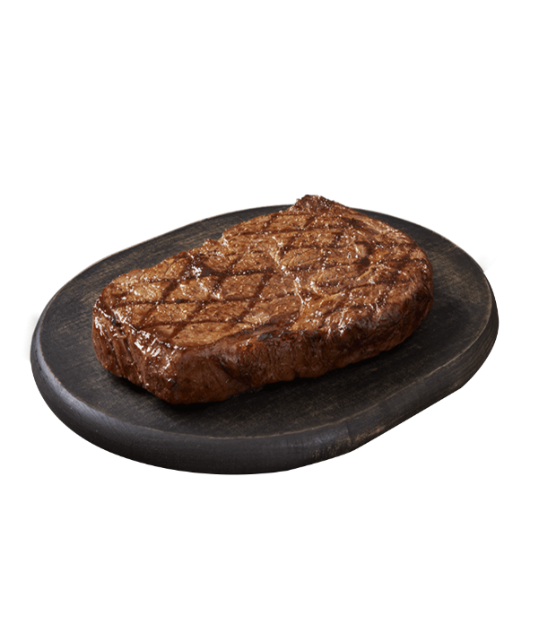
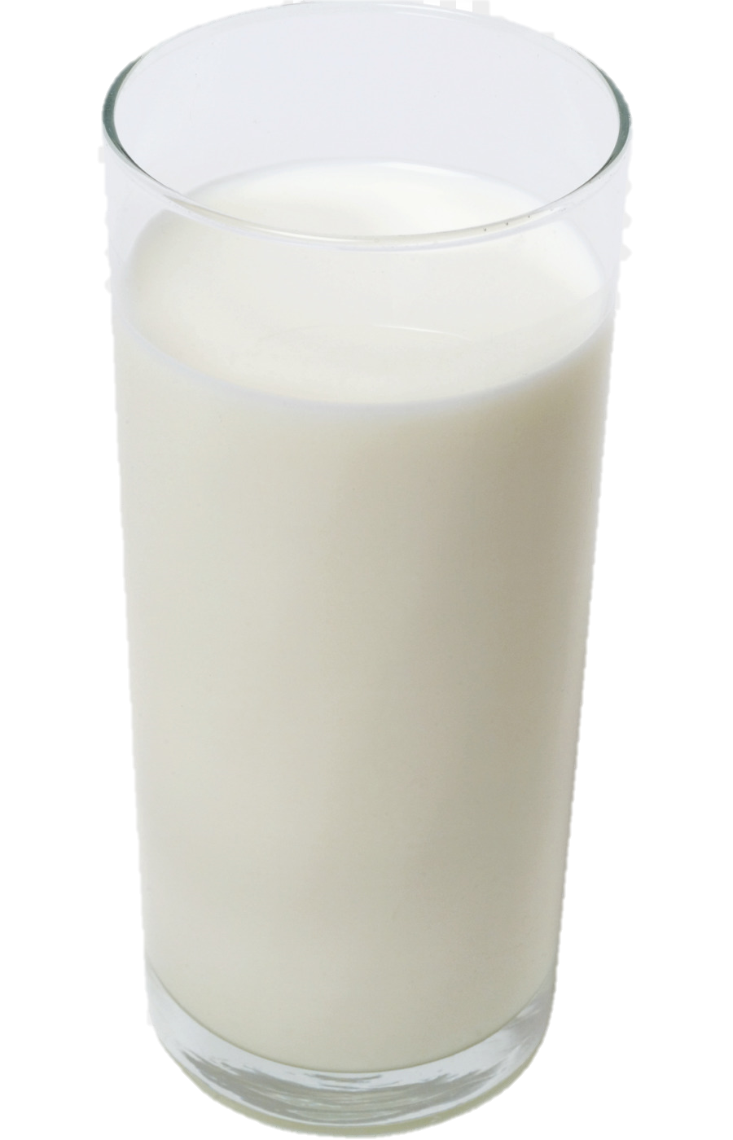
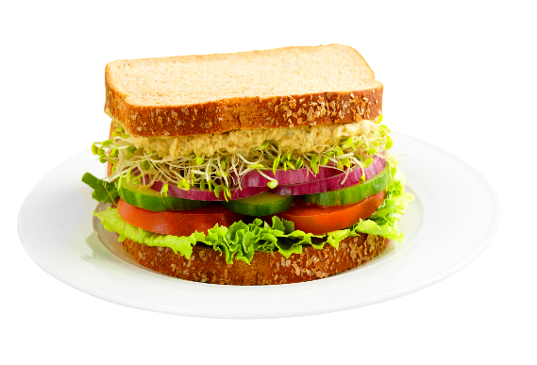
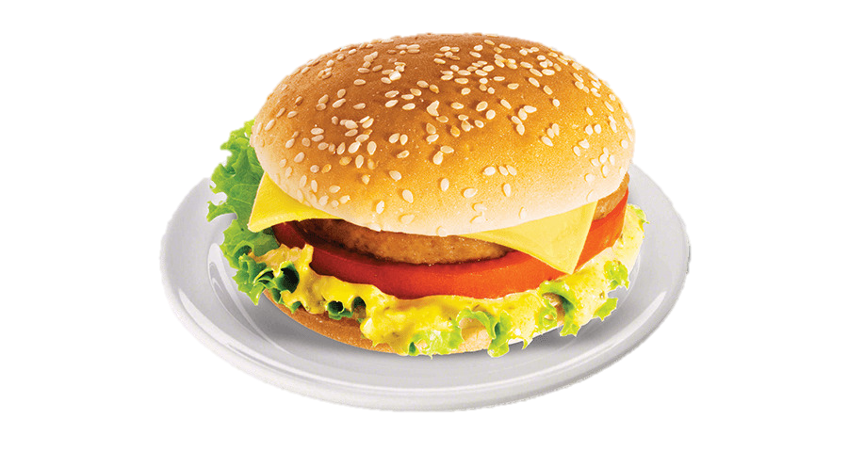
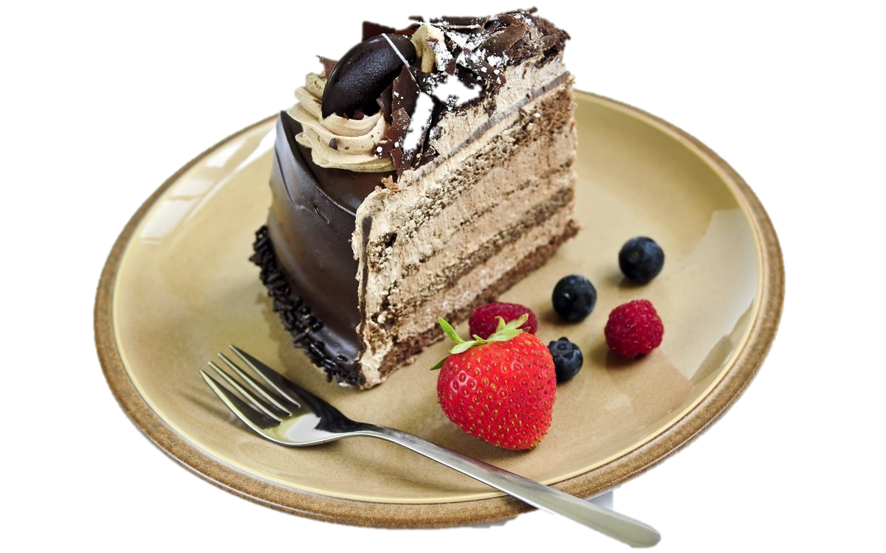
A cup of tea
A piece of cake

Slide 3
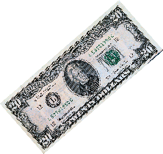
Thank you! Here you are!

Slide 4
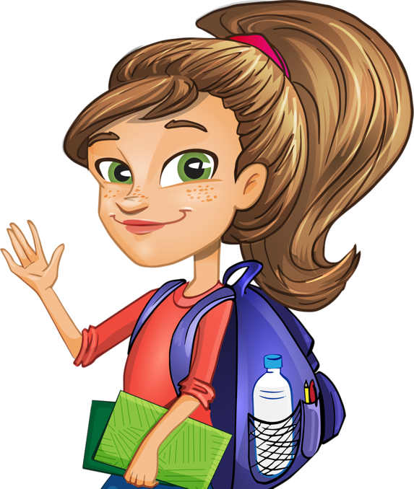
Hi! Fruit salad and a glass of orange juice, please!
Good morning! How can I help you?
Just a second!

Slide 5
Fruit salad
A glass of orange juice

Slide 6
Thank you! Here you are!

Slide 7
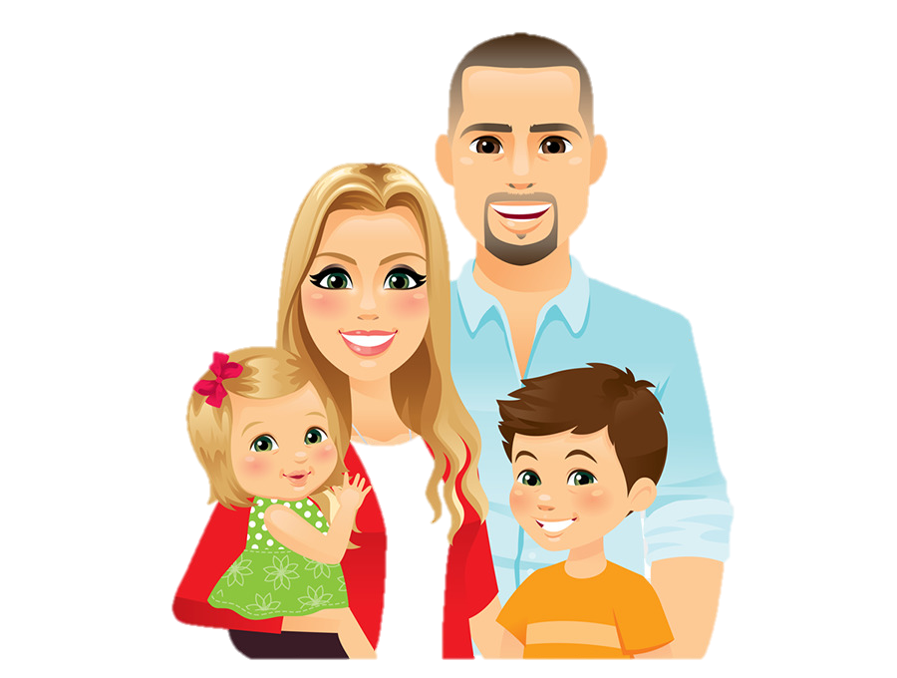
Hi! We would like a sandwich, a burger, some salad and a steak, please!
Good morning! How can I help you?
Just a second!

Slide 8
Sandwich
Burger
Salad
Steak

Slide 9
Thank you! Here you are!

Slide 10
Hi! Fried potato, chicken and a cup of coffee, please!
Good morning! How can I help you?
Just a second!

Slide 11
Fried potato
Chicken
A cup of coffee

Slide 12
Thank you! Here you are!

