Slide 1
Halloween Учитель: Свищева Э.Г.

Slide 2
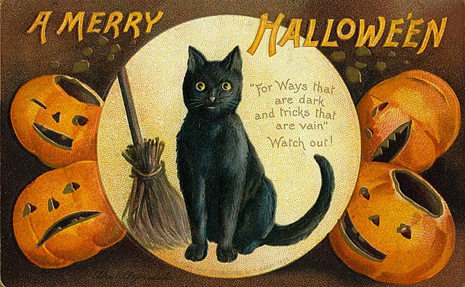

Slide 3
We celebrate Halloween on the 31st of October.

Slide 4
Symbols

Slide 5
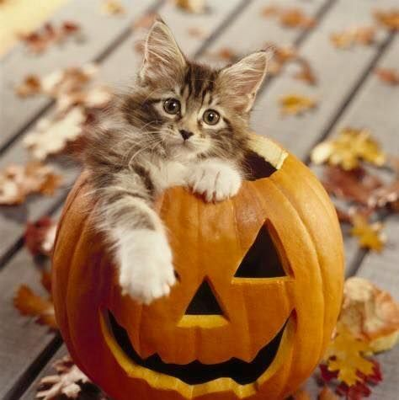
Pumpkin

Slide 6
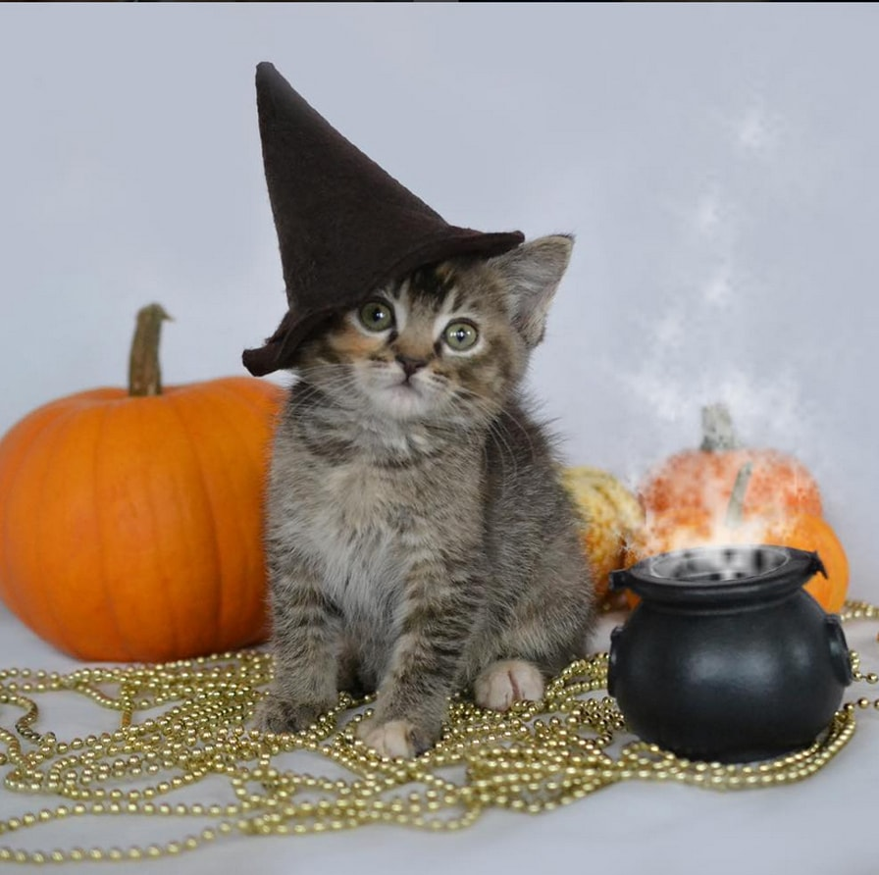
Costumes

Slide 7
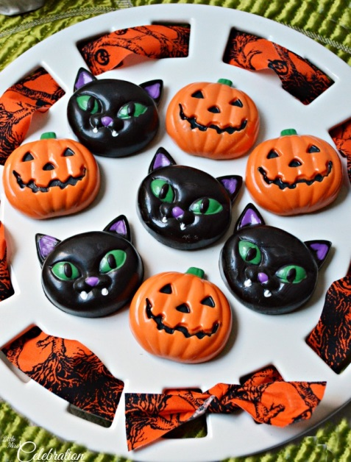
Sweets

Slide 8
