Slide 1
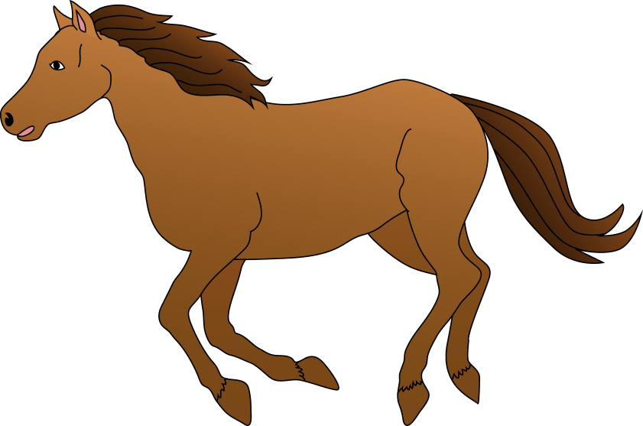
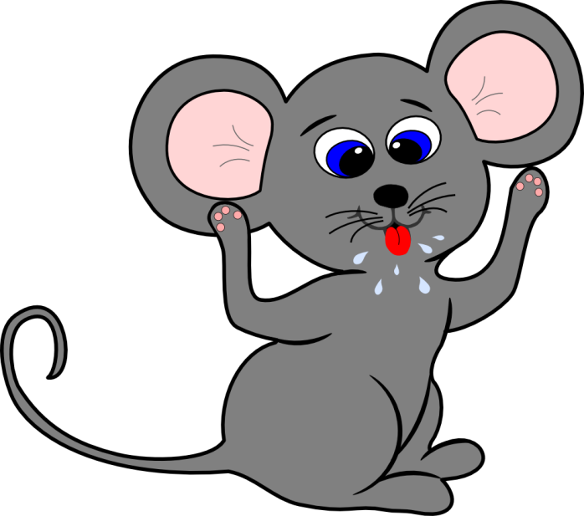
Pets

Slide 2
CAT

Slide 3
DOG

Slide 4
MOUSE

Slide 5
BIRD

Slide 6
RABBIT

Slide 7
FISH

Slide 8
HORSE

Slide 9
HAMSTER

