Slide 1
Clothes and Fashion

Slide 2
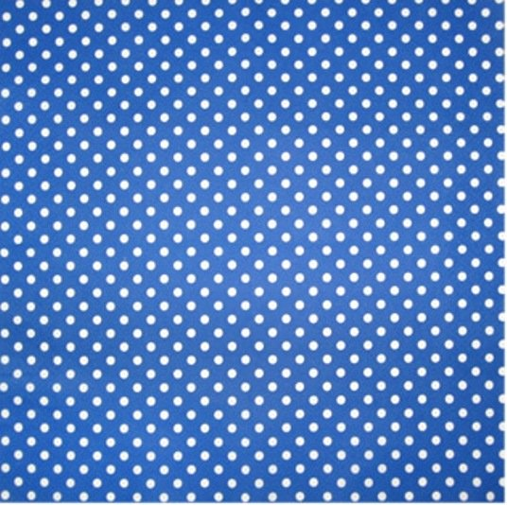
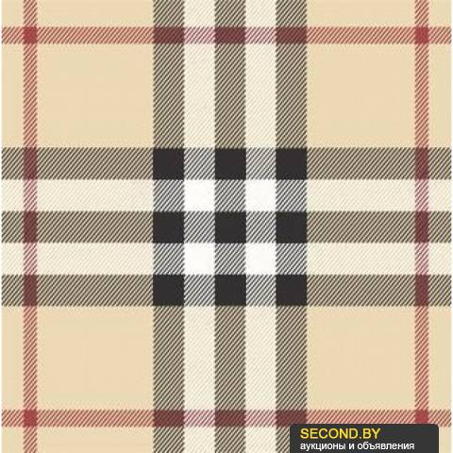
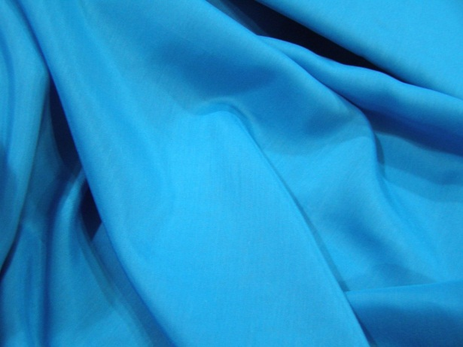
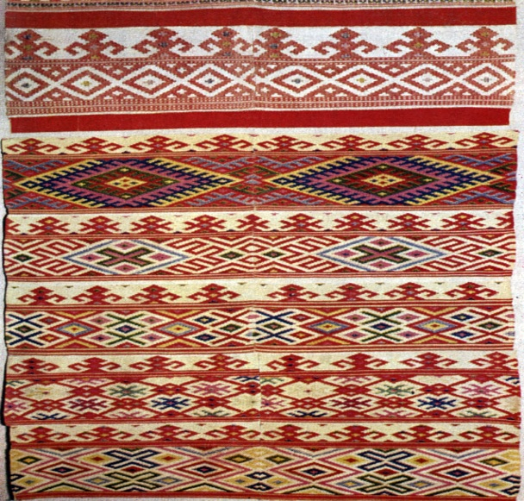
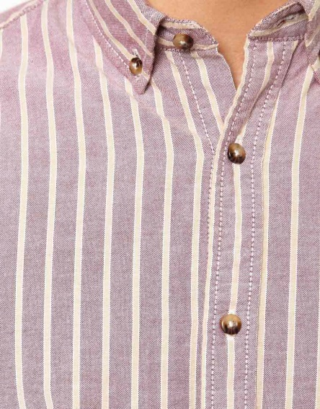
Pattern
Floral
Striped
Checked
Plain
Polka-dot
Patterned

Slide 3
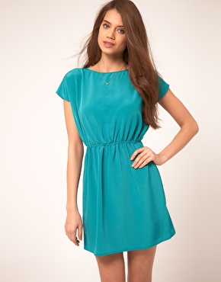
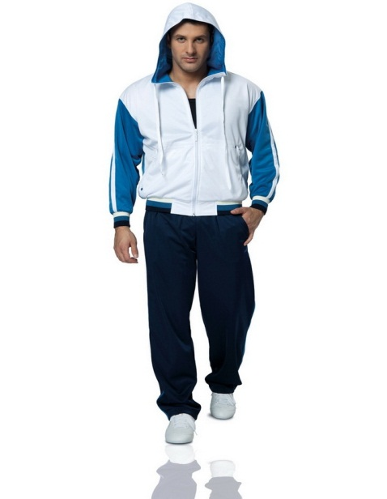
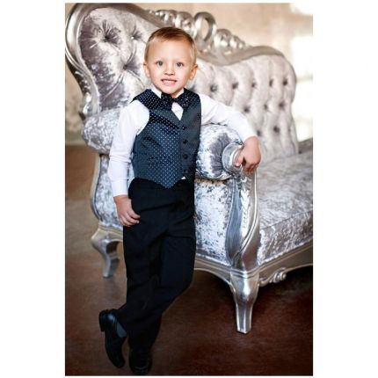
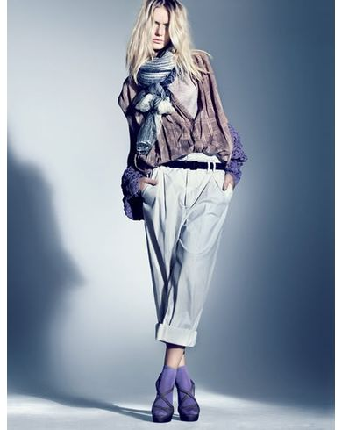
Style
Baggy
Elegant
Tight-fitting
Loose-fitting
Casual
Smart
Sporty
Scruffy

Slide 4
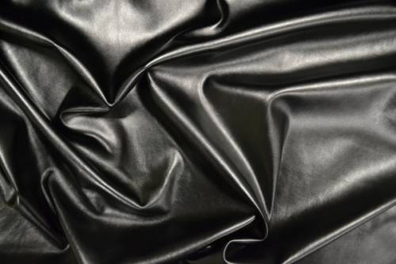
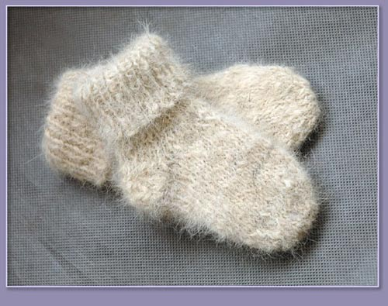
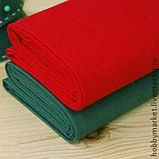
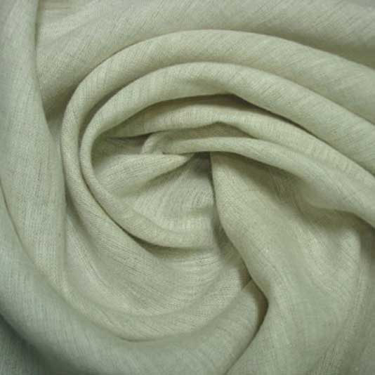
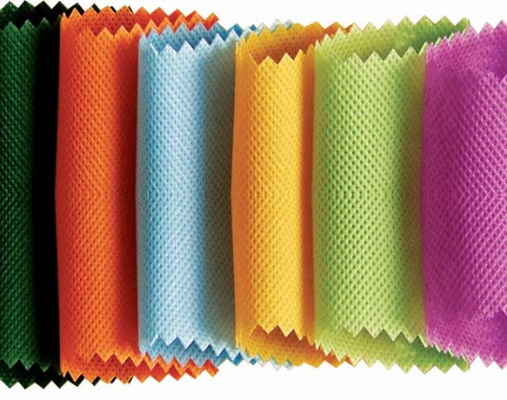
Material
Velvet
Leather
Silk
Cotton
Woolen
Nylon
Linen

Slide 5
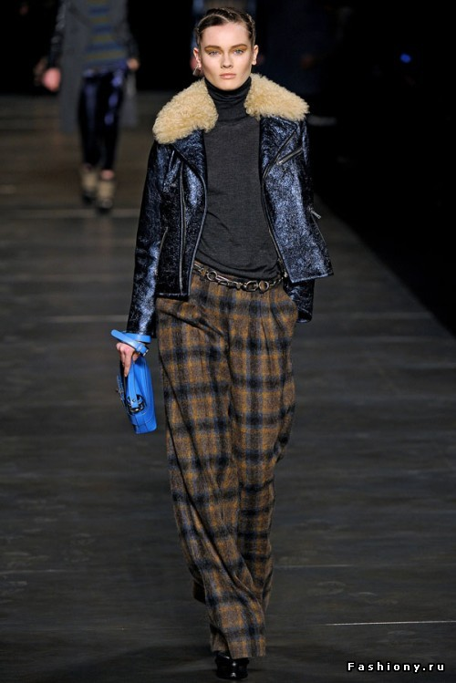
The man/woman in picture __ is wearing ____. He/she looks smart/classy/modern/ trendy/ fashionable/casual/ridiculous/old-fashioned/funny.
A)
B)

Slide 6
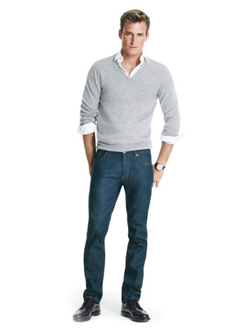
The man/woman in picture __ is wearing ____. He/she looks smart/classy/modern/ trendy/ fashionable/casual/ridiculous/old-fashioned/funny.
C)
D)

Slide 7
The man/woman in picture __ is wearing ____. He/she looks smart/classy/modern/ trendy/fashionable/casual/ridiculous/old-fashioned/funny.
E)
F)

Slide 8
Маtch the verbs and their meanings:
To fit – to be the right shape or size for sth/sb
To suit – to make you look attractive
To match, to go with – to combine well
To try on – to put a piece of clothing to see if it fits and how it looks
To wear – to have sth on your body as a piece of clothing

Slide 9
Use the correct form of each word to fill in the blanks: fit, match, suit, wear, try, go
1. A: How about those trousers? They ........... you perfectly.
B: Yes, but they're too casual for the occasion.
2. A: What about the red shirt? It ..................... your trousers.
B: You are right! I haven't ................ it for ages.
3. A: This dress is great. Why don't you ...........…. it on?
B: The colour doesn't ................ me.
4. A: What do you think of this shirt?
B: It doesn't ............... with the trousers.
5. A: What about these two colours? Do you think they .................?
B: Sure!
6. A: That coat really .................. Bill.
B: I don’t think so!

Slide 10
Pattern Floral Striped Checked Plain Polka-dot Patterned | Style Baggy Elegant Tight-fitting Loose-fitting Casual Smart Sporty Scruffy | Material Velvet Leather Silk Cotton Woolen Nylon Linen

