Slide 1
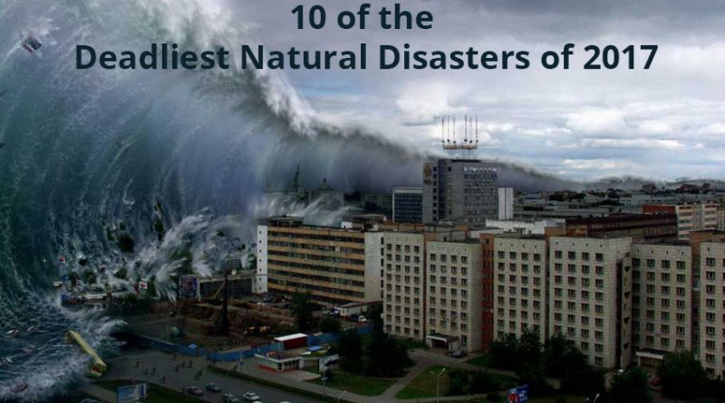

Slide 2
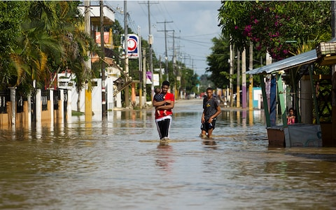
1. Hurricane Maria in the Dominican Republic.
Local residents wade through the flooded streets of Arenoso, Dominican Republic, on 24 September 2017 after Hurricane Maria, a major Atlantic hurricane of the 2017 season.

Slide 3
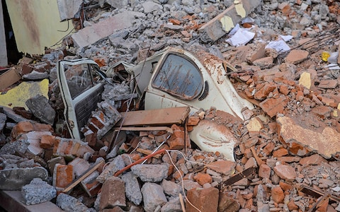
2. Earthquake in Mexico.
A car crushed by rubble is seen outside a collapsed house after a magnitude 7.1 earthquake rocked Mexico on 20 September 2017, killing more than 200 people.

Slide 4
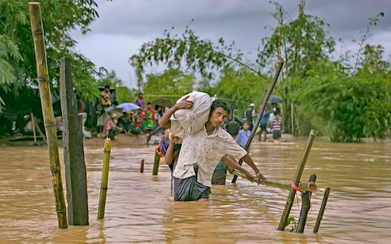
3. Monsoon flooding in Bangladesh.
Refugees cross a flooded bridge in the Balukhali Rohingya refugee camp in Bangladesh after monsoon rain caused devastation in parts of India, Bangladesh and Nepal, killing more than 1,200 people this summer. Aid agencies are calling the floods one of the worst regional humanitarian crises in years with more than 40 million people affected.

Slide 5
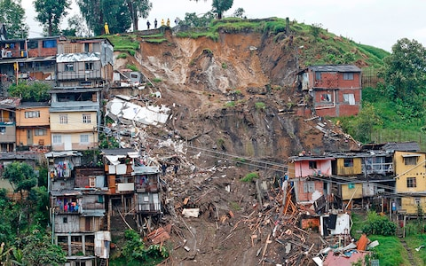
4. Mudslide in Colombia
A deadly mudslide killed at least 200 people in Mocoa, Colombia in early April 2017. Two weeks later dozens of hillsides gave way in Manizales, pictured.

Slide 6
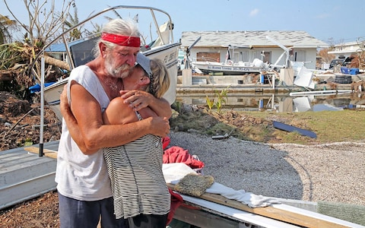
5 Hurricane Irma in the USA and Caribbean.
David and Dee Thorne hug near the remains of their home following Hurricane Irma in the Florida Keys on 20 September. Irma, a category five storm, was the most powerful Atlantic storm in a decade and caused widespread destruction across the Caribbean and the southern US.

Slide 7
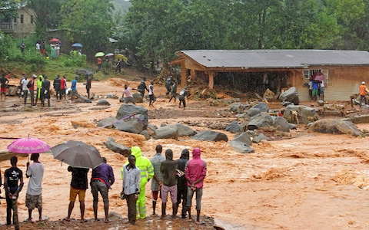
6. Flooding and landslides in Sierra Leone.
Bystanders look on as floodwaters rage past a damaged building in Freetown, Sierra Leone on 14 August 2017. At least 312 people were killed and more than 2,000 left homeless when heavy flooding and landslides hit Sierra Leone’s capital.

Slide 8
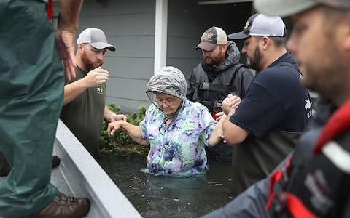
7 Hurricane Harvey in the USA.
Rescue workers help a woman from her home after Hurricane Harvey caused extreme flooding in Port Arthur, Texas. Harvey, which first hit on 25 August 2017, is the most powerful hurricane to hit Texas in more than 50 years.

