Slide 1
“Welcome to Great Britain”
“The United Kingdom of Great Britain and Northern Ireland”

Slide 2
Great Britain is a country of amazing beauty, with a rich history and centuries-old traditions.
The birthplace of many outstanding figures and an internationally tourist center.
Great Britain is a royal family, original culture and customs, ancient architectural sights, haunted family castles, chapels and cathedrals, ancient universities, lively cities and villages that have not changed over the centuries.

Slide 3
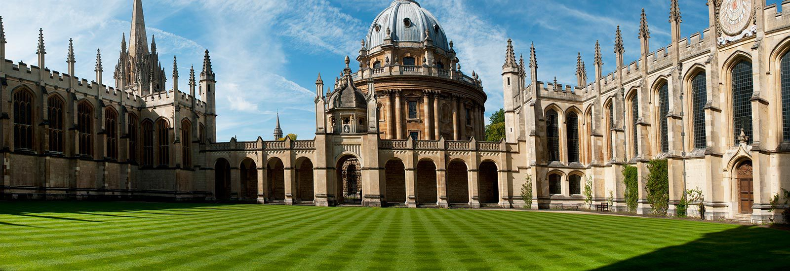
Oxford University
It the oldest university in the English-speaking world

Slide 4
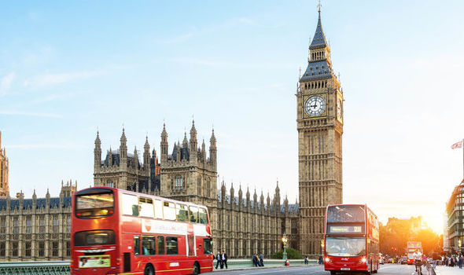
Big Ben
Big Ben is the nickname for the Great Bell of the clock of the Palace of Westminster in London

Slide 5
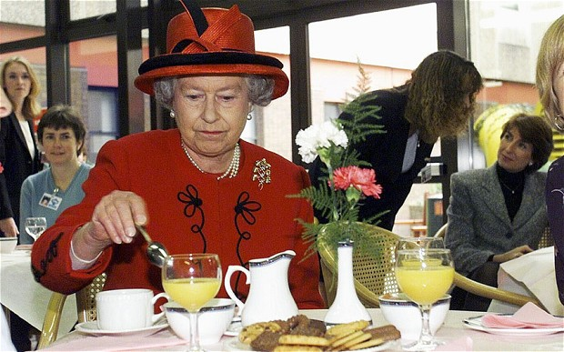
«Five o’clock Tea»

Slide 6
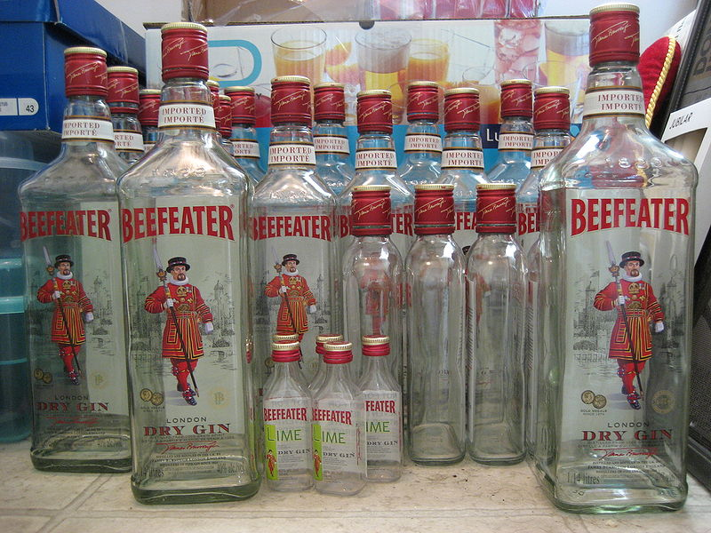
Beefeater — английский Джин
Beefeater Gin is a brand of gin owned by Pernod Ricard and bottled and distributed in the UK, by the company of James Burrough. Beefeater remained in the Burroughs's family control until 1987.

Slide 7
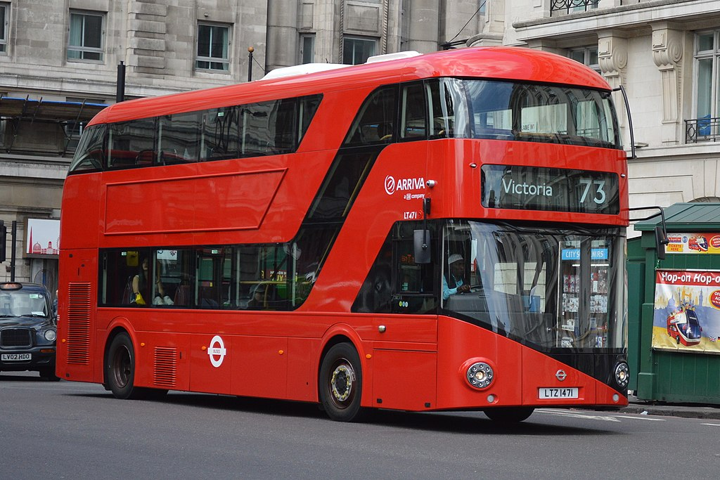
A double-decker bus
is a bus that has two storeys or decks. Double-decker buses are used for mass transport in the United Kingdom, Europe.

Slide 8
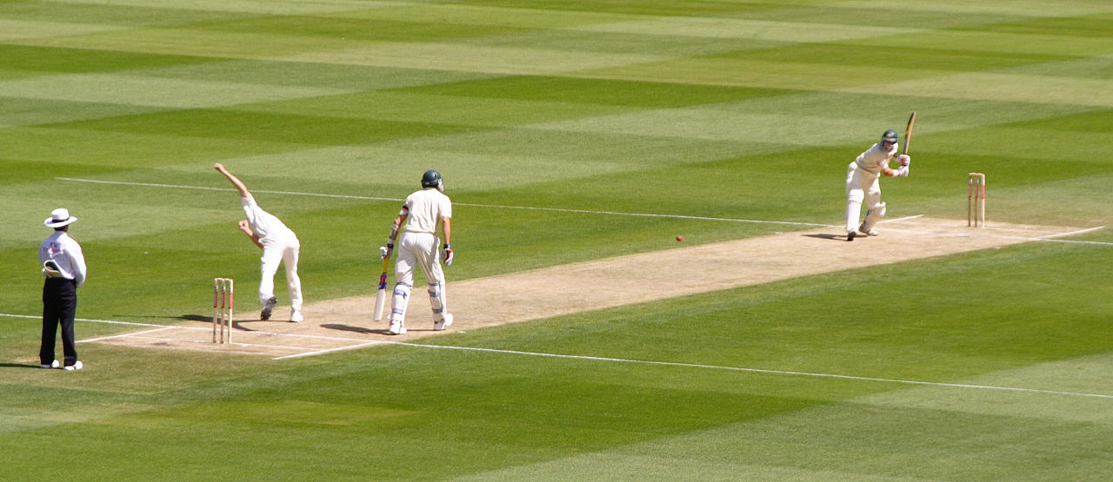
Cricket
Cricket is a bat - and – ball game played between two teams of eleven players on a field. It is the ancient and nationalities sport game in England.

Slide 9
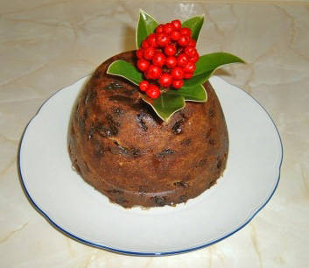
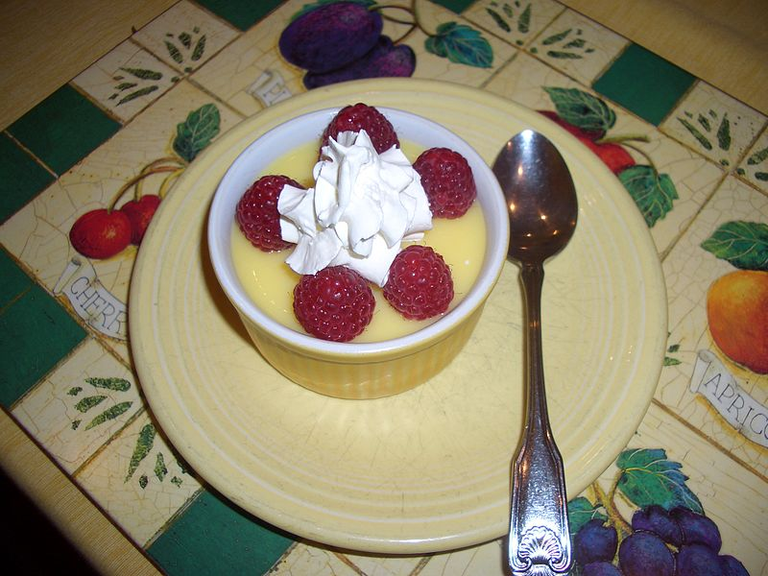
Pudding (English Pudding)
English dessert of eggs, sugar, milk and flour, cooked in a water bath. Fruits or spices are added to the pudding. In England pudding was considered as a dish of the Christmas table.

Slide 10
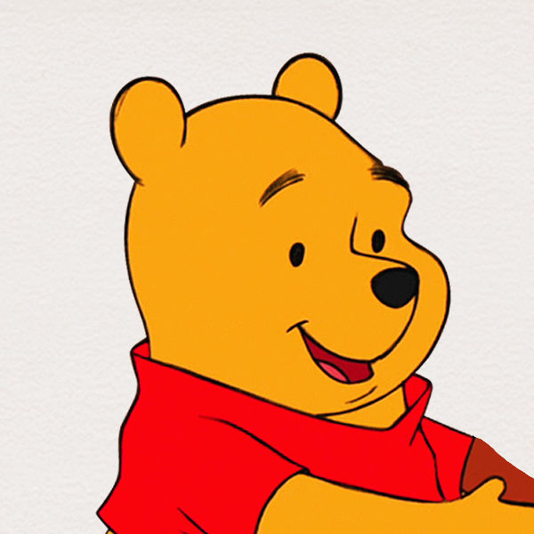
Winnie-the-Pooh
Is called Pooh Bear, is a fictional teddy bear created by English author A. Milne.

Slide 11
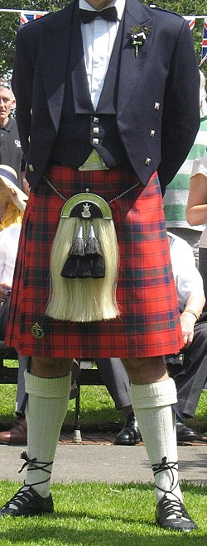
Kilt
is a type of knee-length skirt with pleats at the back, originating in the traditional dress of men and boys in the Scottish Highlands . It is first recorded in the 16th century.

Slide 12
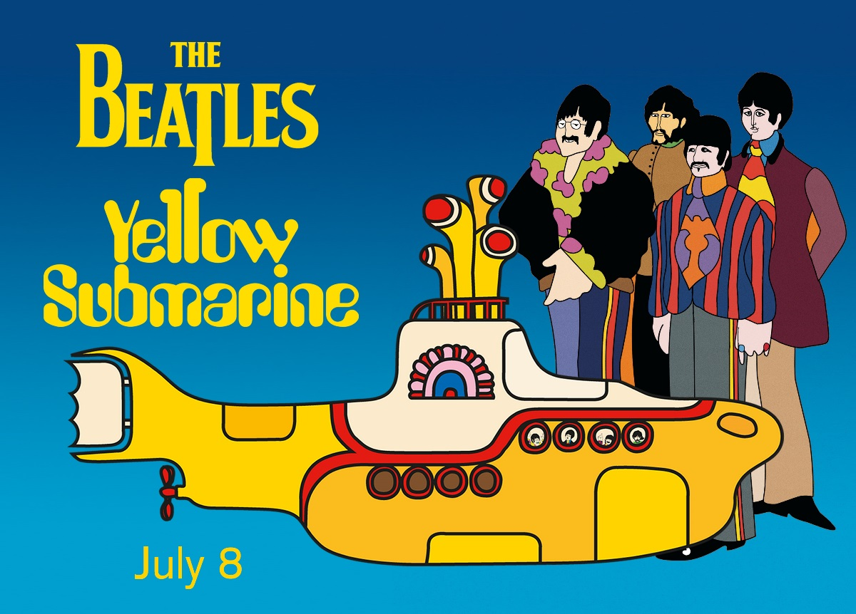
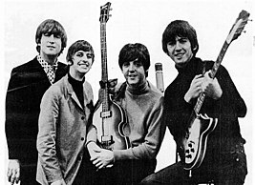
"Yellow Submarine"
is a 1966 song by the Beatles, written by Paul McCartney and John Lennon. The single went to number one on every major British chart.

