Slide 1
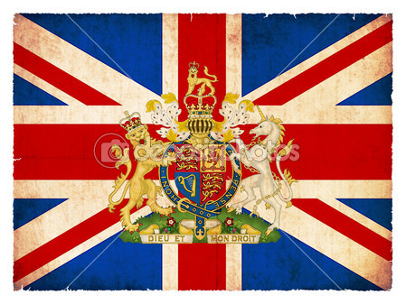
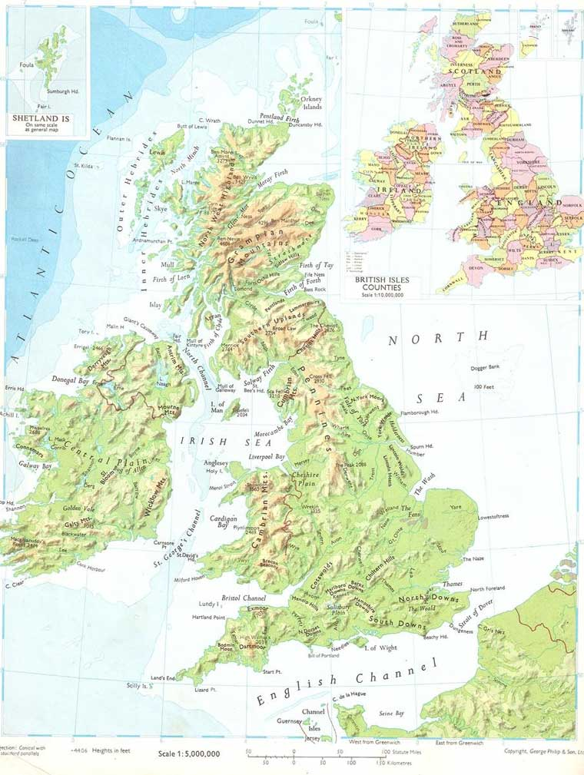
England
Myths and legends

Slide 2
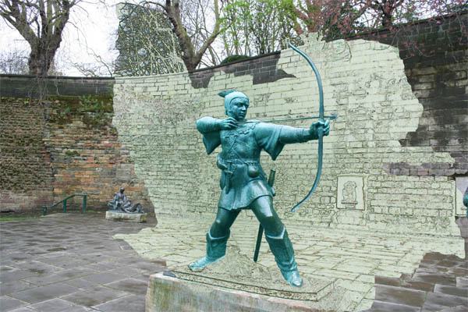
Robin Hood Notingham
This hero is known all over the world as the best bower, who robbed rich persons and gave money to poor ones. But never the less, not each person know him very well. His name associats with England, as well as tea and cookies.
However, we don’t know about him so much indeed. So, you can put on your green suit and go to Notingham to find out this magic hero by yourself. Maybe, you’ll see this boy next to the biggest oak-tree in the Sherwoods forest.

Slide 3
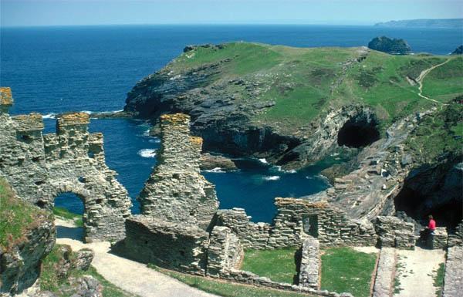
Tintagel, Cornwell
King Author was born in this wild, magic, picturescue places. It’s worse to visit these wonderful English highlands to see your own eyes that Author’s native motherland.
These are Tintagel’s seasides. A midleaged historic Jeffry Monmootskiy said, that in these very places the king Author was born.
In addition to say, nearby those places there was the Marlin’s cave.
Nowadays, this destroyed castle is the best romantic place for young men and who loves romantic.

Slide 4
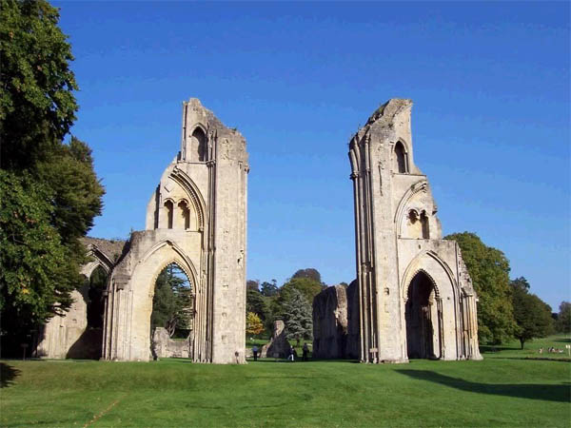
Glastoneberry, Sommerset
Glastoneberry is the super magic place. It’s among beautiful highlands where there are much sole energy.
They say, that the king Author was berried there. Young Jesus was there as well.

Slide 5
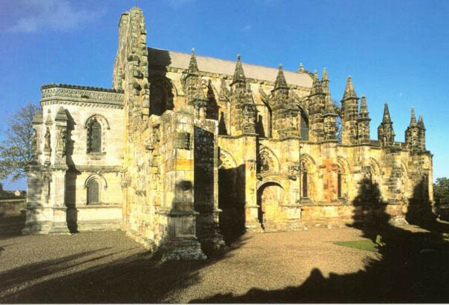
Rossling Church, Scotland
Long time ago, there were knights who refer to that church. People believed that there was St.Graal, which was shown in a famous film “ Cod Da Vinchi”.

Slide 6
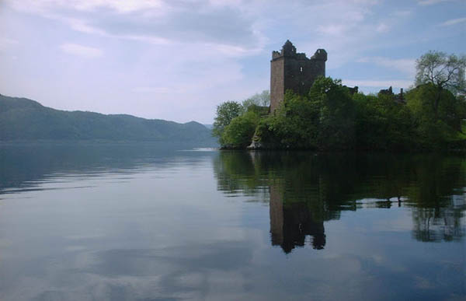
Monster of Loch- Ness, Loch-Ness,
Scotland Highlands.
It’s worse to say some words about Scotland. It’s famous all over the world for its Loch-Ness monster. This lake is also famous for its main aqueous resource of savourless water in Scotland.
Nobody saw that monster, but that lake is beautiful its own. High hills are surrounded that lake, full of beauty, calm and magic.

