Slide 1
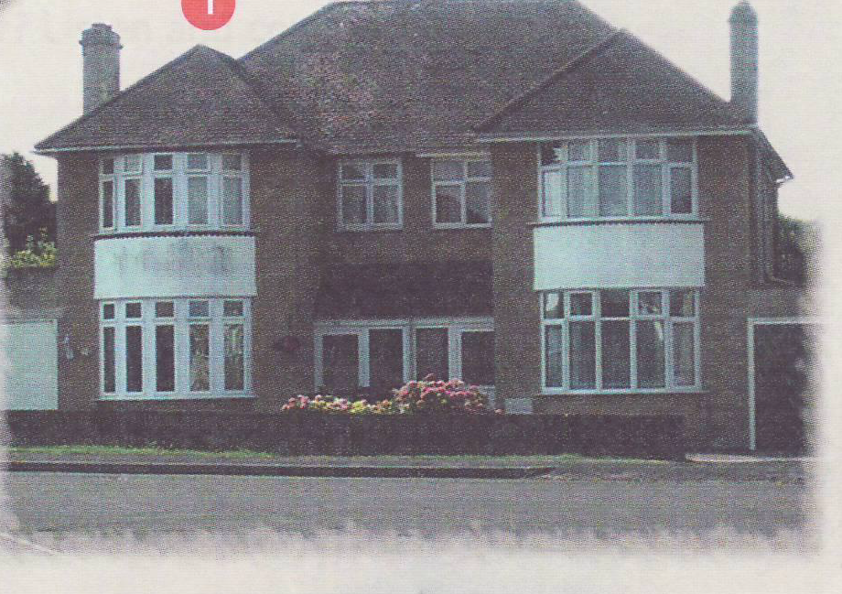
My home, my castle
Учитель английского языка
ГБОУ ООШ с. Заплавное
Анисимова Мария Ильдусовна

Slide 2
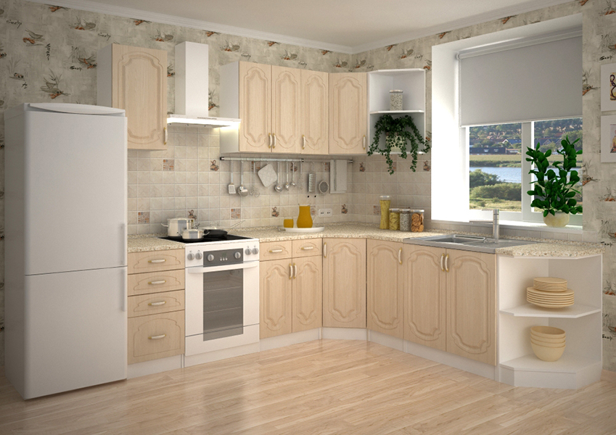
We cook breakfast, dinner in it.

Slide 3
It has trees, grass, flowers. What is it?

Slide 4
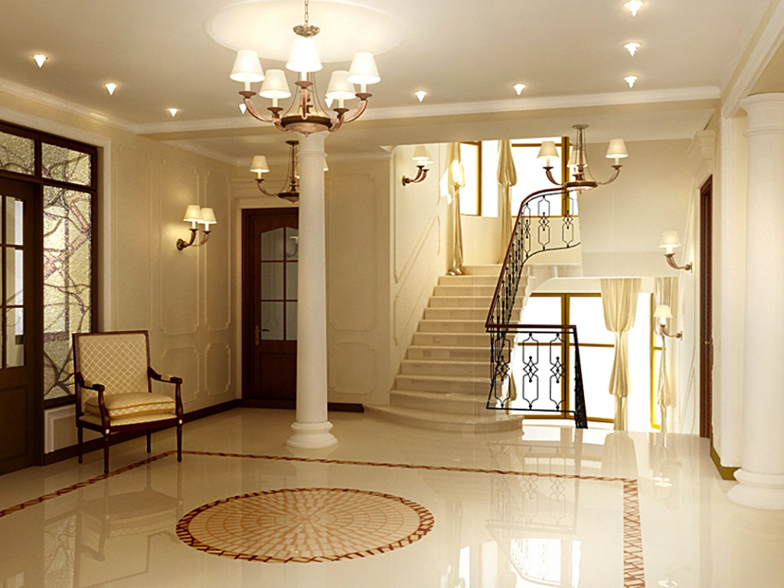
It’s a place where our dogs and cats often sleep.

Slide 5
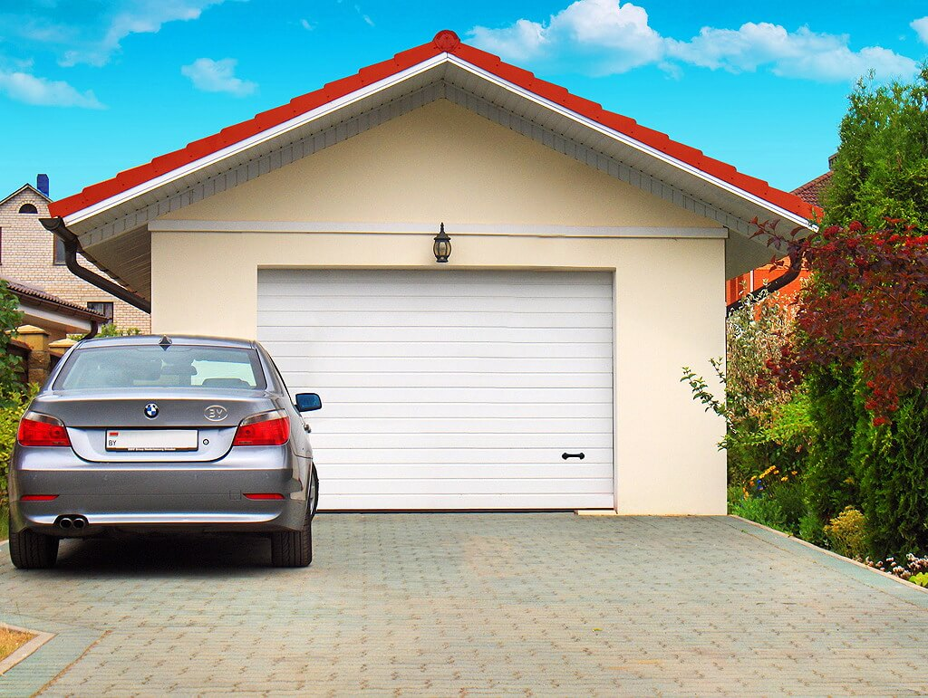
It’s a place where we keep our cars.

Slide 6
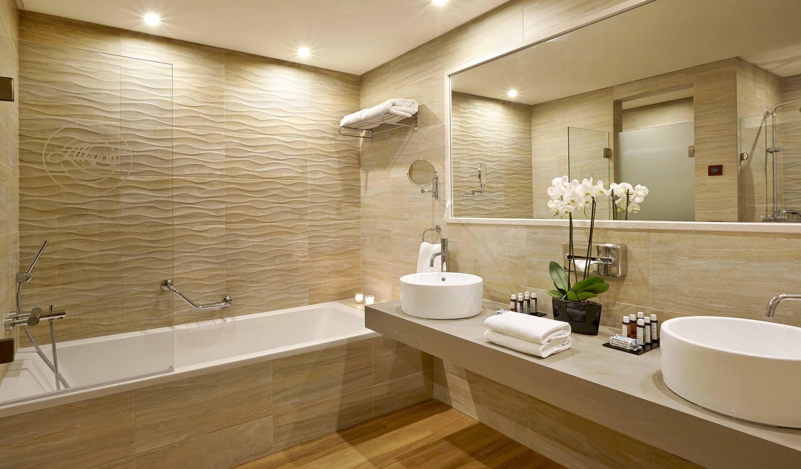
We take a shower in it.

Slide 7
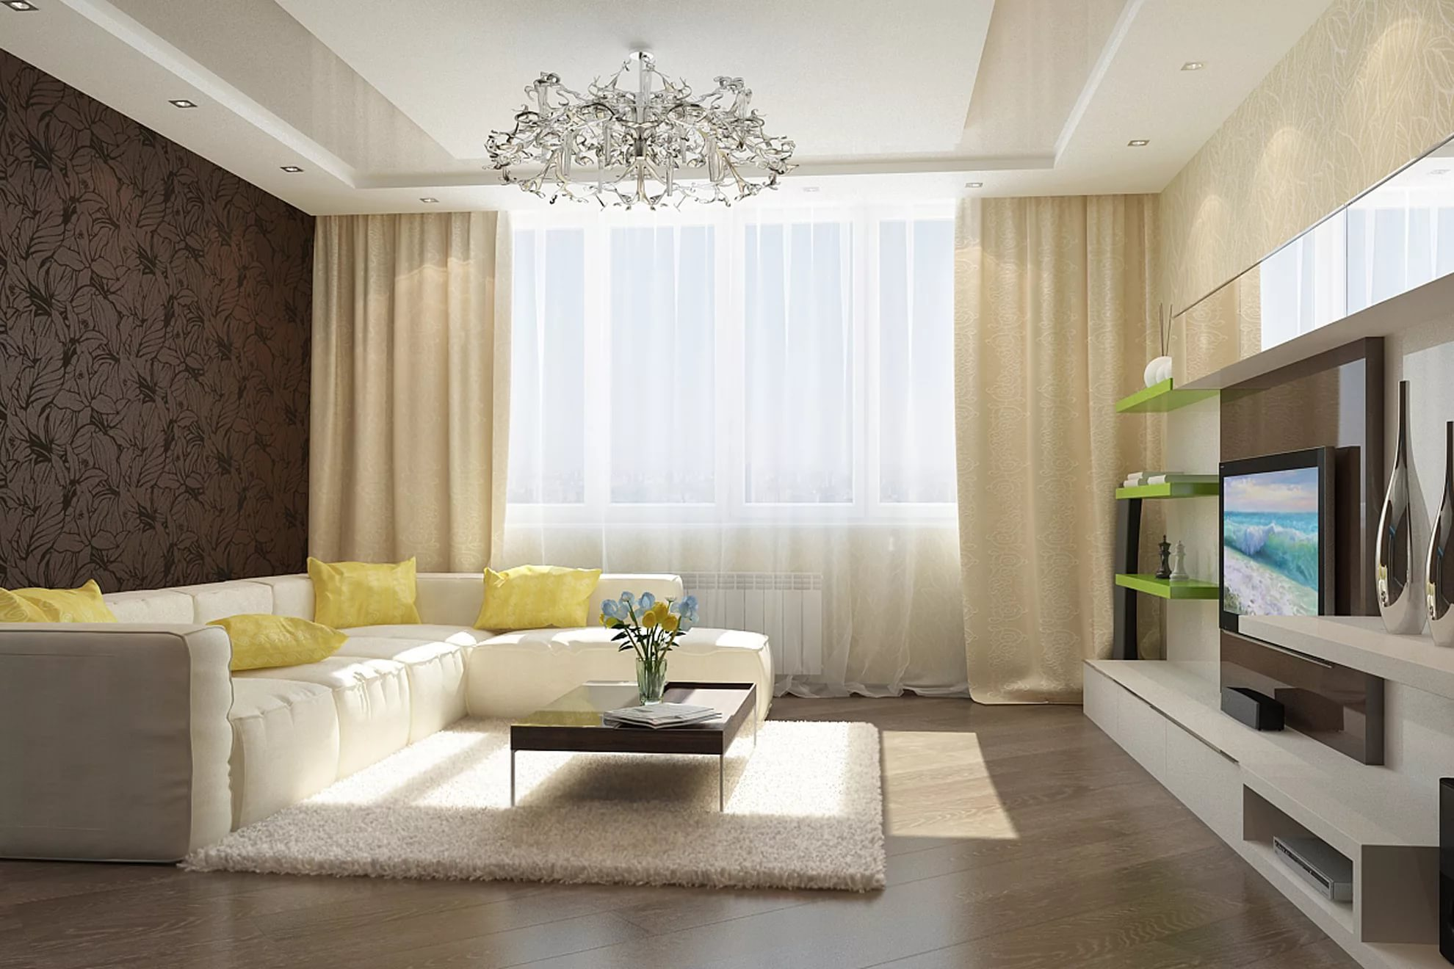
It’s a room where we watch television.

Slide 8
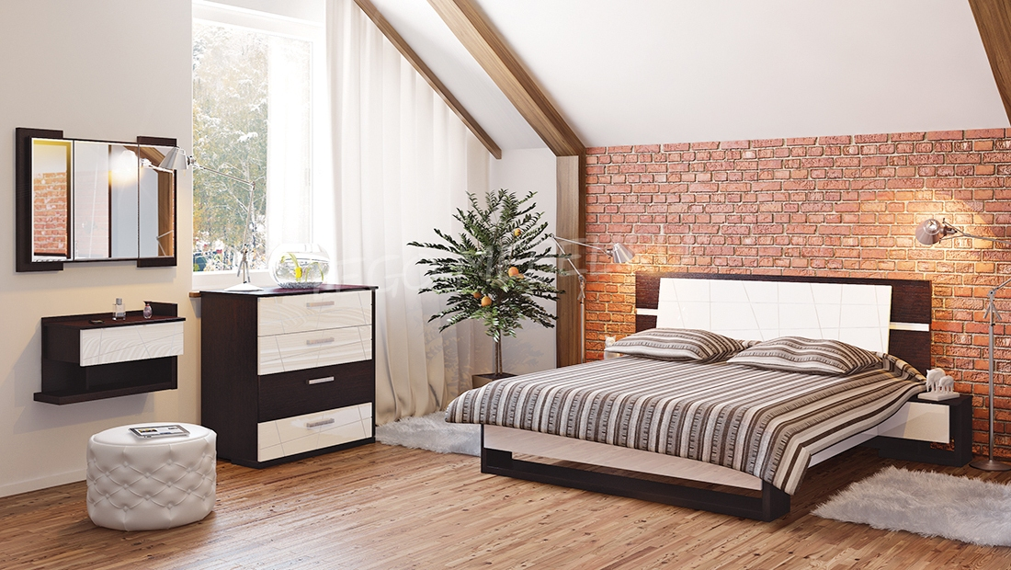
We sleep in it.

Slide 9
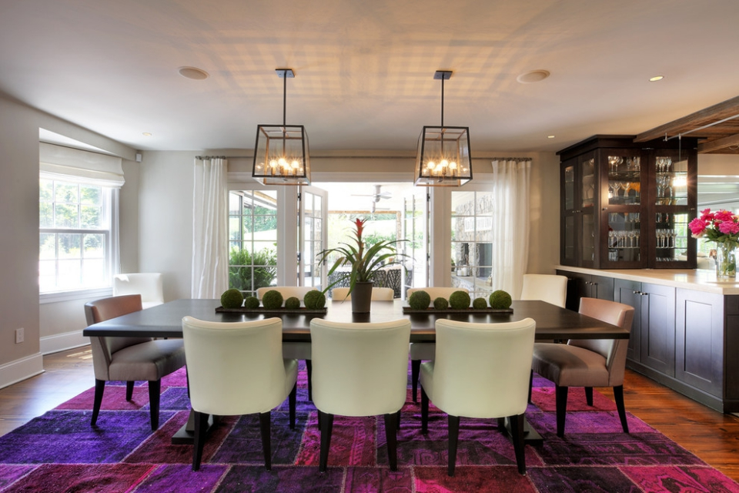
We eat breakfast, dinner in it

Slide 10
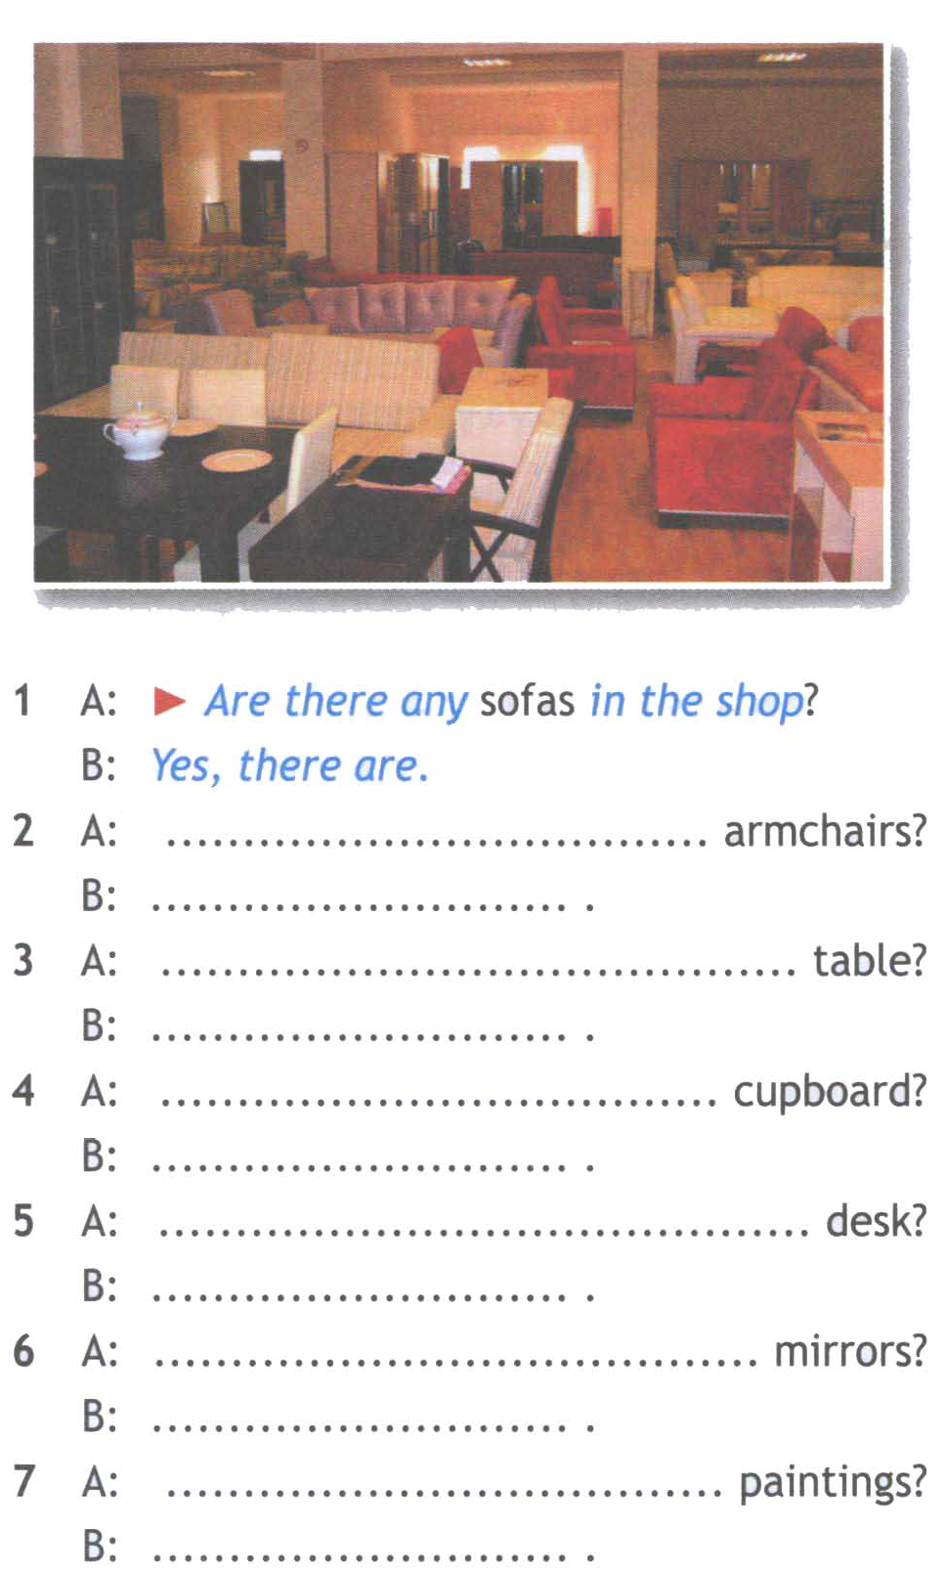
A: Are there any armchairs?
B: Yes, there are.
A: Is there a table?
B: Yes, there is.
A: Is there a cupboard?
B: Yes, there is.
A: Is there a desk?
B: Yes, there is.
A: Are there any mirrors?
B: Yes, there are.
A: Are there any paintings?
B: Yes, there are.

Slide 11
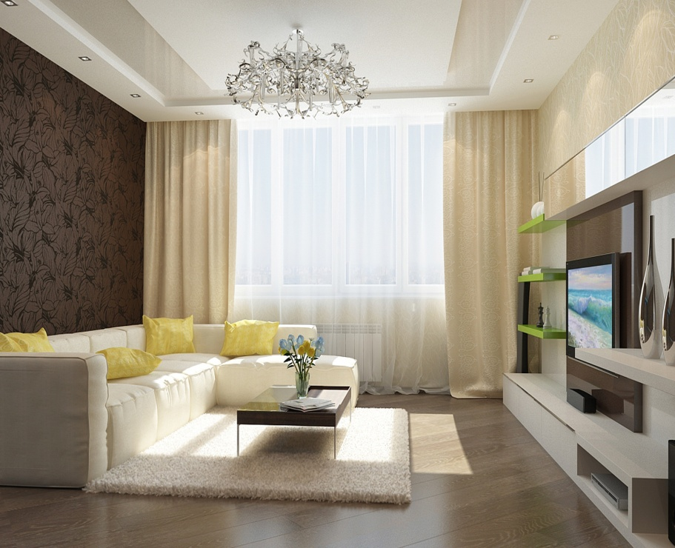

Slide 12
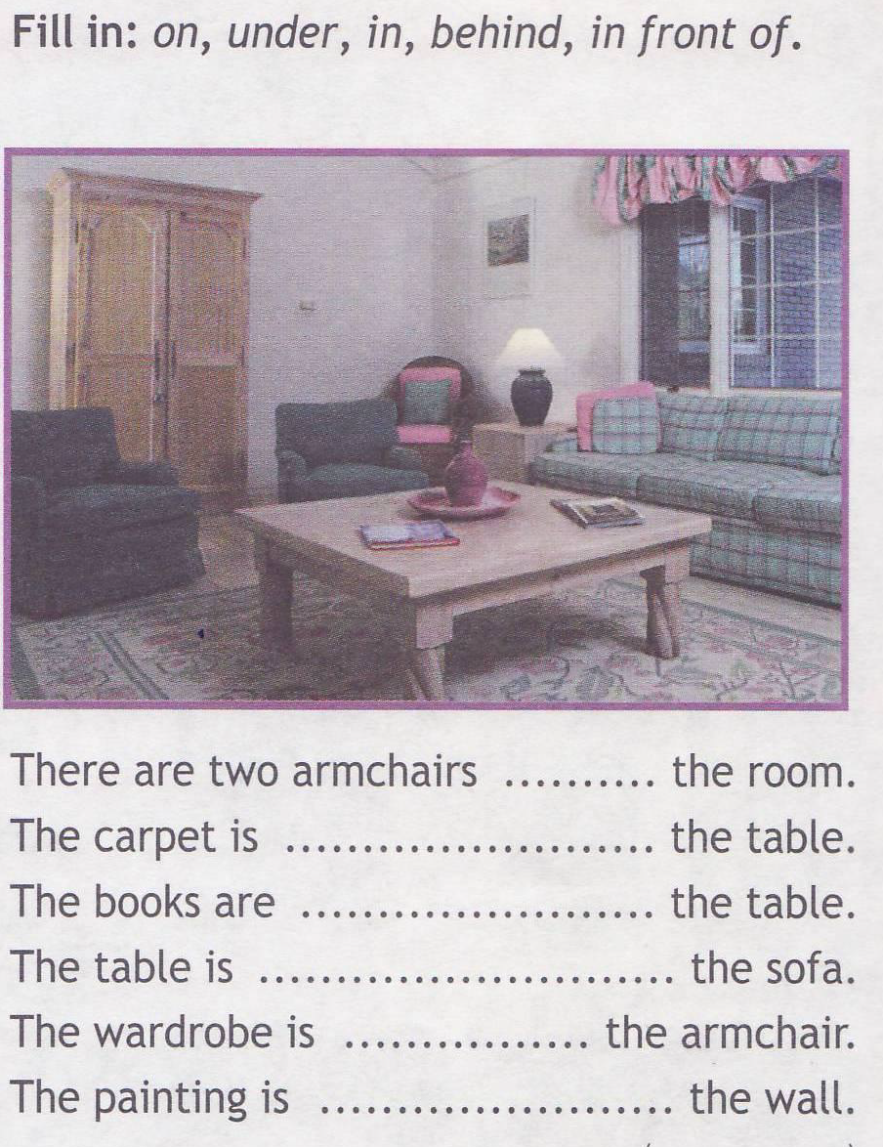
in;
under;
on;
in front of;
behind;
on.

Slide 13
Cross the odd word out. 1. wardrobe - bed – sink – chair 2. fridge – book – table – cooker 3. sofa – washbasin – toilet – bath 4. armchair – carpet – coffee table – garden 5. kitchen – bathroom – bedroom - garage

Slide 14
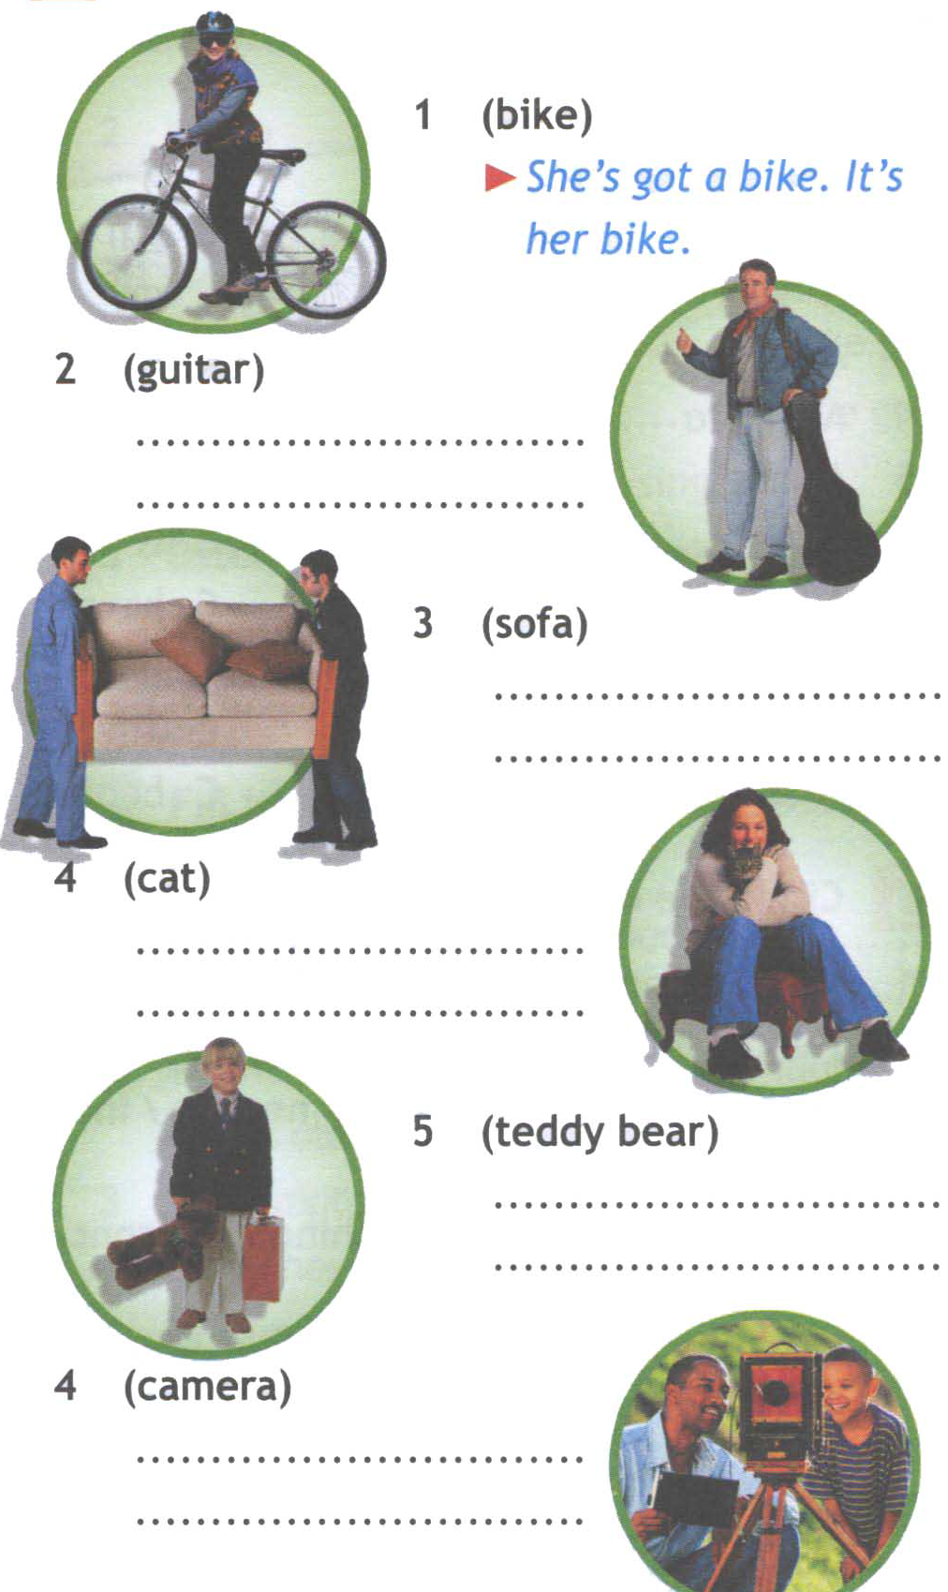
He’s got a guitar. It’s his guitar.
They’re got a sofa. It’s their sofa.
She’s got a cat. It’s her cat.
He’s got a teddy bear. It’s his teddy bear.
We’re got a camera. It’s our camera.

Slide 15
