Slide 1
Architecture of Belarus

Slide 2
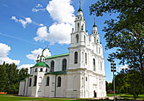
Saint Sophia Cathedral
St. Sophia Cathedral in the ancient town of Polotsk does not look like other Eastern Orthodox churches of the same name. It is one of the oldest temples constructed by Eastern Slavonic peoples and the first church built from stone on the territory of Belarus.
St. Sophia (Hagia Sophia) Cathedral is distinguished by remarkable and symbolic architecture. It was built on the right bank of the Western Dvina River in the 11th century. In the mid-18th century it was rebuilt to the design of the Vilna Baroque Style (Late Belarusian Baroque Style).

Slide 3
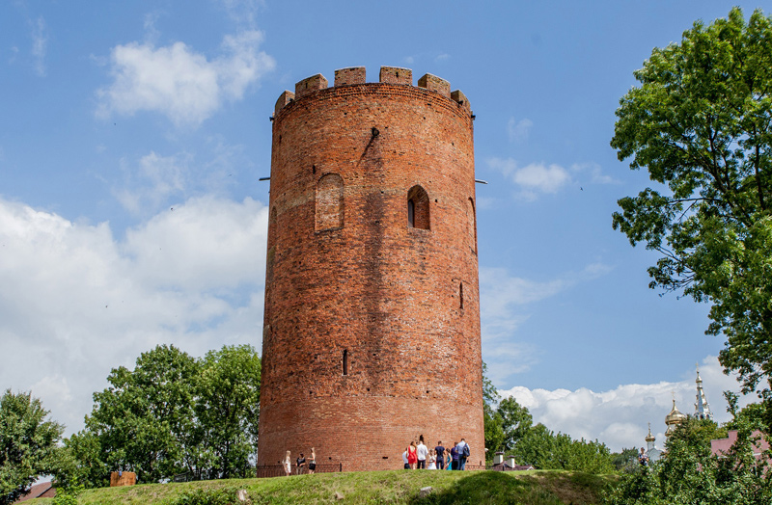
Kamenets Tower.
The town of Kamenets, Brest region , is home to a unique specimen of defense architecture – the Kamenets Tower (also referred to as Kamenets Vezha). Its origins go back a long way to the second half of the 13th century. According to the chronicles, the Kamenets Tower was built between 1276 and 1288 for defensive purposes and therefore lacks architectural and decorative elements. There are a lot of myths and legends surrounding the Kamenets Tower. One of such fantastic legends says that the Kamenets Tower was built by an unknown giant and is a monument to him.

Slide 4
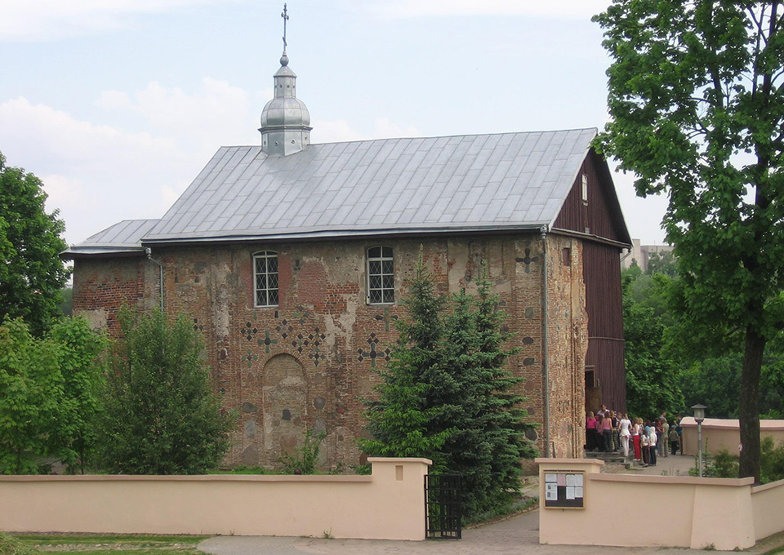
Boris and Gleb Church in Grodno
One of the few surviving monuments of architecture of the period beginning of the 12th century is the Church koloska. The Shrine was lit in honor of the angels defenders princes Gleb and Boris Vsevolodovicha.
During a landslide in 1853 part of the Church disappeared under the water surface of the river Neman. From 1995 to 2005 with the support of UNESCO, work was done to strengthen the river Bank and now the cultural – historic heritage in danger.

Slide 5
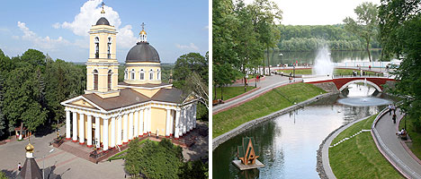
Gomel Palace and Park Ensemble
The two-storey palace of Field Marshal Pyotr Rumyantsev was built between 1777 and 1796 to a Neoclassical design.. After Pyotr Rumyantsev's death in 1796, the grounds were slowly improved by his son Nicholas (1754-1826). His brother Sergei was the next owner. He was never interested in country housekeeping and promptly sold the palace to the crown (1834). Gomel was immediately purchased by another Field Marshal, Ivan Paskevich, who had both the palace and the park substantially renovated.

Slide 6
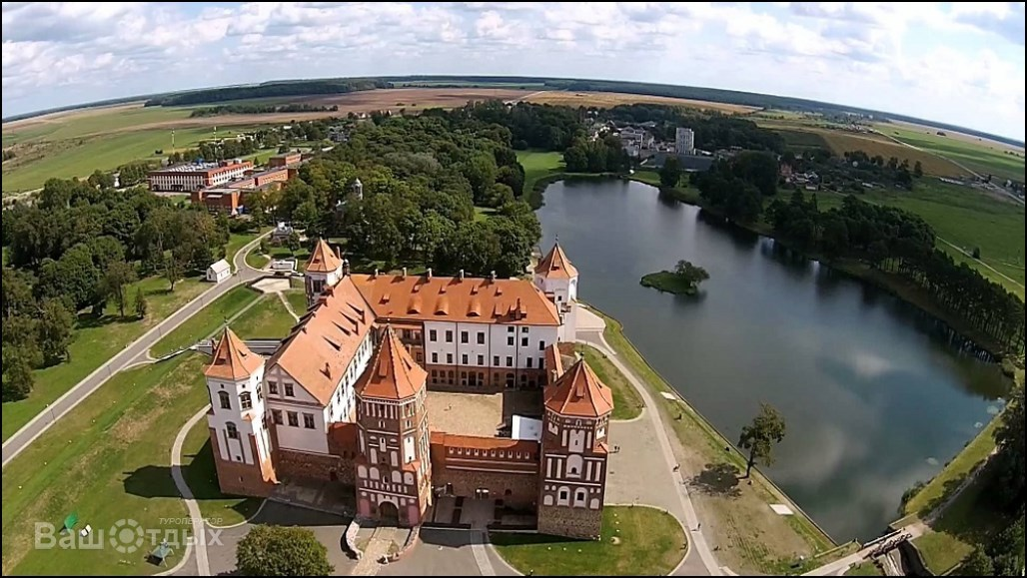
Mir Castle
Mir Castle in Grodno region is one of the most important tourist attractions in Belarus an outstanding 16th-century fortification and a UNESCO heritage. The Mir Castle complex (Mirsky zamok) is an outstanding example of 16th-century fortification art.
The construction of this Belarus’ Gothic stylecastle was started in the 1520s by Duke Ilinich.
In 1568 the castle came into the hands of Mikolay Radziwil, who completed it in Renaissance style.

Slide 7
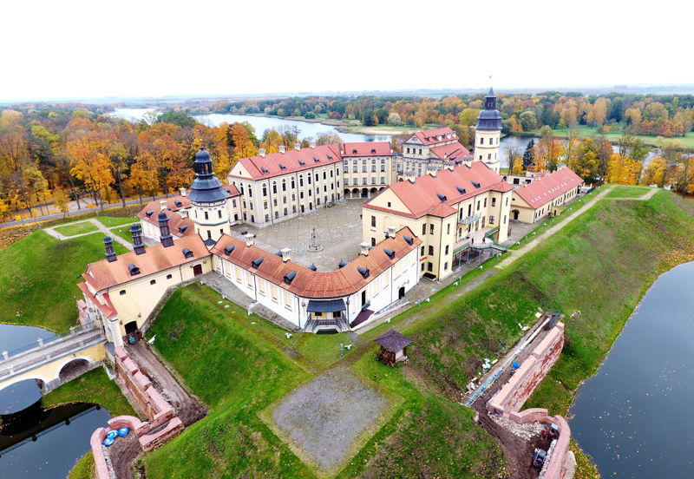
Nesvizh Palace
Nesvizh Palace is considered the country’s most beautiful palace by the people of Belarus. Its richly diverse architecture and attractive gardens make it one of the most popular tourist attractions in Belarus. The estate and town was acquired by the Radziwil family in the middle of the 16th century, and they stayed there until 1939.
The foundation stone of Nesvizh Palace was laid in 1584. It was rebuilt many times and as a consequence has features of many architectural styles including:
Renaissance
Baroque
Rococo
Classicism
Neo-gothic
Modernism

Slide 8
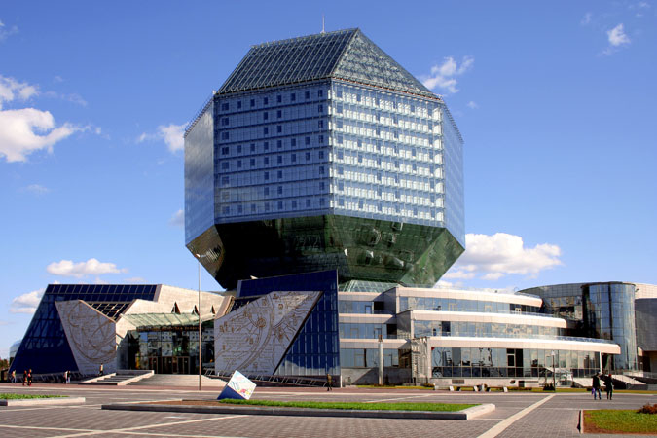
Modern Architecture
The National Library is an attractive landmark of Belarus. Today the library is more than a rich collection of books. It is a multipurpose center that combines high technologies, ultramodern design and unusual architecture.

