Slide 1
EVERY COUNTRY HAS ITS OWN NATIONAL SYMBOL AND EMBLEM

Slide 3
Daffodil – the emblem of Wales

Slide 5
St.Andrew’s flag – the flag of Scotland

Slide 6
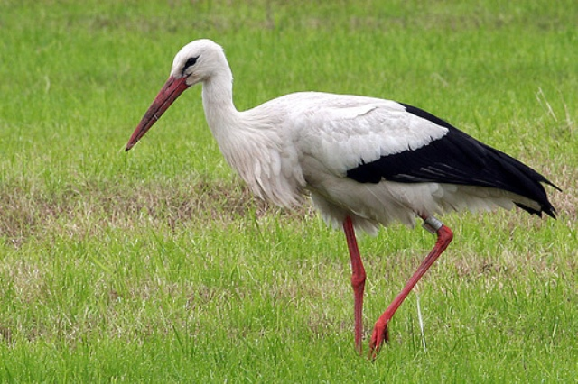

Slide 7
White stork – the national symbol of Belarus

Slide 8
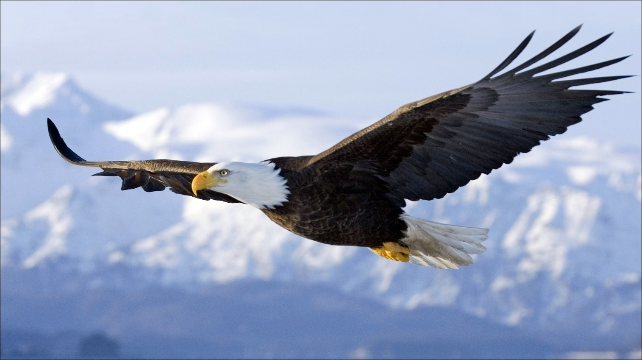

Slide 9
Bald eagle – the national symbol of the USA

Slide 11
Red rose – the symbol of England

Slide 12
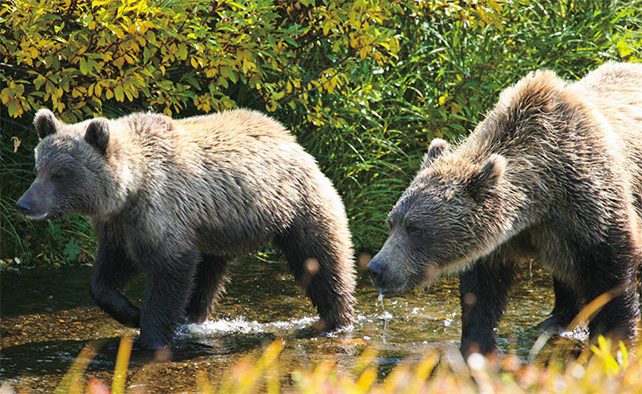

Slide 13
Bear – the national symbol of Russia

Slide 15
The national emblem of Belarus

Slide 17
Union Jack – the national flag of the UK

Slide 19
The national emblem of the UK

Slide 21
Cornflower – the national symbol of Belarus

Slide 23
Stonehenge – the national symbol of the UK

