Slide 1
Icons of Russia.

Slide 2
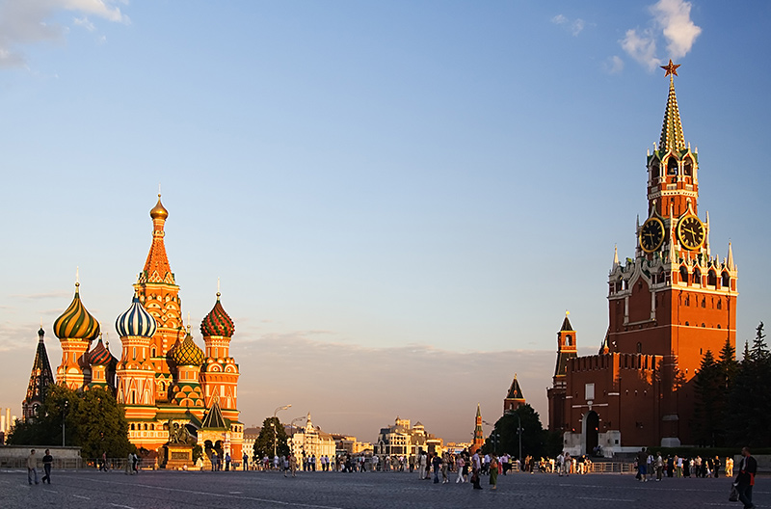
Kremlin
It’s the heart of Moscow, our capital city. It was built in 15-16 centuries. The main Kremlin Tower, the Spasskaya Tower, has become a symbol of Russia.

Slide 3
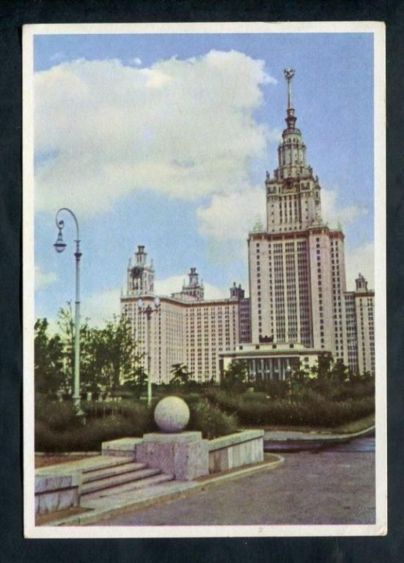
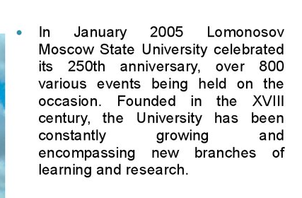
Moscow University

Slide 4
Rostov-Weilikij

Slide 6
Matryoshka
*Matryoshka - Russian wooden toy in the form of a painted doll, inside of which are similar to her dolls smaller. Number of nested dolls usually 3 or more.

Slide 8
Brown bear

Slide 9
Historical information

Slide 10
Symbols

