Slide 1
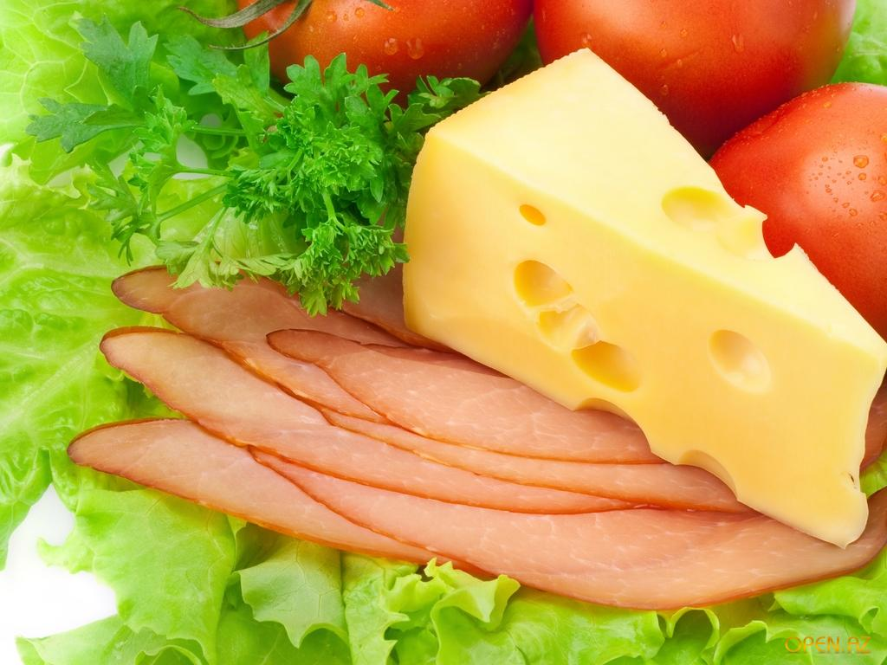
I like to eat porridge, I like to eat cheese, I like to eat carrots, I like to eat sweets. I like to drink coffee, I like to drink milk, I like to drink juice. I am strong, I think.

Slide 2
Would You Like Some Coffee?

