Slide 1
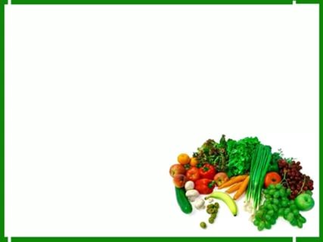
Урок английского языка в 4 классе
Тема урока: Закрепление лексики по теме: «Еда и напитки»
Цель урока: закрепление предметных знаний, умений, навыков, формирование универсальных учебных действий
Подготовила :
Учитель английского языка
Абдулаева Айисат Даировна

Slide 2
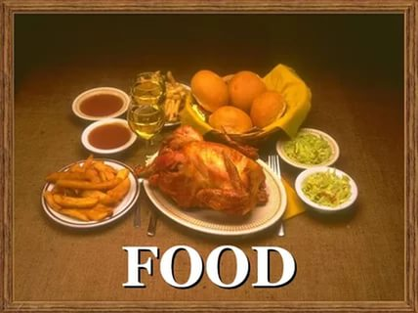

Slide 3
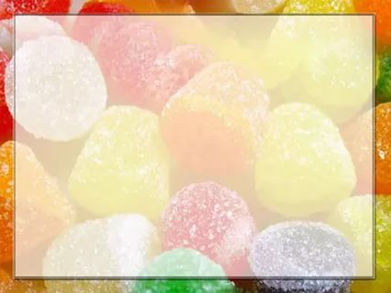
Try to guess - what is it?
Name a fruit that is always sour. (кислый) It is yellow on the inside and outside. Adults (взрослые) like to drink tea with it.

Slide 4
Monkeys like to eat it.

Slide 5
Its name is its colour.

Slide 6
Clean, but not water,
White , but not snow,
Sweet (сладкий), but not ice-cream,
What is it?

Slide 7
Which alphabet is a hot drink?

Slide 8
You smile when you name it
The mouse likes it very much.

Slide 9
This little orange lady
Is hard (трудно) to be found(найти),
As only her green plait( коса)
Sticks out (торчит) of the ground.

Slide 10
It is red and sweet,
It is good to eat.

Slide 11
chocolate, milk, meat, nuts, juice, porridge, hamburger, cake, fish, fruit, chips, sweets, vegetables
Food
Healthy food
milk
meat
juice
porridge
fish
fruit
vegetables
Unhealthy food
chocolate
nuts
hamburger
cake
chips
sweets

Slide 12
Complete the sentences with is / are
There ___ some oranges and an apple on the plate.
There ___ some bread on the dish.
There ___ no any milk in the jug.
There ___ not any eggs in the fridge.

Slide 13
5.How many bananas ___ there on the dish?
6.There ___ some tea in the cup.
7.There ___ some chocolate in the bag.
8.There ___ some butter on the butter dish.
9.There ___ some cucumbers and tomatoes in this salad

