Slide 1
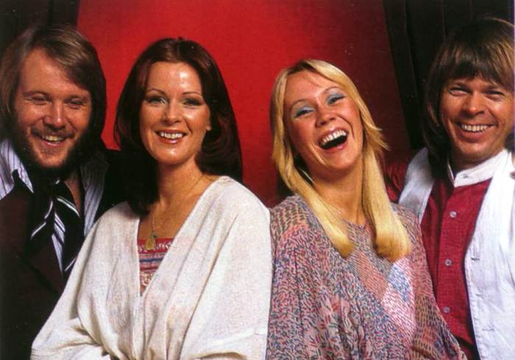
ABBA
Swedish music quartet, They existed in the years 1972-1982

Slide 2
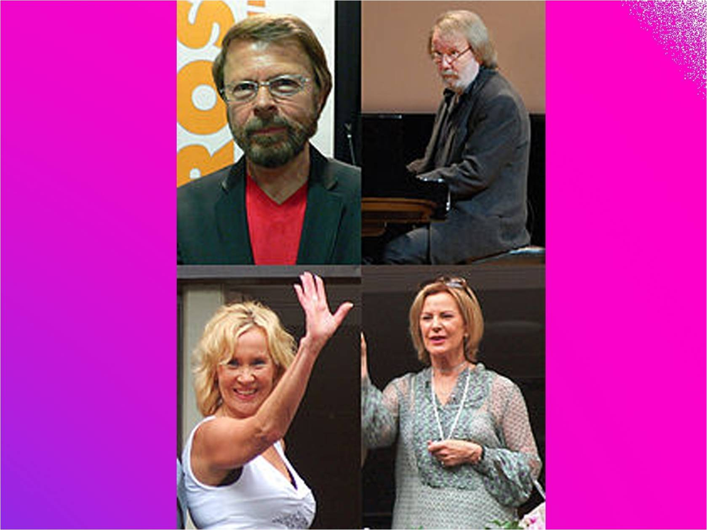

Slide 11
Seems to me now That the dreams we had before Are all dead, nothing more Than confetti on the floor It's the end of a decade In another ten years time Who can say what we'll find What lies waiting down the line In the end of eighty-nine...

